Slide 1
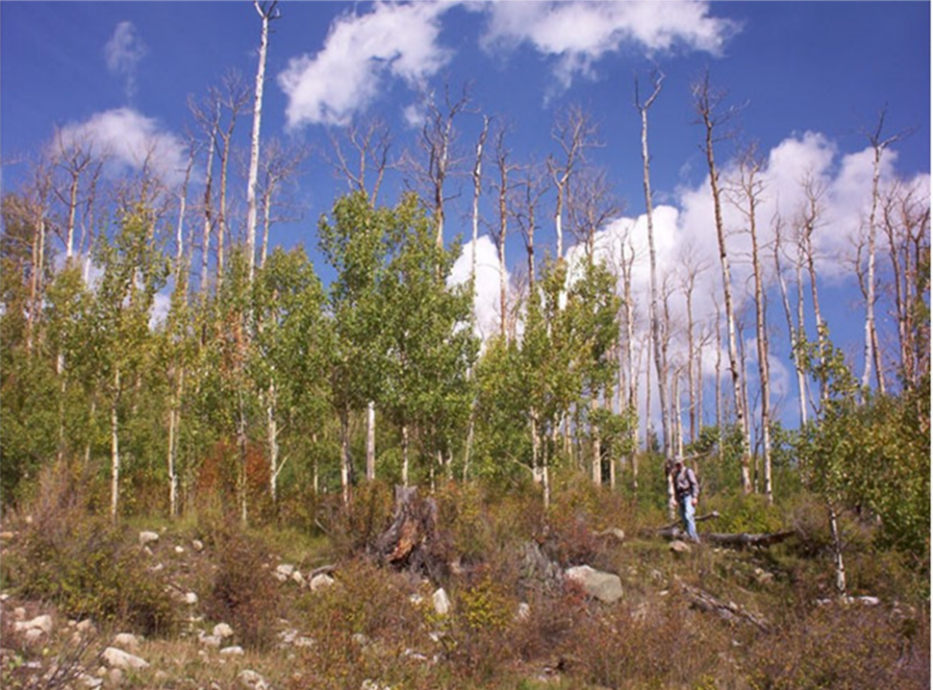
Disease Ecology: Can Plant Disease Affect Human Health? by Blyssalyn V. Bieber, Gabrielle T. Welsh, Mayra C. Vidal, Whitley R. Lehto, Erin M. Lehmer, Robin M. Tinghitella, and Shannon M. Murphy
NATIONAL CENTER FOR CASE STUDY TEACHING IN SCIENCE

Slide 2
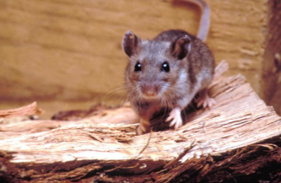
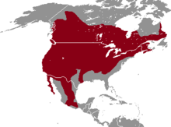
What is Sin Nombre Virus?
In humans, Sin Nombre virus causes hantavirus pulmonary syndrome – 38% mortality!
Transmission electron micrograph of the Sin Nombre virus
Primary reservoir is the widespread deer mouse, Peromyscus maniculatus.

Slide 3
What is Sin Nombre Virus?
SNV does not adversely affect the infected deer mice, but they can stay infected for life.
The virus is transmitted between deer mice during fights, but how is it transmitted to humans?

Slide 4
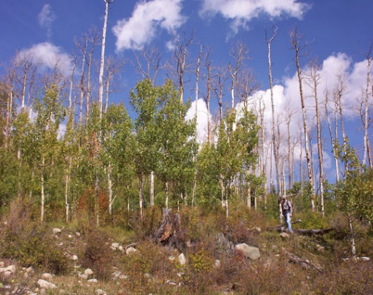
What is Sudden Aspen Decline?
Widespread trembling aspen forest mortality in Rocky Mountain West.
“Gold hills of autumn” replaced with bald patches.
As of 2011, more than 17% of CO aspen dead.
Likely due to sudden aspen decline (SAD).
Creative Commons License
Associated Press

Slide 5
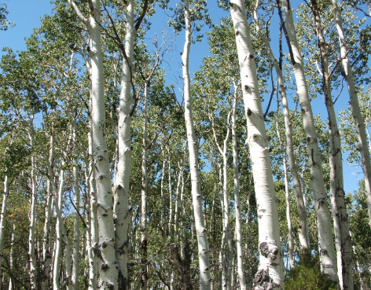
What is Sudden Aspen Decline?
What causes forest die-off due to SAD?
Drought stress causes “hydraulic failure” – trees are water stressed causing xylem to fail.
Aspen often reproduce from root suckers instead of seeds; dying aspen groves often lack sprouts.

Slide 6
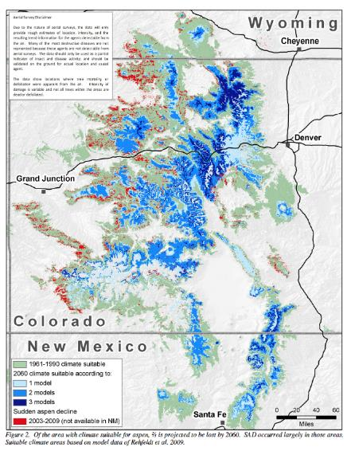
What is Sudden Aspen Decline?
Impacts of SAD consistent with impacts of climate change on aspen.
Of the area with climate suitable for aspen, 2/3 is projected to be lost by 2060.

Slide 7
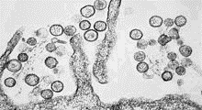
Can plant diseases influence diseases that affect humans?
?
Associated Press

Slide 8
Group Question Set A
In your groups, discuss the following and be prepared to share with the class:
What abiotic variables do you think would be affected by the amount of canopy cover in an aspen stand?
How would these abiotic variables be affected by a loss of canopy cover?

Slide 9
Group Question Set B
In your groups, discuss the following and be prepared to share with the class:
Could sudden aspen decline and recent increased prevalence of Sin Nombre virus in humans be related?
If so, how? If not, why not?

Slide 10
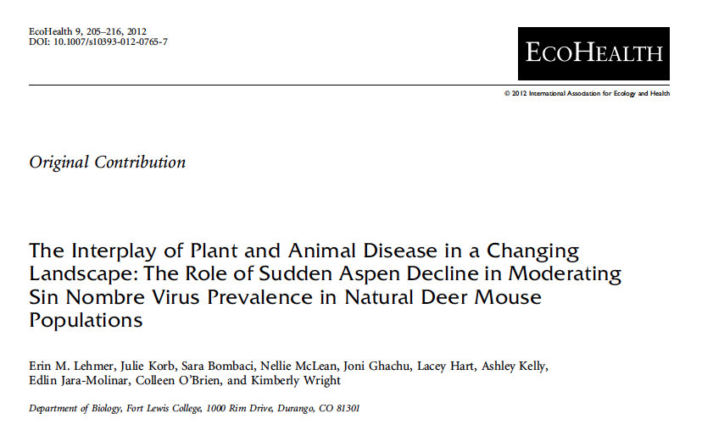

Slide 11
Measurements at 100 high, med, low SAD sampling locations
A
Canopy cover (crown fade) of study sites showing low (A), moderate (B), and high (C) levels of SAD.

Slide 12
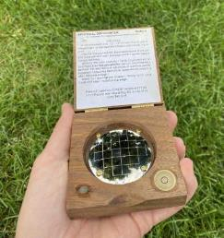
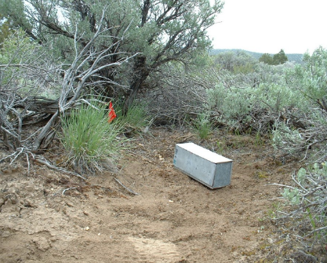
Methods: measure forest structure, mammal community, and SNV prevalence
Spherical densiometer
Sherman live traps
www.rickly.com
Marty Heaney Bio-West, Inc.

Slide 13
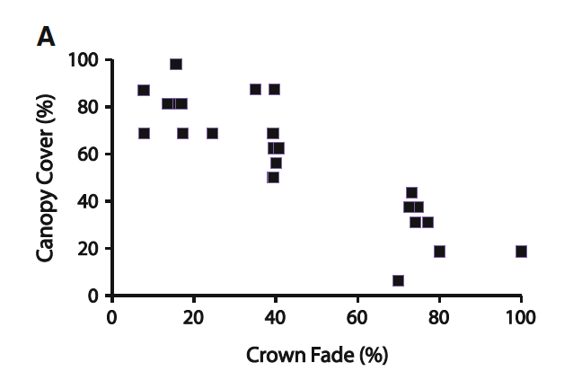
Data Sheet 1 – answer Question 1

Slide 14
Causation vs. Correlation
Causation
Correlation
cause and effect relationship
a variable is directly causing the other
relationship between variables
increasing or decreasing trends in relation to each other
CORRELATION DOES NOT IMPLY CAUSATION

Slide 15
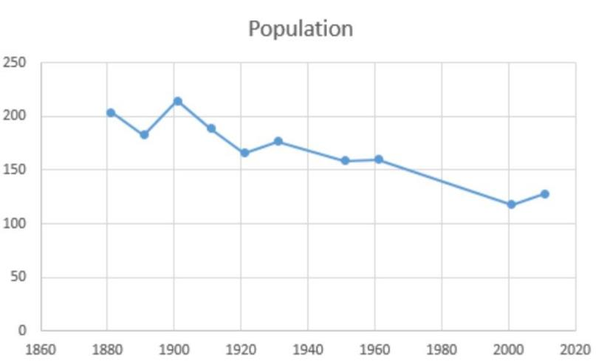
Divorce rate in Maine
correlates with
Per capita consumption of margarine
0 2 4 6 8 10
Divorce rate in Maine
0 2 4 6 8 10 12 14 16
Pounds of Margarine Consumed
Year (2002-2009)

Slide 16
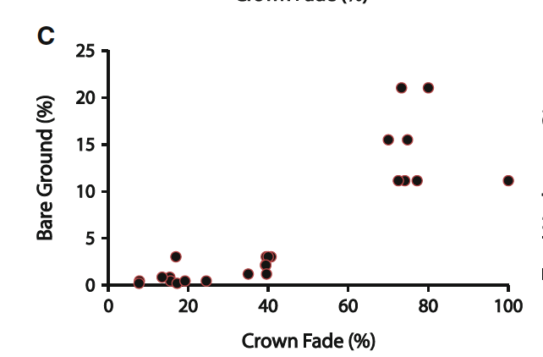
Data Sheet 2 – answer Question 2

Slide 17
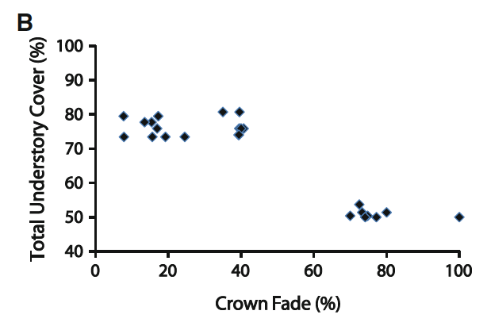
Answer Question 3

Slide 18
Data Sheet 2 – answer Question 3

Slide 19
Answer Question 3

Slide 20
Is this what you predicted?

Slide 21
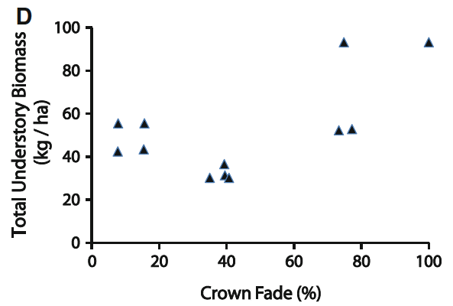
Data Sheet 3 – answer Question 4

Slide 22
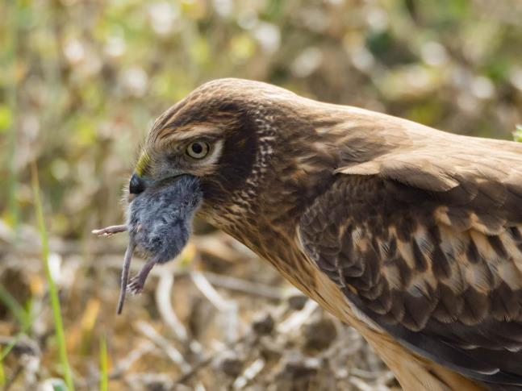
Northern Harrier caught rodent for meal

Slide 23
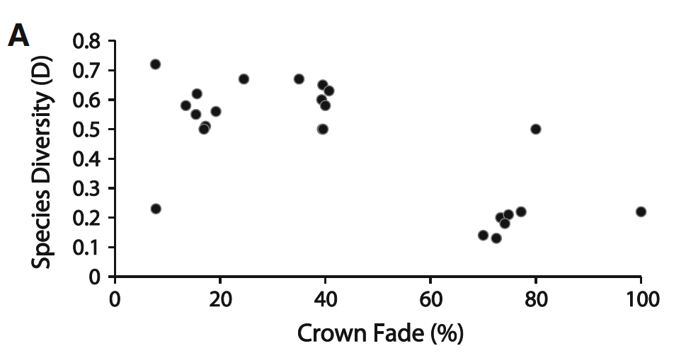
Answer Question 5

Slide 24
Is this what you predicted?

Slide 25
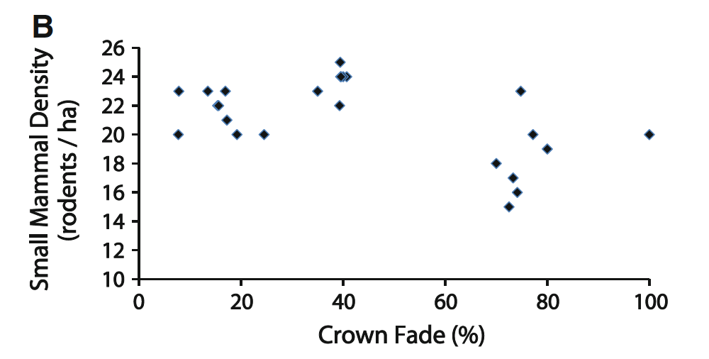
Data Sheet 4 – answer Question 6

Slide 26
Answer Question 7
Deer Mouse Density

Slide 27
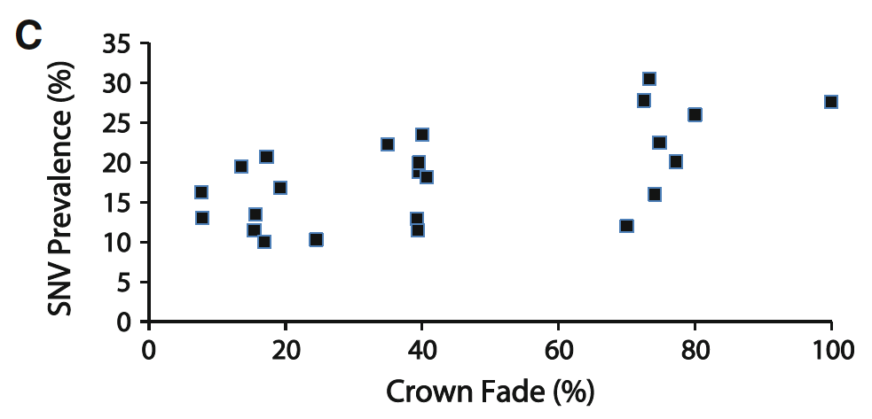
Answer Question 8
Deer Mouse Density
(rodents/ha)

Slide 28
Answer Question 9

Slide 29
Answer Question 10
Given what you know now after working through the data published by Lehmer and co-authors, could Sudden Aspen Decline and the recent increased prevalence of Sin Nombre virus in humans be related?
If so, how?
If not, why not?
If you identified a relationship, could this relationship be causation or correlation? Explain your response.

Slide 30
Additional Readings
Jones, K., N.G. Patel, M.A. Levy, A. Storeygard, D. Balk, J.L. Gittleman, P. Daszak. (2008). Global trends in emerging infectious diseases. Nature 451: 990-4.
Nijhuis, M. (2008). What’s killing the aspen? The signature tree of the Rockies is in trouble. Smithsonian Magazine.
Daley, J. (2012, January 3). Researchers find cause of “sudden aspen decline.” Deseret News.

Slide 31
Image Credits
Slide 1: aspen trees: Erin Lehmer, personal photograph, 2012
Slide 2: electron micrograph of SNV: CDC/Cynthia Goldsmith, public domain https://commons.wikimedia.org/wiki/File:Sin_Nombre_hanta_virus_TEM_PHIL_1136_lores.jpg
map of SNV range: Izvora, CC by 3.0
https://commons.wikimedia.org/wiki/File:Peromyscus_maniculatus_range_map.png
deer mouse: CDC/James Gathany, public domain
https://commons.wikimedia.org/wiki/File:Deer_mouse,_Peromyscus_maniculatus_8360_lores.jpg
Slide 3: researchers working with deer mouse: Erin Lehmer, personal photograph, 2012
Slide 4: top image of aspen: US Forest Service, Sothwestern Region, Kaibab National Forest CC by SA-2.0 https://commons.wikimedia.org/wiki/File:Aspen_Sky_(4446695252).jpg
bottom image of aspen: Erin Lehmer, personal photograph, 2012
Slide 5: aspen trees: Tewy, CC by SA-3.0
https://commons.wikimedia.org/wiki/File:Aspen_(Populus_tremuloides)_02.jpg
Slide 6: USDA Forest Service, Forest Health Protection, Rocky Mountain Region. Sudden Aspen Decline in Colorado, 2011 https://www.fs.usda.gov/Internet/FSE_DOCUMENTS/fsbdev3_038824.pdf
Slide 7: aspen trees: Erin Lehmer, personal photograph, 2012
electron micrograph of SNV: CDC/Cynthia Goldsmith, public domain https://commons.wikimedia.org/wiki/File:Sin_Nombre_hanta_virus_TEM_PHIL_1136_lores.jpg
deer mouse: CDC/James Gathany, public domain
https://commons.wikimedia.org/wiki/File:Deer_mouse,_Peromyscus_maniculatus_8360_lores.jpg
Slide 11: Lehmer, E. M., J. Korb, S. Bombaci, N. McLean, J. Ghachu, L. Hart, A. Kelly, E. Jara-Molinar, C. O’Brien and K. Wright (2012). The interplay of plant and animal disease in a changing landscape: the role of sudden aspen decline in moderating Sin Nombre virus prevalence in natural deer mouse populations. EcoHealth 9, 205-216.
Slide 12: spherical densiometer: Blyssalyn Bieber, personal photograph, 2021
aspen trees: US Forest Service, Sothwestern Region, Kaibab National Forest CC by SA-2.0 https://commons.wikimedia.org/wiki/File:Aspen_Sky_(4446695252).jpg
Sherman live trap: Erin Lehmer, personal photograph, 2012
Slide 15: Divorce rate in Maine correlates with Per capita consumption of margarine: Tyler Vigen, Spurious Correlations, CC by 4.0 https://www.tylervigen.com/spurious-correlations
Graph: Mattallen8, Adforton population graph CC BY-SA 4.0 https://commons.wikimedia.org/wiki/File:Adforton_population_graph..PNG
Slide 22: Northern Harrier with rodent: Amit Patel, CC by 2.0 https://www.flickr.com/photos/amitp/31581919847/

