Slide 1
Outbreak!
NATIONAL CENTER FOR CASE STUDY TEACHING IN SCIENCE
by
Samuel C. Cohler, Dania V. Corrales, Nicholas E. Kreusser, Darin Ngo, Rishi S. Gadepally, Lesly I. Benitez, Sarah Ahmad, Janerys D.M. Munoz, & Andrea Nicholas
Notes:
Credit: Licensed image © Sn333g | Dreamstime.com, ID 171189760.

Slide 2
Patient Vitals
Age: 10
Sex: M
Height: 4’5”
Weight: 70 lbs
BP: 120/80
Temp: 103 °F
Notes:
Hint: It is common in fall and winter in the US

Slide 3
Patient Symptoms
Fever
Cough
Shortness of breath
Duration: Past 1–2 weeks

Slide 4
Question 1
What should we ask the patient about?
Family history
Travel
Chronic conditions
All of the above

Slide 5
Patient Information
Family History
Hypertension
No cancer or diabetes diagnoses
Recent Travel History
No traveling recently
Lives in the United States
Chronic Condition(s)
No chronic conditions

Slide 6
Question 2
What tests would you run to help diagnose this patient?
Sputum test
Flu nasal swab test (RIDT)
Chest X-ray
MRI

Slide 7
Initial Tests
Sputum test: Negative, no bacteria or fungi detected
Rapid influenza diagnostic test: Negative
(Chest X-Ray and MRI would not be run for an initial diagnostic!)

Slide 8
Question 3
What type of disease is this?
Bacterial
Viral
Fungal

Slide 9
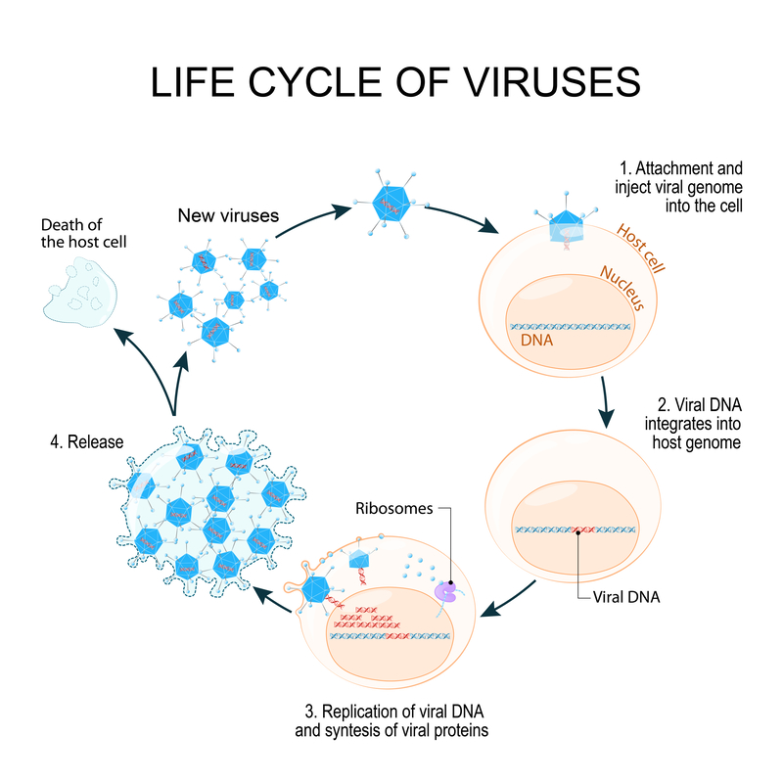
Suggested Image: stages of lifecycle of a virus
Notes:
Credit: Licensed image © Designua | Dreamstime.com, ID 89912323.

Slide 10
Serology Test
ELISA (enzyme linked immunosorbent assay) used to detect antibodies against virus → results take few hours
If (+) move to IFA
IFA (immunofluorescence assay) more specific and detects virus infected cell → results take few hours
If (+) along with ELISA, patient is considered (+)
If (+) ELISA and indeterminate IFA, move to microneutralization
Microneutralization considered gold standard
Pro: highly specific test to detect virus-neutralizing antibodies
Con: highly labor intensive and results take up to 5 days

Slide 11
Question 4
Given this new information, what test would you run now?
Molecular test
Serology test
Biopsy
Spinal tap
I don’t know

Slide 12
Test Results
rRT-PCR molecular tests indicate amplification of specific coronavirus envelope (upE) and nucleocapsid (N) genes
ELISA and IFA both positive for coronavirus nucleocapsid (N) and spike (S) proteins
Results confirmed with positive microneutralization for coronavirus antibodies

Slide 13
Question 5
What is your diagnosis?
Influenza (flu)
Coronavirus
Rhinovirus (common cold)
Lyme disease

Slide 14
Diagnosis: Coronavirus
A coronavirus is typically not dangerous, and often causes an infection in your respiratory tract and sinuses.
It has symptoms extremely similar to that of the common cold and most people gets the infection at least once in their life.

Slide 15
Coronaviruses
Large family of viruses
Cause diseases ranging from the common cold to severe acute respiratory syndrome (SARS)
Middle East respiratory syndrome (MERS)
Viral respiratory disease caused by a novel coronavirus (MERS-CoV)
First identified in Saudi Arabia in 2012
35% reported patients died

Slide 16
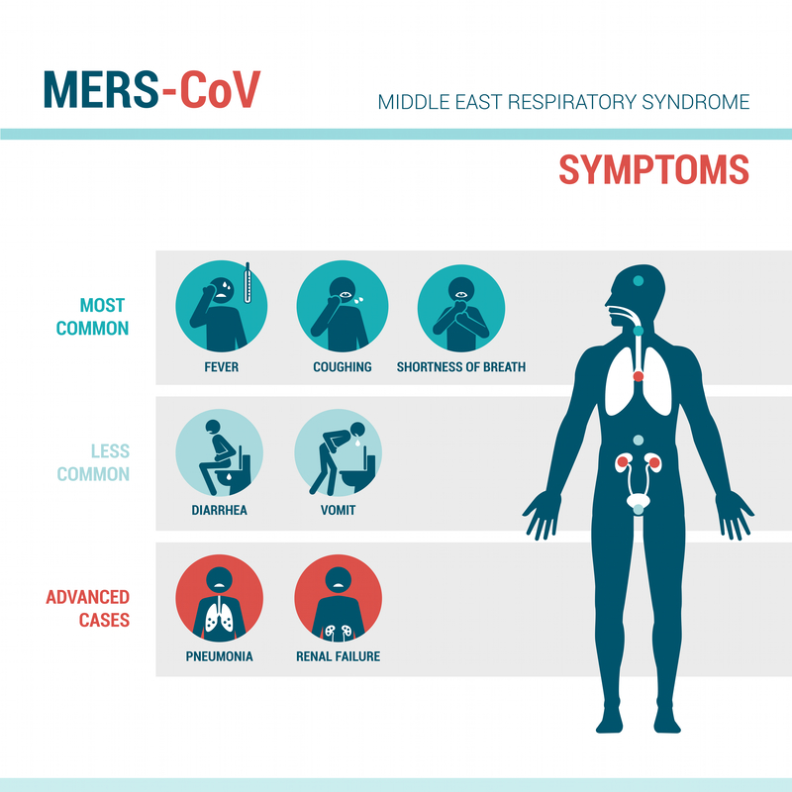
Symptoms
Fever, cough, shortness of breath
Pneumonia is common, but not always present
Diarrhea has been reported, but is not common
Sometimes asymptomatic
Severe illness can cause respiratory failure
Notes:
Credit: Licensed image © Elenabsl | Dreamstime.com, ID 55529192.

Slide 17
How to Diagnose
CDC conducts several different laboratory tests to detect MERS-CoV infection.
Molecular tests, which look for evidence of active infection
Serology tests, which look for previous infection by detecting antibodies to MERS-CoV
Notes:
https://www.cdc.gov/coronavirus/mers/lab/lab-testing.html
We explained serology tests above, so skip over that when presenting

Slide 18
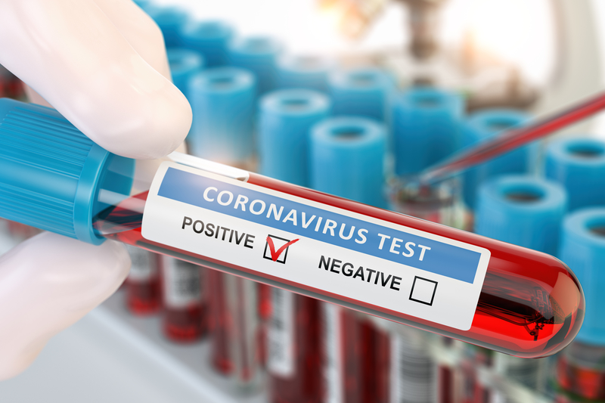
Molecular Tests
rRT-PCR used to detect viral RNA
CDC requires a positive PCR test for two specific genome targets or single positive target with sequence of second target.
Recommended that multiple samples from various parts of lungs taken for accuracy.
CDC considers two consecutive negative PCR tests to indicate that patient is negative for MERS-CoV.
Notes:
Credit: Licensed image © Maksym Yemelyanov | Dreamstime.com, ID 171151740.

Slide 19
How It Spreads
Majority of human cases have been attributed to human-to-human infections in health care settings.
Dromedary camels are a major host for MERS-CoV and an animal source of MERS infection in humans, exact mechanism unknown.
Close contact necessary for spread
Unprotected care to an infected patient.
Aerosol droplets from lungs of affected individuals; coughing, sneezing.
Gastrointestinal complications are possible, but fecal-oral transmission route is unsupported.

Slide 20
People Most Commonly Affected
Older people
People with weakened immune systems
People with renal disease, cancer, chronic lung disease, diabetes (chronic diseases)
Young children

Slide 21
In-Class Outbreak!

Slide 22
Outbreak Investigation Steps: CDC
1. Prepare for fieldwork
2. Establish existence of an outbreak
3. Verify the diagnosis
4. Construct a working case definition
5. Find cases systematically and record information
6. Perform descriptive epidemiology
7. Develop hypotheses
8. Evaluate hypotheses epidemiologically
9. Reconsider, refine, and re-evaluate hypotheses (as needed)
10. Compare and reconcile with lab & environmental students
11. Implement control and prevention measures
12. Initiate or maintain surveillance
13. Communicate findings
Notes:
https://www.cdc.gov/coronavirus/about/symptoms.html

Slide 23
SARS Mechanism
Virus Glycoprotein Spike (S) is received by transmembrane Angiotensin-Converting Enzyme 2 (ACE2) and enters host cell via Receptor-Mediated Endocytosis.
Studies in monkeys show treatment with soluble ACE2 receptors and anti-ACE2 antibodies can disrupt virus entry, which may significantly impact the way SARS-CoV is targeted by antiviral therapies.
Notes:
https://www.rndsystems.com/resources/articles/ace-2-sars-receptor-identified

Slide 24
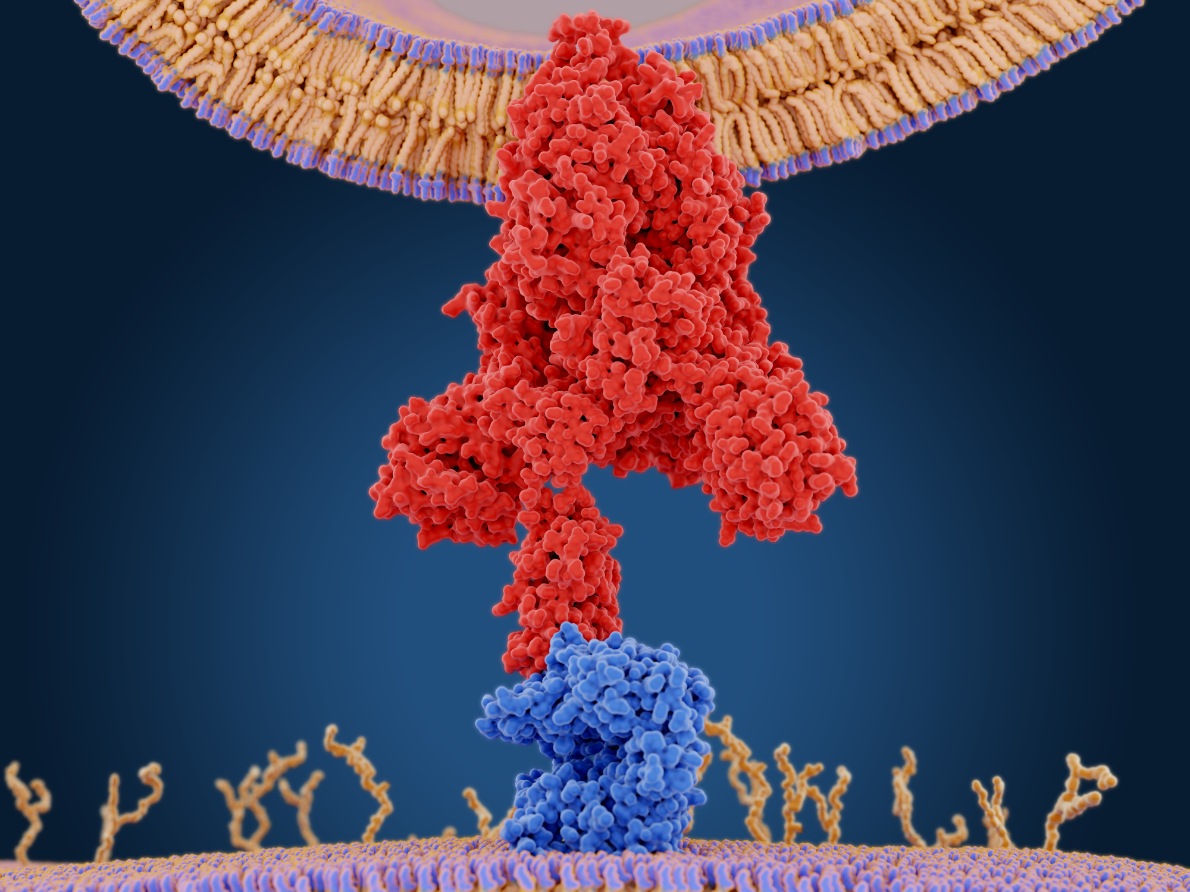
SARS Mechanism (cont)
SARS virus entry into a cell using the ACE2 receptor. The spike protein (red) mediates the coronavirus entry into host cells by binding to ACE2 (blue) through its S1 subunit and then fuses viral and host membranes through the S2 subunits.
Notes:
Credit: Licensed image © Juan Gaertner | Dreamstime.com, ID 171583572 .

Slide 25
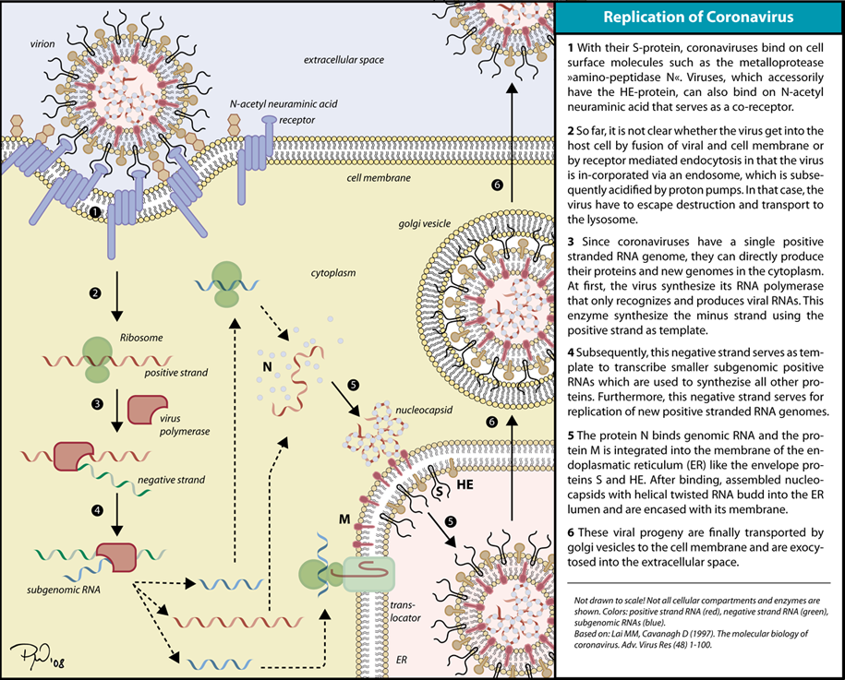
Inside the Cell…
Notes:
(+) Sense RNA is transcribed to produce (-) sense template
(+) Sense RNA is also translated directly/ indirectly (subgenomic genes = indirect) to produce proteins
Utilizes Proteolytic Cleavage (Post Translational Cut: ~ multiple proteins arise from one “polyprotein”) and subgenomic RNA’s to produce a variety of necessary proteins.
Glycoproteins are cotranslated into the Rough E.R membrane. Nucleocapsid (containing replicated genome) interacts with E.R. bound glycoproteins and follows secretory pathway to exit cell. New virus membrane is derived from host cell E.R. membrane!
Image credit: Crenim at English Wikipedia, CC BY-SA 3.0, https://commons.wikimedia.org/wiki/File:Coronavirus_replication.png.

Slide 26
SARS Outbreak of 2003
November 2002 – July 2003
8,098 people infected with SARS accompanied with pneumonia or respiratory distress syndrome (744 died).
In the US, only 8 people were laboratory confirmed with SARS. All 8 were confirmed to travel to countries of transmission during the outbreak. There were no deaths.

Slide 27
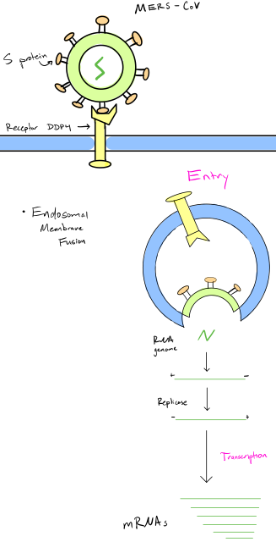
MERS Mechanism
An envelope protein called spike facilitates fusion of the viral particle with the cell membrane so that DNA can be injected into cell.
Fusion involves cutting of the viral envelope protein at specific locations. This process is catalyzed by the protease furin.
MERS-CoV binds to an entry receptor (DPP4) found on the surface of lung epithelial cells triggering receptor mediated endocytosis of viral particles.
Notes:
Image credit: Samuel Cohler, case author.

Slide 28
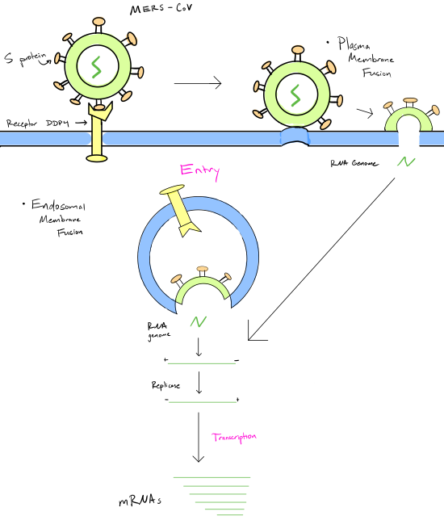
MERS Mechanism (cont.)
MERS-CoV spike proteins become cleaved by endosomal proteases during or after endosome maturation.
This occurs via a two-step cleavage mechanism that occurs at distinct site.
This furin-mediated activation is unusual in that it occurs partly during virus entry. It allows fusion of viral and endosomal membranes, causing release of viral genome into cytoplasm.
Notes:
Image credit: Samuel Cohler, case author.

Slide 29
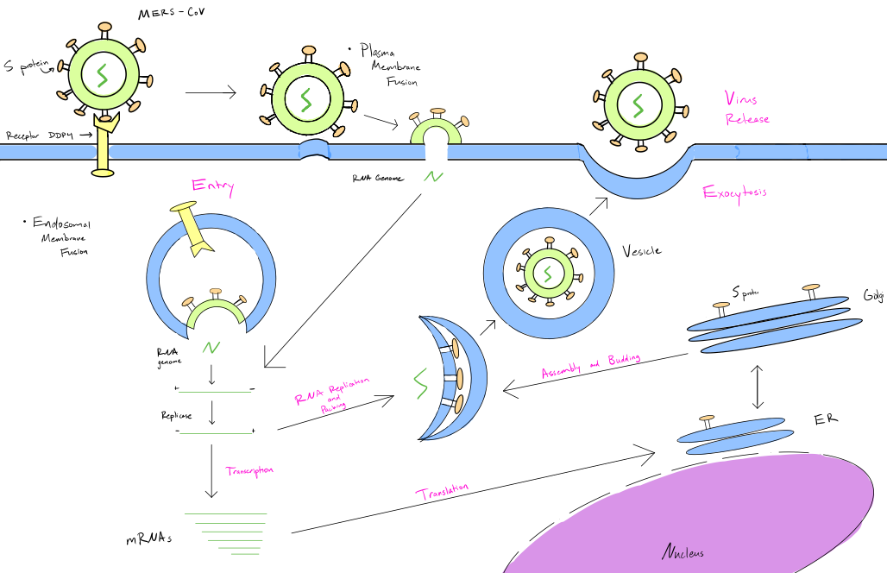
Cytoplasm
Notes:
Image credit: Samuel Cohler, case author.

Slide 30
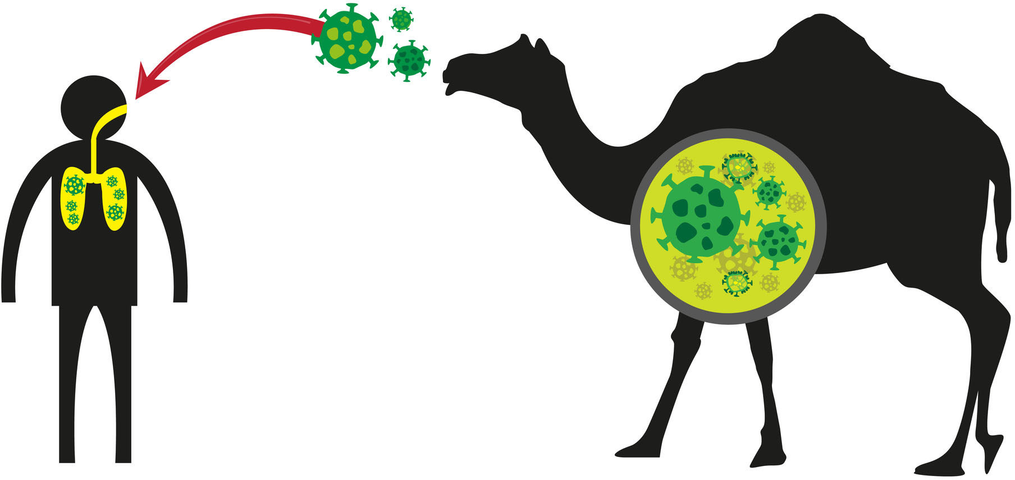
Source of Virus
MERS-CoV is a zoonotic virus.
Origins of the virus are not fully understood, but it might have originated in bats and was transmitted to camels in the past.
First reported in Saudi Arabia in 2012 and has spread to several other countries including the US.
Notes:
Credit: Licensed image © Crystaleyestudio | Dreamstime.com, ID 43240415.

Slide 31
MERS Timeline
By May 2013: 44 reported cases in Saudi Arabia
By June 2013: MERS had infected at least 60 people in Jordan, Qatar, Saudi Arabia, Arab Emirates, Tunisia, Germany, the UK, France and Italy
May 2014: first US patient diagnosis
June 2014: 688 cases in Saudi Arabia
May 2015: 150 cases in South Korea

Slide 32
Precautions Against Disease Spread
Anyone visiting farms, markets, barns, or places where dromedary camels and other animals are present should practice general hygiene measures.
Wash hands before and after touching animals.
Avoid contact with sick animals.

Slide 33
Precautions Against Disease Spread (cont.)
Consumption of raw or undercooked animal products (e.g., milk, meat) carries a high risk of infection. (Eating camel meat and drinking camel milk is safe if pasteurized or cooked.)
People with chronic diseases especially should avoid contact with camels, drinking raw camel milk or urine, or eating uncooked meat.
Prevention & control are critical in facilities if patients are suspected to have MERS-CoV to decrease risk of transmission from patient to patient or patient to health-care workers.

Slide 34
Treatment
No vaccine or specific treatment is currently available.
If conditions are minor (common cold) most often it is advised to have plenty of fluids and bed rest, and use over the counter medications like ibuprofen.
For more severe cases like SARS, antiviral medications and steroids are sometimes given to reduce lung swelling, but aren’t effective for everyone.
Notes:
Treatment is supportive and based on patient’s clinical condition

Slide 35
Epidemiological & Socioeconomic Health Risk Factors
MERS outbreaks have occurred in Saudi Arabia, United Arab Emirates, &Republic of Korea (many developed countries).
80% human cases reported in Saudi Arabia through contact with infected dromedary camels or infected people.
SARS discovered in Asia in Feb 2003 (see map); outbreak lasted 6 months spreading to more than two dozen countries before stopped in July 2003.
Suggested Image: Map of world showing spread of MERS virus
Notes:
Image Credit: CIA, public domain, https://commons.wikimedia.org/wiki/File:SARS_Spread_as_of_03-28-2003,_larger_image.png.

Slide 36
Epidemiological & Socioeconomic Health Risk Factors cont.
In the US, people usually get infected with common human coronaviruses in the fall and winter.
Most people will get infected with one or more of the common human coronaviruses in their lifetime.
Young children are most likely to get infected. However, people can have multiple infections in their lifetime.

