Slide 1
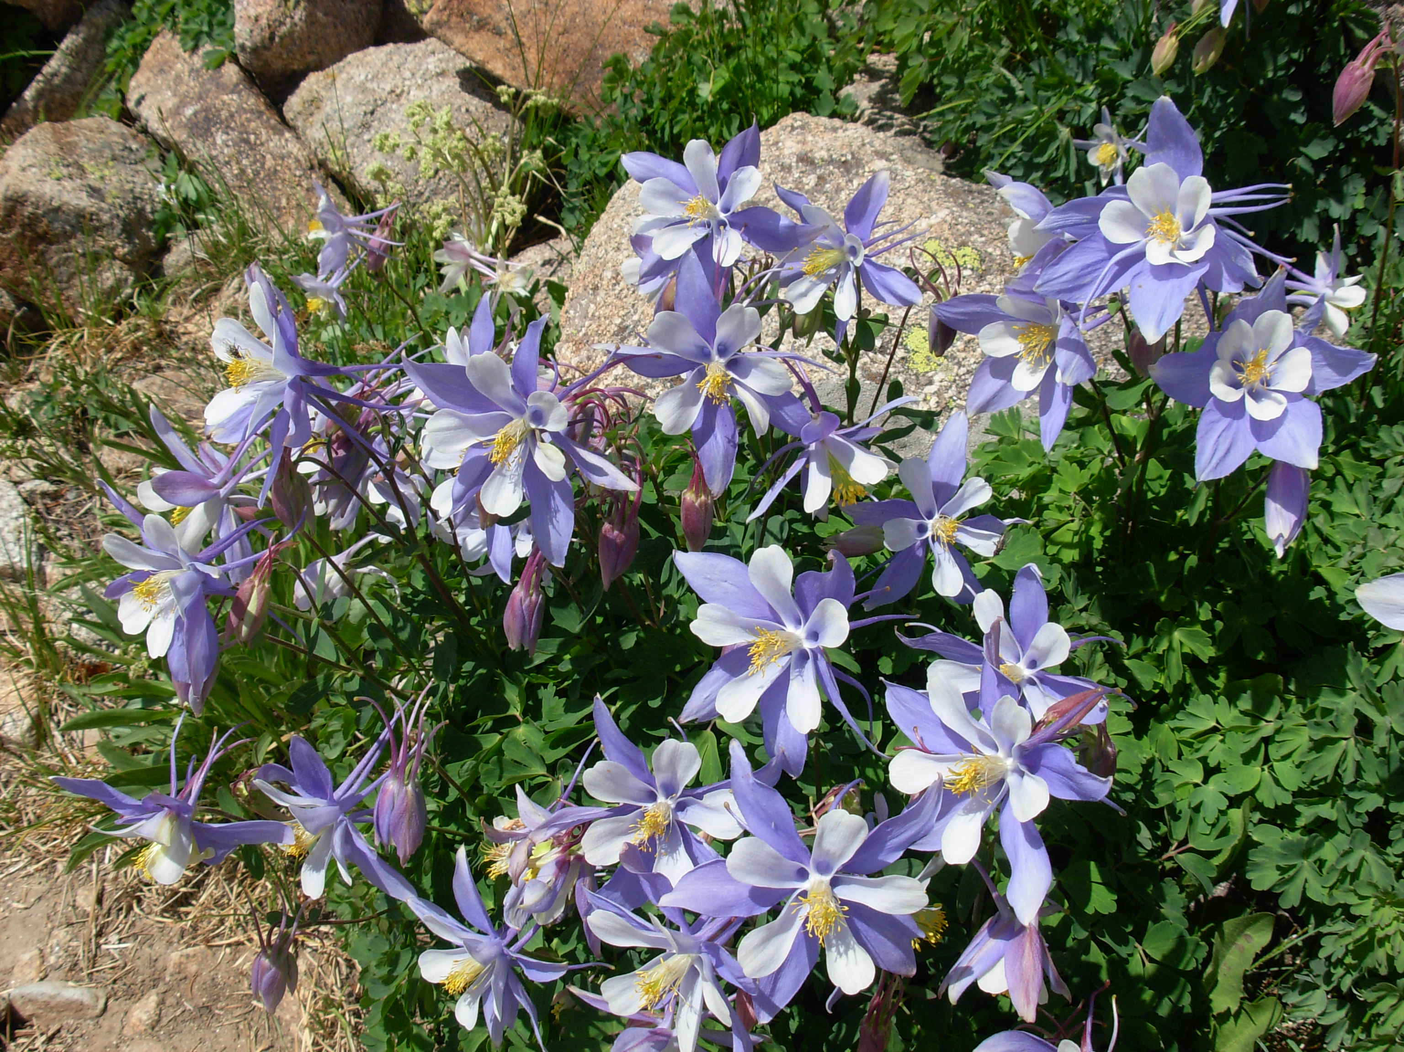
Reproductive Isolation in Columbines
by J. Phil Gibson
University of Oklahoma
Notes:
Image Credit
Clump of columbines Copyright © 2006 J. Phil Gibson

Slide 2
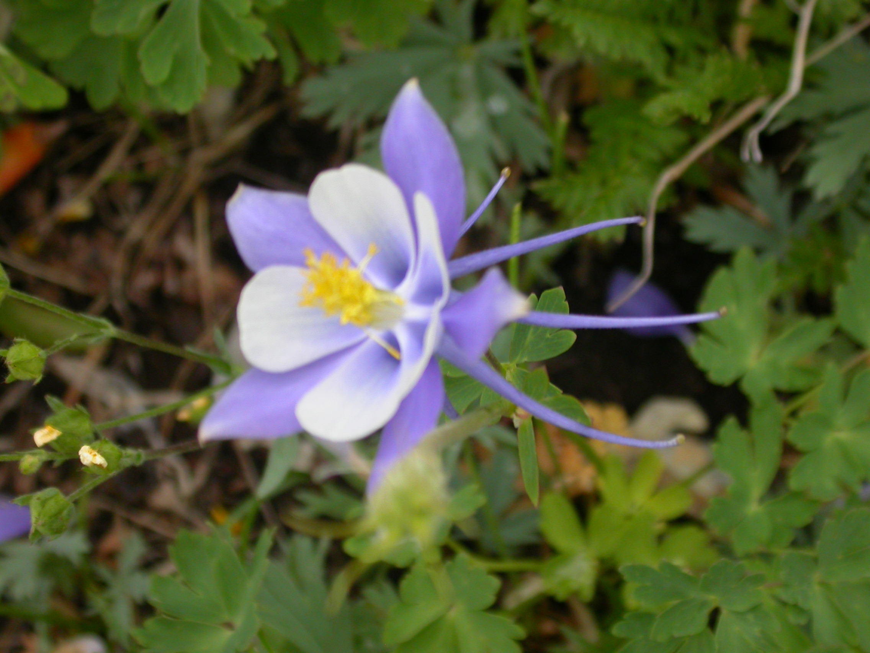
Columbine Case Questions:
How can a phylogenetic perspective provide insights on evolution and ecology of plant reproduction?
How can we identify and test for reproductive isolation in plant species?
How do flowers, pollinators, and pollination systems work?
Aquileqia caerulea – Colorado columbine
Notes:
These are the overarching questions addressed in the case study.
Image Credit
Aquilegia flower Copyright © 2006 J. Phil Gibson

Slide 3
Clicker Question #1
The diagram to the right is a phylogeny for 5 species in the same genus. This phylogeny shows. . .
  the degree to which organisms look like one another.
  hypothesis of how different organisms are related through common ancestors.
  the hypothesized sequence in which species evolved from left to right.
  the amount of change each species has experienced.
  which species are most closely related to the species at point M.
1 2 3 4 5
M

Slide 4
Clicker Question #2
What do the lines in this phylogeny represent?
  The history of mating between individuals.
  Lineages of organisms.
  Each line represents a single individual.
  Which species evolved first, second, third, etc.
  All of the above.
1 2 3 4 5

Slide 5
Clicker Question #3
What do the nodes (indicated by G, P, R, and M) represent in the phylogeny?
  Where two species hybridized.
  Lineages of organisms.
  Common ancestors of different species.
  The sequence in which species 1-5 evolved.
  None of the above.
1 2 3 4 5
G
P
R
M

Slide 6
Clicker Question #4
What does the point labeled R indicate?
  Species 5 in the past.
  Species 2 in the past.
  Where species 2 and species 5 hybridized.
  The common ancestor of species 2, 3, 4, & 5.
  Where species 5 became species 2.
1 2 3 4 5
G
P
R
M

Slide 7
Clicker Question #5
Which statement(s) below accurately describe what is happening at the nodes indicated by MRPG? (choose all that apply)
  Speciation is occurring.
  Mutation and natural selection are making the best new species.
  One species is turning into another species.
  Gene pools are becoming separated and isolated.
  Two species are coming together to make a new species.
1 2 3 4 5
G
P
R
M

Slide 8
Phylogenies are hypotheses about relationships among taxa.
Branches (clades) represent different lineages.
Nodes, where clades diverge indicate common ancestors and points of lineage separation (speciation).
Different clades may share features due to common ancestry (ancestral traits), but members of a clade share unique features (derived traits) not present in other clades.
1 2 3 4 5
Notes:
This slide covers the fundamental concept that a phylogeny is a graphical representation of hypothesized relationships among taxa. It presents the basic information about how to read the lines and nodes. One can continue the example of this by describing a genus of the instructor’s choice and explaining how five species in that genus will share some common traits, species that share a more recent common ancestor will share more traits, and each species will have some unique species defining traits.

Slide 9
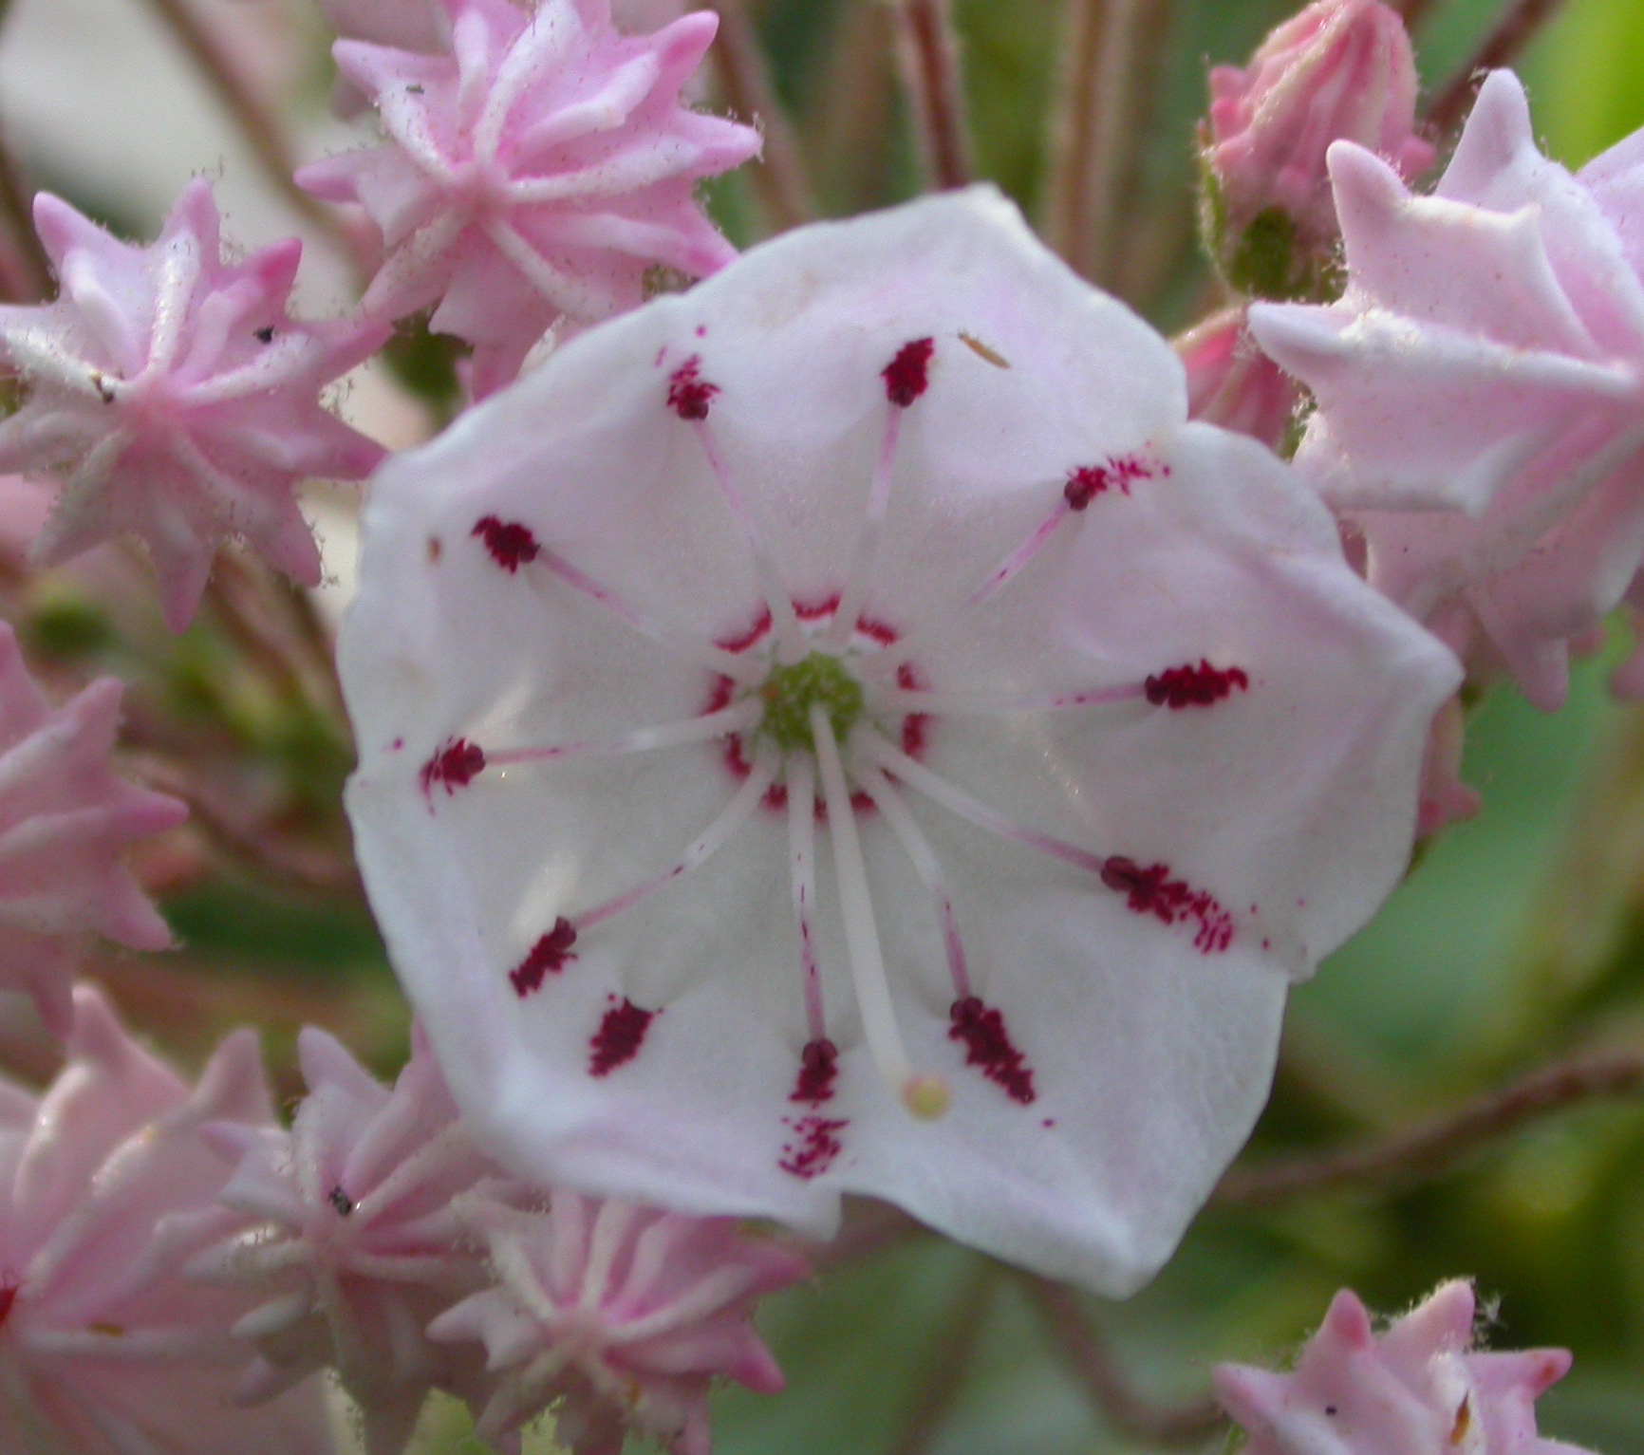
Flowering plants are a clade that share a unique feature, flowers.
sepals
petals
{
stamen
pistil
filament
{
ovary
style
anther
stigma
Notes:
This slide presents a mountain laurel (Kalmia latifolia) flower for discussion of general floral structure and function. It can be mentioned that many species, such as this one, have unique adaptations to get pollen on pollinators. This species uses a trigger mechanism such that when pollinators visit the flower they cause the stamens to be released from pockets in the petals and hit the pollinator with the anther to deposit pollen on the insect.
Image Credit:
Kalmia latifolia flower Copyright © 2006 J. Phil Gibson

Slide 10
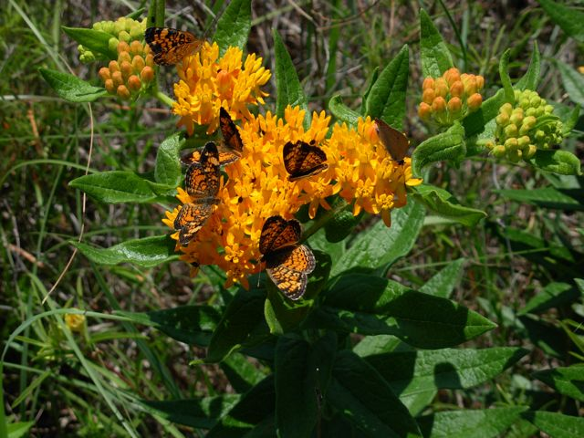
What Do Pollinators Do?
Pollination is the transfer of pollen from an anther to a receptive stigma. Biotic pollination is often a mutualistic relationship between a plant and animal attracted to its flowers to pick up pollen and then carry it to another flower for sexual reproduction.
Notes:
This slide introduces the function of pollinators in flowering plant reproduction. Although it focuses on biotic pollination vectors, it is worth mentioning that many plants successfully use wind as an abiotic pollination vector.
Image credits:
Butterflies on a milkweed Copyright © 2012 J. Phil Gibson

Slide 11
Clicker Question #6
What do you think is the most important feature of a flower for attracting pollinators?
  Flower color
  Flower shape
  Flower orientation
  A reward, such as nectar
  A reward, such as pollen
Notes:
There is no single correct answer to this question. It is provided to have students think about the importance of different floral features and then promote discussion among students.

Slide 12
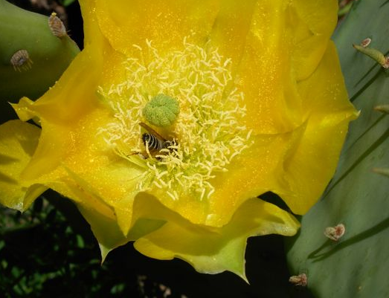
Pollinator Attractants
Primary Attractants
Food (nectar, pollen)
Shelter (heat in solar tracking flowers)
Other needed materials (e.g. waxes, pheromones, repellants)
Secondary Attractants
Odor (scents & fragrances)
Visual cues (color, shape, nectar guides)
Notes:
These are different categories of attractants. Primary attractants provide something the pollinator needs whereas secondary attractants get pollinators’ attention.
Image credits:
Cactus flower with bee Copyright © 2012 J. Phil Gibson

Slide 13
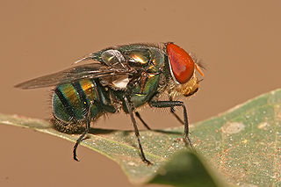
Biotic Pollination Syndromes
Flies: no characteristic preferences for particular color, scent, or structural features of flowers, generalists (myophily).
Carrion and dung flies: purple-brown flowers with scent of decaying protein, flowers have deep traps in petals to temporarily capture pollinators (sapromyophily).
Notes:
These are general features of pollination syndromes involving flies. Although there is variation, these are general patterns. Flies may have pollen deposited in their body while foraging for nectar or pollen. Carrion flies typically have pollen deposited on them when attracted to flower seeking a site to lay eggs.
Image Credits:
Chrysomya megacephala male.jpg http://en.wikipedia.org/wiki/File:Chrysomya_megacephala_male.jpg
Permission is granted to copy, distribute and/or modify this document under the terms of the GNU Free Documentation License, Version 1.2 only as published by the Free Software Foundation;

Slide 14
Biotic Pollination Syndromes
Hawkmoths: white or pale green color, strong sweet scent, deep narrow tubes contain nectar they access with unrolled proboscis (sphignopily).
Butterflies: preferences for red, yellow, and blue flowers with moderately strong sweet scent, deep narrow tubes contain nectar they access with unrolled proboscis (psychopily).
Notes:
These are general features of pollination syndromes involving hawkmoths and butterflies. Although there is variation, these are general patterns. Note that these animals will typically need to unroll their proboscis into the flower to drink nectar and have pollen deposited on the body in the process.
Image credits:
Butterflies on a milkweed Copyright © 2012 J. Phil Gibson

Slide 15
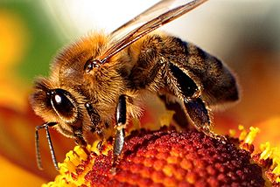
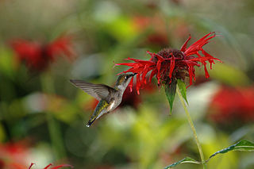
Biotic Pollination Syndromes
Bees: wide color preference but lower preference for pure red flowers, sweet scented flowers with open or tubular petals, often with prominent anthers (melittophily).
Birds: preference for bright colored flowers particularly red, no scent, wide deep tubes with nectar (ornithophily).
Notes:
These are general features of pollination syndromes involving bees and birds. Although there is variation, these are general patterns. Note that although bees may gather some pollen, most of the pollen for plant reproduction is deposited on the animal as it forages for nectar.
Image credits:
http://upload.wikimedia.org/wikipedia/commons/thumb/3/32/Bee-apis.jpg/320px-Bee-apis.jpg Permission is granted to copy, distribute and/or modify this document under the terms of the GNU Free Documentation License, Version 1.2 or any later version published by the Free Software Foundation; with no Invariant Sections, no Front-Cover Texts, and no Back-Cover Texts.
http://upload.wikimedia.org/wikipedia/commons/thumb/1/14/RubyThroatedHummingbird.jpg/320px-RubyThroatedHummingbird.jpg
This file is licensed under the Creative Commons Attribution 3.0 Unported license.

Slide 16
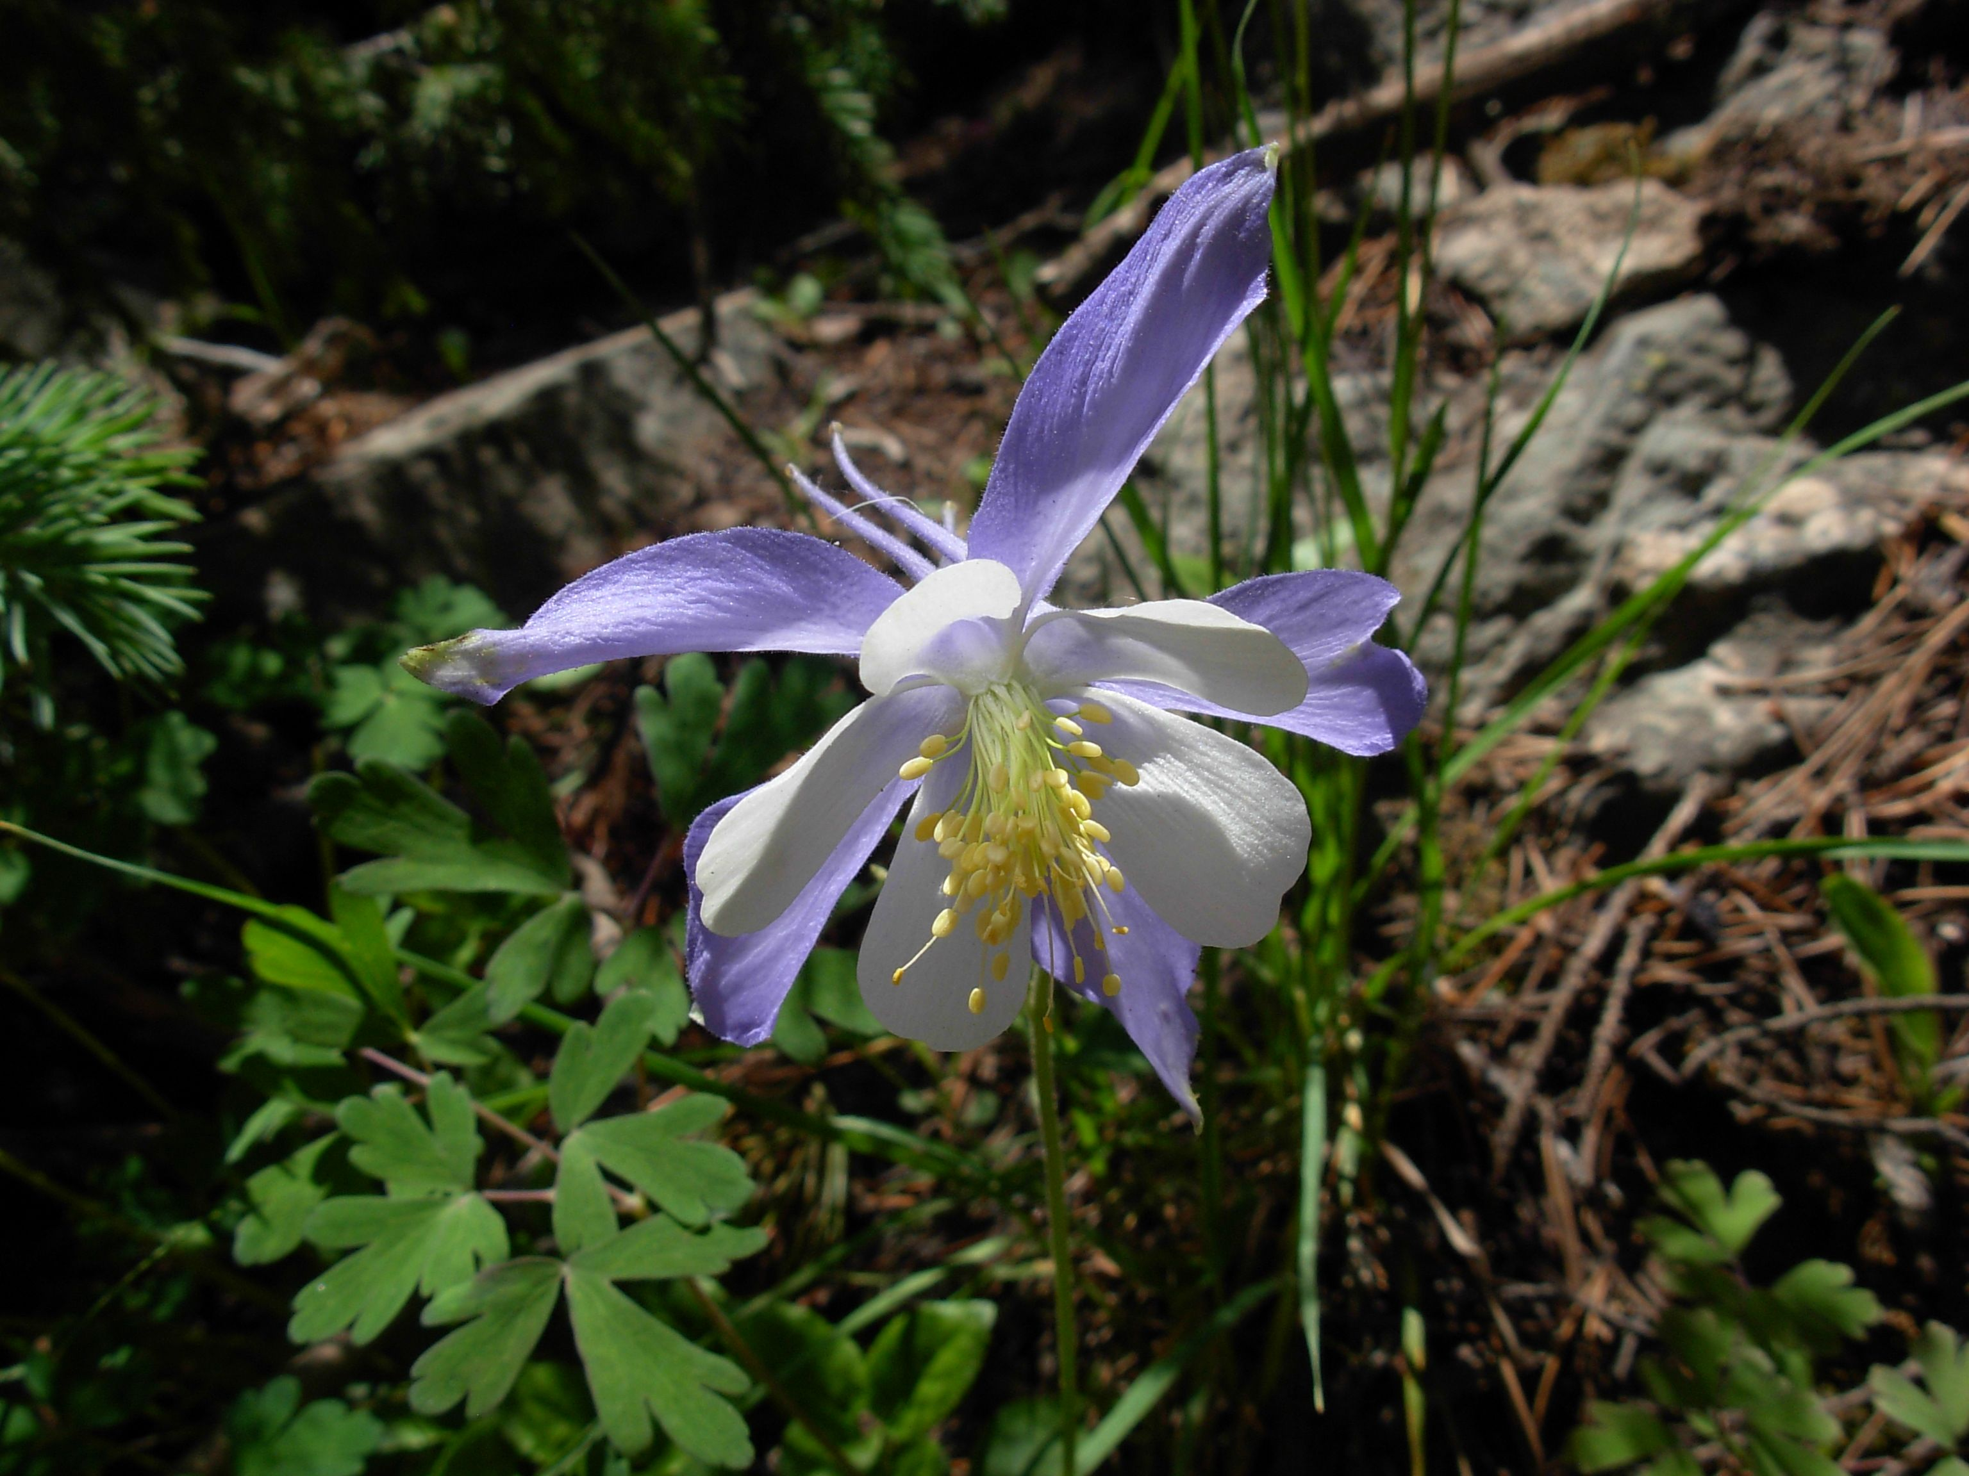
Flowers and Pollinators:
A structural-functional-behavioral interaction
Floral structure can promote reproductive isolation and speciation by affecting either pollinator behavior (behavioral isolation) or pollen transfer (mechanical isolation). This may be particularly important in columbines which have a number of unique floral features.
Notes:
This slide introduces a concept developed by Verne Grant that floral features are key elements to reproductive isolation in flowering plants
Grant, V. 1949. Pollination systems as isolating mechanisms in angiosperms. Evolution 3: 82-97.
Image credits
Bear Lake Columbine Copyright © 2006 J. Phil Gibson

Slide 17
Aquilegia spp. (Columbines) - Spurs & Species
All columbine flowers have spurs and other structural similarities.
The spurs contain nectar, a sugar-rich reward for pollinators who visit flowers.
spurs
stigmas
anthers
Notes:
This slide introduces specific structural features of a typical columbine flower in the genus Aquilegia that is the central focus of the case study. The position and function of nectar spurs that contain a reward and the color of the flower should be highlighted. As pollinators approach flowerers to obtain nectar, they will be coated with pollen form the anther and deposit pollen as their body contacts the stigma. Students can be prompted to discuss how columbine features such as nectar spurs could functionally influence floral function and reproductive isolation.
Image Credit
Detail from Clump of columbines Copyright © 2006 J. Phil Gibson

Slide 18
Clicker Question #7
In columbines, color would be an example of a _________ attractant and nectar would be an example of a _________ attractant.
primary/secondary
floral/pollinator
secondary/primary
bird/insect
reward/visual

Slide 19
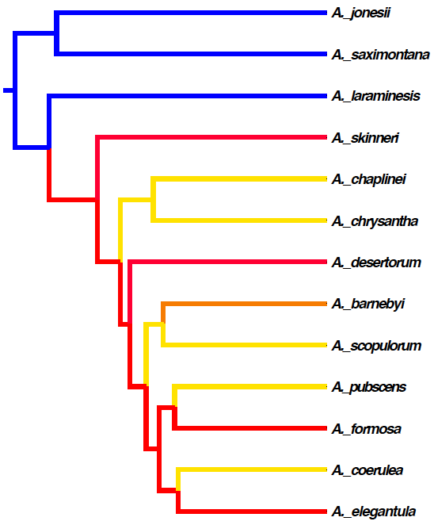
A. jonesii
A. saximontanta
A. laramiensis
A. skinneri
A. chaplinei
A. chrysantha
A. desertorum
A. narnebyi
A. scopulorum
A. pubescens
A. formosa
A. coerulea
A. elegantula
Nectar spurs are considered innovations that have promoted speciation and reproductive isolation in columbines. Changes in spur length may result in pollinator shifts.
How could this work?
How might hummingbirds, bees, and moths differ in why & how they visit flowers?
bee pollinated
hummingbird pollinated
hawkmoth pollinated
hummingbird & hawkmoth pollinated
Notes:
This slide presents a phylogeny of columbines based on DNA sequence data. Pollination system has then been mapped onto the phylogeny as indicated by the different colored branches. The two species that are the focus of the case study are circled in the slide animation. Instructors should point out that the hawkmoth-pollinated species seem have evolved from ancestors that were hummingbird pollinated. This could happen if mutations causing floral features to change are favored by new pollinators. Pollinators will differ in why and how they approach flowers based on the way they access the reward and they way they physically move towards or around the flower. For example, birds hover and approach flowers whereas bees will walk on the flower.
Modified from Whittall, J.B. and S. A. Hodges. 2007. Pollinator shifts drive increasingly long nectar spurs in columbine flowers. Nature 447: 706-709.

Slide 20
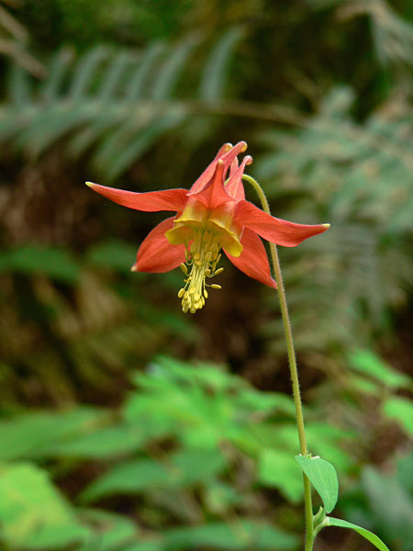
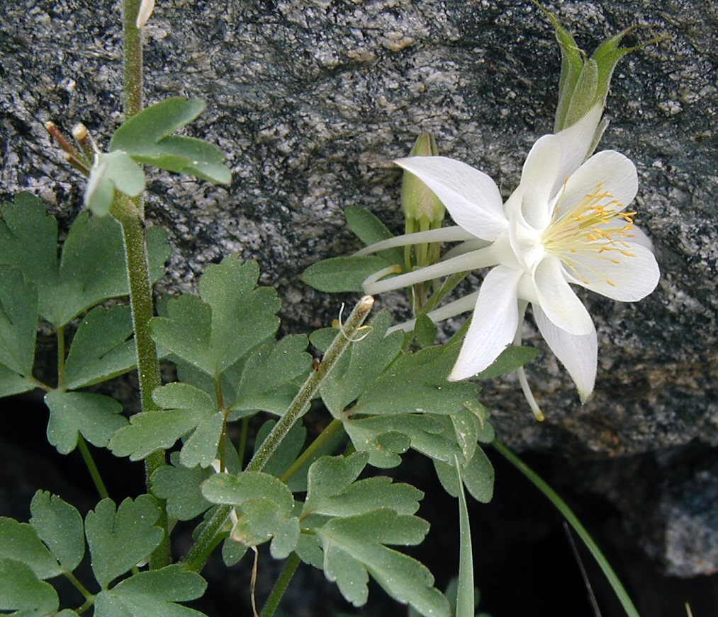
Aquilegia formosa
average spur length 10-20 mm
native to western North America
low-mid elevation, mesic sites
Aquilegia pubescens
average spur length 25-40 mm
native to Colorado and California
high elevation, drier sites
Aquilegia fomosa and A. pubescens are species that evolved from a recent common ancestor based on a genetic phylogeny.
What differences between A. formosa and A. pubescens flowers may be important for interacting with pollinators?
Why might their sharing a recent common ancestor be important?
Notes:
This slides introduces focal species in the case. Students should note color differences (formosa red, pubescens white), spur length (formosa shorter at 10-20 mm, pubescens longer at 25-40 mm), and orientation (formosa downward, pubescens more upward) differences between flowers of the different species. This slides also prompts students’ thoughts about the case regarding pollination syndromes, speciation, and reproductive isolation. Students should understand that that the species share a common lineage, but that populations of the common ancestor became reproductively isolated from one another which gave rise to separate lineages that can eventually became separate species.
Images credits:
A. formosa: http://species.wikimedia.org/wiki/File:Aquilegia_formosa_14962.JPG This file is licensed under the Creative Commons Attribution-Share Alike 3.0 Unported license.
A. pubescens: Copyright © 2009 Barry Breckling http://calphotos.berkeley.edu/cgi/img_query?enlarge=0000+0000+1209+2492
This image has a Creative Commons Attribution-NonCommercial-ShareAlike 3.0 (CC BY-NC-SA 3.0) license.

Slide 21
Clicker Question #8
Because they share a common ancestor. . .
both species are completely different from one another and share no traits.
both columbine species share some traits, but also have other unique features that differentiate them.
both columbine species will attract the same pollinators and grow in the same places.
both columbine species are reproductively isolated from one another.

Slide 22
Spurs & Species
Given the proposed importance of nectar spurs and other floral features, how would you test their influence on columbine speciation?
Develop an hypothesis and design an experiment to to explore potential causes and function of behavioral isolation and mechanical isolation between A. pubescens and A. formosa flowers.
Notes:
This slide asks groups to develop hypotheses and design a basic experiment they would conduct to test for behavioral or mechanical isolation in these species. After discussing, some or all groups should report back to the whole class. Instructor should have students evaluate one another’s experiments for control, variables, data to collect, and other aspects of experimental design.

Slide 23
In an initial study, researchers presented both columbine species in a hexagonal array with nine flowering individuals of each spp. Arrays were placed near A. pubescens and A. formosa populations and pollinator visits recorded.
Why did they do this?
A. formosa
A. pubescens
Notes:
This slide introduces the first experiment the researchers conducted. This slide provides a rough diagram to demonstrate the experimental array with both species. This initial experiment is essential to test whether pollinators showed preferences for different species. The array was used to test whether pollinators would differentiate among species in a mixture where both are equally present. Students should think about and explain why presenting both species together in an array to give pollinators a choice is important to the study Note: The actual array structure was not shown in the paper. Thus, this is an approximation of the design based upon the researchers’ description.
Modified from Fulton, M. and S.A. Hodges. 1999. Floral isolation between Aquilegia formosa and Aquilegia pubescens. Proc. R. Soc. Lond. B. 266: 2247-2252.

Slide 24
What would you expect?
Draw a bar graph to show your predicted mean visits per flower per hour by different pollinators to A. formosa & A. pubescens
Notes:
This slide provides the axes of a graph in which students use their knowledge of different pollination syndromes to draw a bar graph that predicts visitation by different pollinators to the the two columbine species. Data from Fulton, M. and S.A. Hodges. 1999. Floral isolation between Aquilegia formosa and Aquilegia pubescens. Proc. R. Soc. Lond. B. 266: 2247-2252.

Slide 25
Experimental Results
Mean visits per flower per hour by different pollinators to A. formosa & A. pubescens
Notes:
This slide shows the results of the pollinator visitation. Mean visitation with standard error are shown in the figure. The data indicate significant differences in hawkmoth and hummingbird visitation to A. pubescens and A. formosa flowers, respectively. Flies and bees visit both species, with greater visitation to A. formosa.
Data from Fulton, M. and S.A. Hodges. 1999. Floral isolation between Aquilegia formosa and Aquilegia pubescens. Proc. R. Soc. Lond. B. 266: 2247-2252.

Slide 26
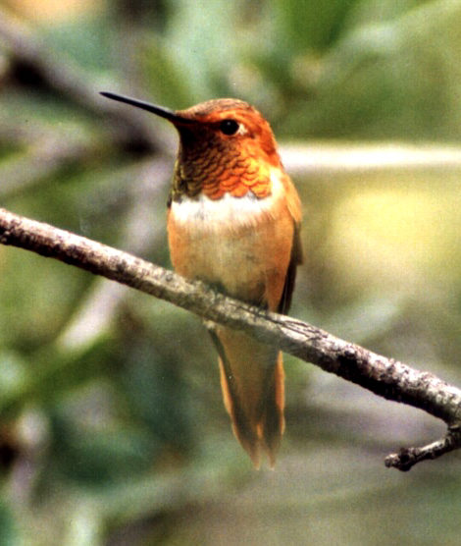
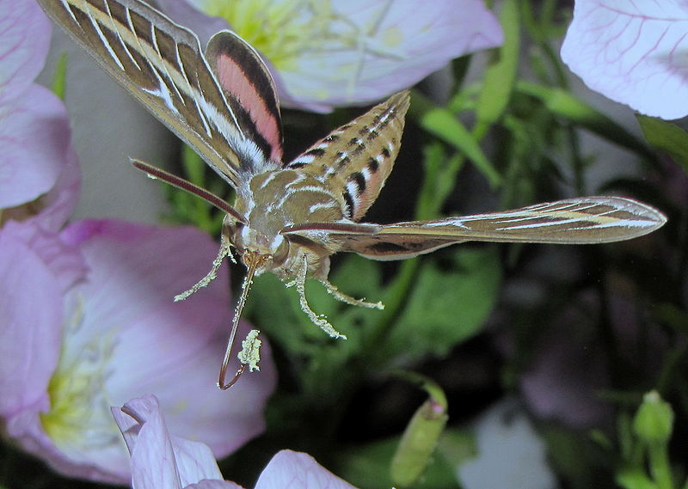
Experimental Results: Pollinators Identified
hummingbirds
bees
Aquilegia formosa
Aquilegia pubescens
flies
hawkmoths
Notes:
Pictures of the two columbine species and their primary pollinators below. Only one hummingbird species is shown, but there are several species that visit A. formosa. Pollinators were observed to probe spurs for nectar in visited species.
Data from Fulton, M. and S.A. Hodges. 1999. Floral isolation between Aquilegia formosa and Aquilegia pubescens. Proc. R. Soc. Lond. B. 266: 2247-2252.
Image Credits:
A. formosa: http://species.wikimedia.org/wiki/File:Aquilegia_formosa_14962.JPG This file is licensed under the Creative Commons Attribution-Share Alike 3.0 Unported license.
A. pubescens: Copyright © 2009 Barry Breckling http://calphotos.berkeley.edu/cgi/img_query?enlarge=0000+0000+1209+2492
This image has a Creative Commons Attribution-NonCommercial-ShareAlike 3.0 (CC BY-NC-SA 3.0) license.
Rufus hummingbird: Selasphorus rufus http://en.wikipedia.org/wiki/File:Selasphorus_rufus.jpg
Hawkmoth: Hyles lineata http://en.wikipedia.org/wiki/File:White-lined_sphinx.JPG This file is licensed under the Creative Commons Attribution-Share Alike 3.0 Unported license.

Slide 27
Experimental Data: Pollinator preferences for A. formosa and A. pubescens
Visits to | hummingbirds | hawkmoths | bees
A. formosa | 81 | 0 | 85
A. pubescens | 9 | 115 | 19
Χ² | 57.6 | 115 | 41.88
p | <0.0001 | <0.0001 | <0.0001
What can the researchers conclude so far?
Notes:
The table presents experimental results from the pollinator visitation observations. Chi squared data show significant differences in visitation, and, therefore, pollinator preferences for the species.
Data from Fulton, M. and S.A. Hodges. 1999. Floral isolation between Aquilegia formosa and Aquilegia pubescens. Proc. R. Soc. Lond. B. 266: 2247-2252.

Slide 28
What data should they collect? Why?
What will the data tell them?
Aquilegia pubescens
The researchers focused on A. pubescens for further study. They planted two arrays of modified and control (unmodified) flowers.
Array 1: pedicels for ½ of the A. pubescens flowers staked to make flowers pendent (point downwards)
Array 2: spurs for ½ of the A. pubescens flowers shortened (squeezed nectar from bottom of spurs, tied & clipped spur)
Notes:
This slide prompts students to think about a manipulative, follow-up experiment conducted from the initial observation results in which the researchers focused on A. pubescens. In this study A. pubescens flowers were manipulated to alter orientation (point downwards) or shorten the spur to determine if there would be a change in pollinator response and effectiveness. These modifications are predicted to alter i) the way a pollinator can approach a flower and ii) the depth they can insert mouthparts to come into contact with anthers and stigmas, respectively. Making the flowers pendent changes orientation and will affect how pollinators approach the flowers. Shortening the spur will alter how far pollinators can insert their head into the flower and, consequently, remove pollen. Nectar was squeezed upwards in the spur so that it would retain the reward in the flower. Simply cutting the spur would remove the reward. Students should discuss the data that should be collected and why those data are informative

Slide 29
A. pubescens Flower Manipulations
Measure visitation and pollen removal as an indicator of effective pollinator visitation.
Unmanipulated
Pendent
Shortened
Notes:
This slide is provided to help students visualize the A. pubescens manipulations and indicated the data to be collected. .
The unmanipulated flowers should have normal visitation by hawkmoth. Pendent flowers are expected to have less hawkmoth visitation due to the change in orientation. The upright flowers should have normal visitation by hawkmoths but due to the shortened spurs. However,, shortening spurs should limit depth pollinator can insert body into the flower and, therefore, should be less effective at pollen removal and delivery.

Slide 30
Clicker Question #9
Which of these hypotheses are the researchers potentially testing?
If floral orientation in A. pubescens is important for reproductive isolation, then we should expect. . .
the floral modifications will have no effect on pollinator visitation and pollen removal.
hawkmoths will be better able to remove pollen from pendent flowers.
hummingbirds will be attracted to the pendent flowers less than unmodified flowers.
the unmodified flowers will have higher visitation by hawkmoths than pendent flowers.

Slide 31
Clicker Question #10
In the spur shortening experiment, you should expect . . .
unmanipulated flowers will have more pollen removed by hawkmoths than the shortened spur flowers.
unmanipulated flowers will have less pollen removed by hawkmoths than the shortened spur flowers.
hawkmoths will visit shortened spur flowers more than the unmanipulated flowers.
hawkmoths will remove more pollen from shortened spur flowers than the unmanipulated flowers.
None of these are expected outcomes for this experiment.

Slide 32
Clicker Question #11
Experimental Data: Visits by Hyles lineata to A. pubescens with differing floral orientation.
Visits to | Number of observed visits
upright | 51
pendent | 5
Χ² | 45.5
p | <0.0001
These results are consistent with the researchers’ prediction about flower orientation and visitation.
A. True B. False
Notes:
Data from Fulton, M. and S.A. Hodges. 1999. Floral isolation between Aquilegia formosa and Aquilegia pubescens. Proc. R. Soc. Lond. B. 266: 2247-2252.

Slide 33
Clicker Question #12
Experimental Data: Visits by Hyles lineata to A. pubescens with long or short nectar spurs.
Visits to | Number of observed visits
long | 17
short | 19
Χ² | 0.11
p | > 0.05
These results are consistent with the researchers’ prediction about spur length and visitation.
A. True B. False
Notes:
Data from Fulton, M. and S.A. Hodges. 1999. Floral isolation between Aquilegia formosa and Aquilegia pubescens. Proc. R. Soc. Lond. B. 266: 2247-2252.

Slide 34
Clicker Question #13
Mean number of pollen grains remaining in A. pubescens anthers after hawkmoth visitation.
These results are consistent with the researchers’ prediction.
A. True
B. False
Notes:
Data from Fulton, M. and S.A. Hodges. 1999. Floral isolation between Aquilegia formosa and Aquilegia pubescens. Proc. R. Soc. Lond. B. 266: 2247-2252.

Slide 35
Clicker Question #14
From these studies we can conclude that. . .
A. orientation promotes mechanical isolation and spur length promotes behavioral isolation.
B. the species have few floral features that would promote reproductive isolation.
C. spur length is a primary attractant and color is a secondary attractant.
D. orientation promotes behavioral isolation and spur length promotes mechanical isolation.
E. floral structure causes reproductive isolation after pollination occurs.

Slide 36
Clicker Question #15
Based upon the data in the floral manipulation studies, spurs act to maintain separate Aquilegia species by. . .
causing flowers to grow in different habitats
offering different rewards to different pollinators
influencing pollen removal from and depositing on flowers.
attracting different pollinators.

Slide 37
Hybrids and Habitats
In addition to differences in pollinators, A. pubescens typically grows at higher elevations and in drier habitats than A. formosa which tends to grow in more moist habitats at lower elevations.
Although they have these differences, hybrid populations of viable, reproductively functioning plants with floral traits and molecular markers characteristic of both species have been identified at intermediate elevations and habitats!
How could this happen?
Notes:
This slide presents habitat information about the two columbine species and introduces the occurrence of hybrids. Because hybrids form, reproductive isolation is clearly not complete between the two species. Students should discuss and report back their thoughts on how this could happen and why it may be important. Referring to information in previous slides on pollinator visitation, bees and flies can be low fidelity pollinators that visit both species. Likewise, hummingbirds or hawkmoths could occasionally visit both species. The key point to mention is that reproductive isolation is not always complete. Hybrids and hybrid zones can form due to pollinator infidelity and hybrid plants tolerating and growing in intermediate abiotic habitat conditions.

Slide 38
Clicker Question #16
The occurrence of hybrids indicates. . .
that A. formosa and A. pubescens are really just one species.
reproductive isolation does not matter for plant species.
pollinator behavior is not important for maintaining species.
reproductive isolating barriers are not always absolute between species.
that habitat is not important for maintaining species.

Slide 39
Epilogue
Floral structural differences can influence pollinator behavior, pollinator effectiveness, and, consequently, reproductive isolation between species.
Although floral features can promote reproductive isolation between species for some pollinators, generalist pollinators may visit both species, resulting in hybrids that can survive in intermediate habitats.
Notes:
Case epilogue reinforces the connection between flower structure, pollinator behavior, and reproductive isolation.

Slide 40
Image Credits
Slide 1: Clump of columbines Copyright © 2006 J. Phil Gibson
Slide 2: Aquilegia flower Copyright © 2006 J. Phil Gibson
Slide 9: Kalmia latifolia flower Copyright © 2006 J. Phil Gibson
Slide 10: Butterflies on a milkweed Copyright © 2012 J. Phil Gibson
Slide 12: Cactus flower with bee Copyright © 2012 J. Phil Gibson
Slide 13: Chrysomya megacephala male.jpg http://en.wikipedia.org/wiki/File:Chrysomya_megacephala_male.jpg
Permission is granted to copy, distribute and/or modify this document under the terms of the GNU Free Documentation License, Version 1.2 only as published by the Free Software Foundation;
Slide 14: Butterflies on a milkweed Copyright © 2012 J. Phil Gibson
Slide 15: http://upload.wikimedia.org/wikipedia/commons/thumb/3/32/Bee-apis.jpg/320px-Bee-apis.jpg Permission is granted to copy, distribute and/or modify this document under the terms of the GNU Free Documentation License, Version 1.2 or any later version published by the Free Software Foundation; with no Invariant Sections, no Front-Cover Texts, and no Back-Cover Texts.
http://upload.wikimedia.org/wikipedia/commons/thumb/1/14/RubyThroatedHummingbird.jpg/320px-RubyThroatedHummingbird.jpg
This file is licensed under the Creative Commons Attribution 3.0 Unported license.
Slide 16: Bear Lake Columbine Copyright © 2006 J. Phil Gibson
Slide 17: Detail from Clump of columbines Copyright © 2006 J. Phil Gibson

Slide 41
Image Credits
Slide 20: A. formosa: http://species.wikimedia.org/wiki/File:Aquilegia_formosa_14962.JPG This file is licensed under the Creative Commons Attribution-Share Alike 3.0 Unported license.
A. pubescens: Copyright © 2009 Barry Breckling http://calphotos.berkeley.edu/cgi/img_query?enlarge=0000+0000+1209+2492. This image has a Creative Commons Attribution-NonCommercial-ShareAlike 3.0 (CC BY-NC-SA 3.0) license.
Slide 26: A. formosa: http://species.wikimedia.org/wiki/File:Aquilegia_formosa_14962.JPG This file is licensed under the Creative Commons Attribution-Share Alike 3.0 Unported license.
A. pubescens: Copyright © 2009 Barry Breckling http://calphotos.berkeley.edu/cgi/img_query?enlarge=0000+0000+1209+2492 This image has a Creative Commons Attribution-NonCommercial-ShareAlike 3.0 (CC BY-NC-SA 3.0) license.
Rufus hummingbird: Selasphorus rufus http://en.wikipedia.org/wiki/File:Selasphorus_rufus.jpg
Hawkmoth: Hyles lineata http://en.wikipedia.org/wiki/File:White-lined_sphinx.JPG This file is licensed under the Creative Commons Attribution-Share Alike 3.0 Unported license.
Chrysomya megacephala male.jpg http://en.wikipedia.org/wiki/File:Chrysomya_megacephala_male.jpg
Permission is granted to copy, distribute and/or modify this document under the terms of the GNU Free Documentation License, Version 1.2 only as published by the Free Software Foundation; http://en.wikipedia.org/wiki/en:Free_Software_Foundation
http://upload.wikimedia.org/wikipedia/commons/thumb/3/32/Bee-apis.jpg/320px-Bee-apis.jpg Permission is granted to copy, distribute and/or modify this document under the terms of the GNU Free Documentation License, Version 1.2 or any later version published by the Free Software Foundation; with no Invariant Sections, no Front-Cover Texts, and no Back-Cover Texts.
Slide 28: A. pubescens: Copyright © 2009 Barry Breckling http://calphotos.berkeley.edu/cgi/img_query?enlarge=0000+0000+1209+2492 This image has a Creative Commons Attribution-NonCommercial-ShareAlike 3.0 (CC BY-NC-SA 3.0) license.
Slide 37:
A. formosa: http://species.wikimedia.org/wiki/File:Aquilegia_formosa_14962.JPG This file is licensed under the Creative Commons Attribution-Share Alike 3.0 Unported license.
A. pubescens: Copyright © 2009 Barry Breckling http://calphotos.berkeley.edu/cgi/img_query?enlarge=0000+0000+1209+2492 This image has a Creative Commons Attribution-NonCommercial-ShareAlike 3.0 (CC BY-NC-SA 3.0) license.

