Slide 1
Cystic Fibrosis: Then and Now
NATIONAL CENTER FOR CASE STUDY TEACHING IN SCIENCE
by
Kathleen A. Nolan and Allen J. Burdowski
Biology and Health Sciences
St. Francis College, Brooklyn, NY

Slide 2
Students, before coming to class you should have:
Watched the 4.5 minute video “Cystic Fibrosis: Then and Now.”

Slide 3
Pay close attention to this scenario…….
This is a true story….
A doctor informs a young father that his newborn baby boy has cystic fibrosis.
The father says, “Yes, that would make sense as I am a carrier for cystic fibrosis.”
But the grandfather says, “No, the baby can’t have cystic fibrosis---my daughter, the mother, was extensively genetically tested and she does not have the gene for cystic fibrosis.”

Slide 4
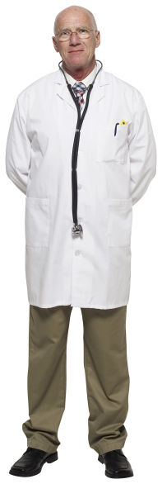
Who is correct? The doctor or the grandfather?
PICK ME!!
WHY?

Slide 5
The grandfather!
PICK ME!!
WHY?

Slide 6
What is the difference between…..
Having cystic fibrosis (or any other disease for that matter) or:
Having a gene for cystic fibrosis?
WHAT DO THE ABOVE TWO STATEMENTS MEAN?

Slide 7
CQ#1: Cystic fibrosis is:
a. an autosomal dominant disease
b. an autosomal recessive disease
c. a sex-linked dominant disease
d. a sex-linked recessive disease
e. a spontaneous mutation

Slide 8
Draw Punnett squares that depict inheritance of all of the below:
an autosomal dominant disease
an autosomal recessive disease
a sex-linked dominant disease
a sex-linked recessive disease

Slide 9
CQ #2 Which is the correct statement? (There could be more than one correct answer.)
a. One-fourth of the children of two carriers will get cystic fibrosis.
b. 25% of the children of two carriers will get cystic fibrosis.
c. 50% of the children of two carriers will get cystic fibrosis.
d. There is a 25% chance that a child will have cystic fibrosis if both parents are carriers.
e. There is a 25% chance that a second child will have cystic fibrosis if both parents are carriers.

Slide 10
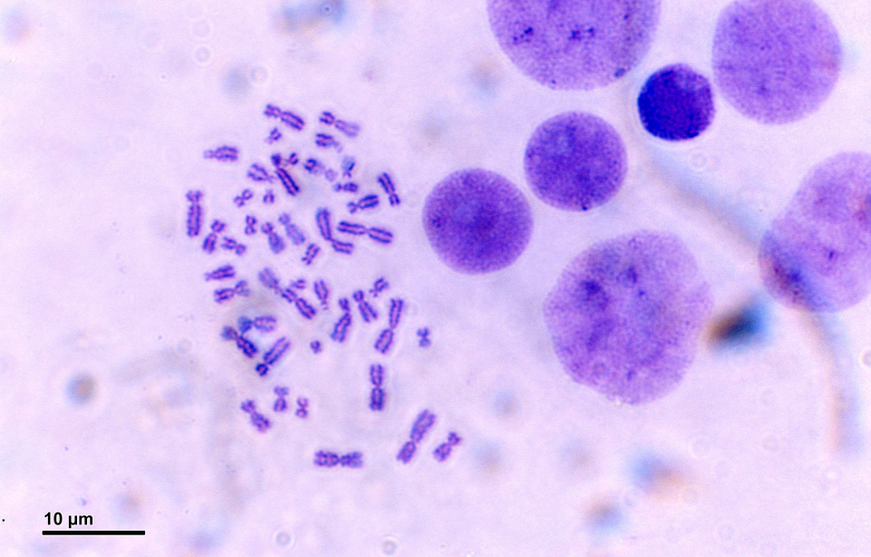
What is this?
What is this a picture of?
Do you remember how this picture was made?

Slide 11
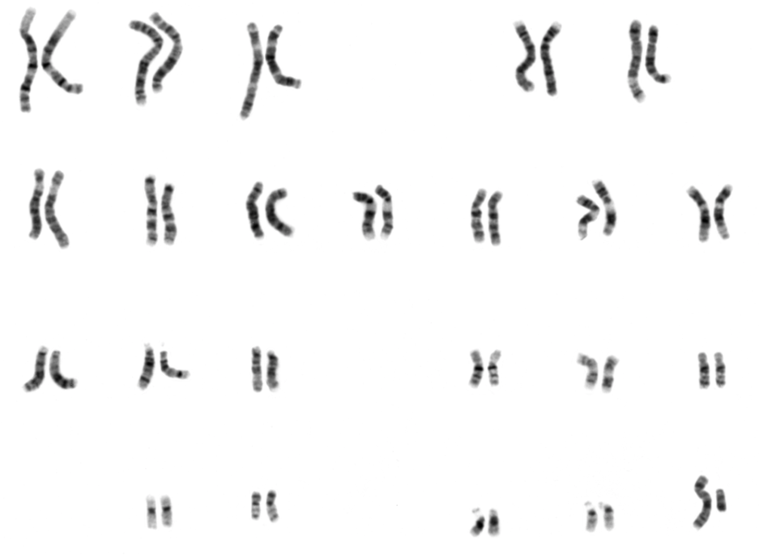
How was this karyotype made?
What sex is this person?

Slide 12
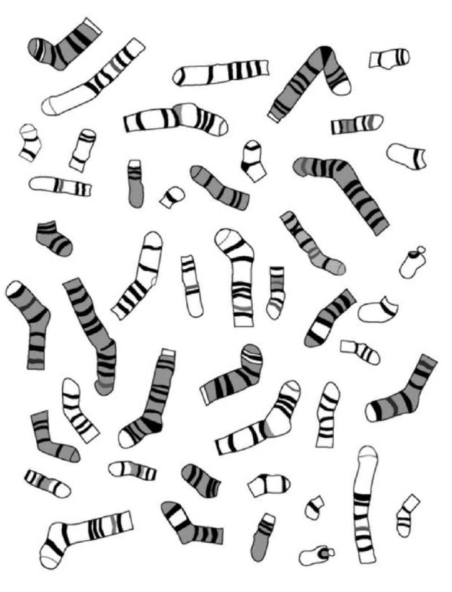
If you wanted to have a little fun….
….you could print, cut out, and align THESE chromosomes! (optional)

Slide 13
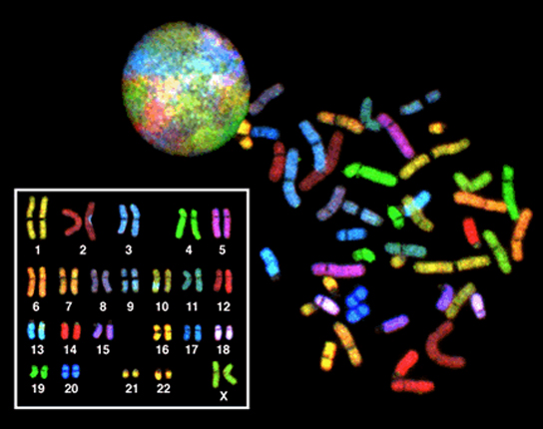
What do you think chromosome painting is?

Slide 14
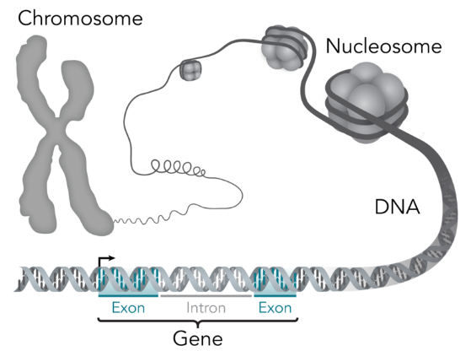
The gene is located at a certain spot, or locus, on a chromosome.

Slide 15
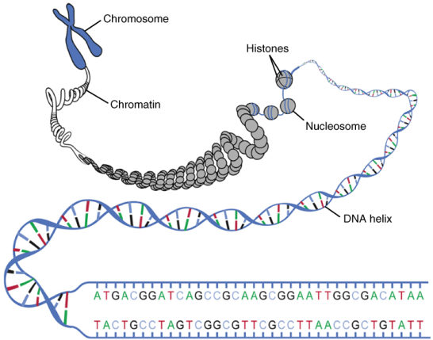
Genes are composed of DNA
Genes are located on chromosomes
Book ≈ chromosome-----→
Gene ≈ chapter----------
DNA ≈ letters on a page-

Slide 16
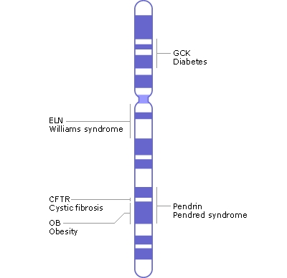
Diagram of Chromosome 7

Slide 17
CF gene is on 7q
What does that mean??
The CF gene is actually the CFTR gene.
That stands for transmembrane conductance regulatory protein
A NORMAL CFTR gene codes for a protein that regulates the passage of chloride from the inside of the cell to the outside of the cell.
People with CF have a MUTANT form of the CFTR gene and thus make an ABNORMAL or NON-FUNCTIONING CFTR protein.

Slide 18
CQ #3: Cystic fibrosis is a disease in which:
a. there is a gene that produces a faulty red blood cell.
b. the body produces no insulin.
c. there is a gene that produces a mucus that is too viscous.
d. there is uncontrolled nervous activity.
e. there is uncontrolled weight gain.

Slide 19
CQ #4 What is NOT a complication of cystic fibrosis?
a. Liver disease
b. Portal hypertension (spleen enlarged)
c. Pancreatic dysfunction
Salty sweat
Obesity

Slide 20
What does “life expectancy” mean?
How is it determined and how might it change?

Slide 21
CQ #5 The mean life expectancy for someone with cystic fibrosis is:
a. 20
b. 30
c. 40
d. 50
e. 60

Slide 22
If the CFTR gene is 1540 amino acids long, how many DNA bases were necessary to code for the FUNCTIONAL part of the
CFTR protein?

Slide 23
4,620
That is plenty of base pairs that might undergo mutations!

Slide 24
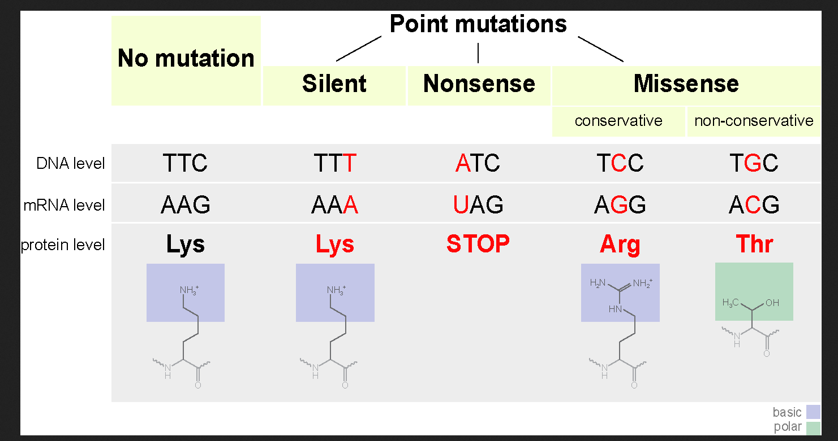

Slide 25
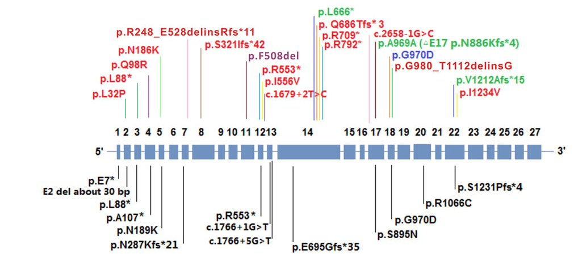
EXAMPLE:
Mutant allele in PURPLE is most common—others are rarer in this study of Chinese patients. http://www.nature.com/articles/hgv201563

Slide 26
For homework, watch the two videos below and hand in a 2-3 page reaction paper for each.
Video I—Living with Cystic Fibrosis
https://www.youtube.com/watch?v=Dn0grhu9h4g&t=17s
(Holly did a follow-up video in 2013 two yrs. later, but it is optional.
https://www.youtube.com/watch?v=p5QBcwd6JwE&t=17s#t=40.984222486
Video 2—My Life Expectancy
https://www.youtube.com/watch?v=mHfKs6n-mOo&t=22s

