Slide 1
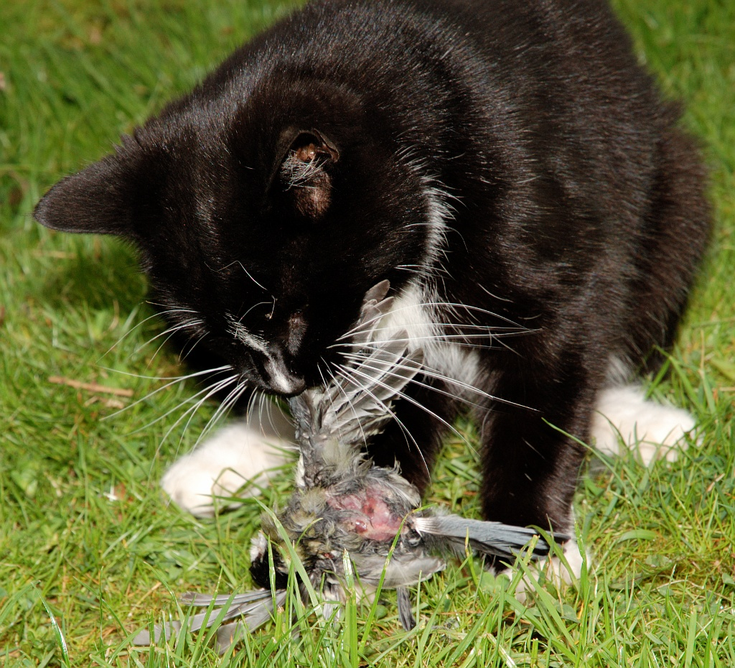
Cat vs. Bird:
Another Look at Complexity in Conservation
by Eric Ribbens Department of Biological Sciences Western Illinois University, Macomb, IL

Slide 2
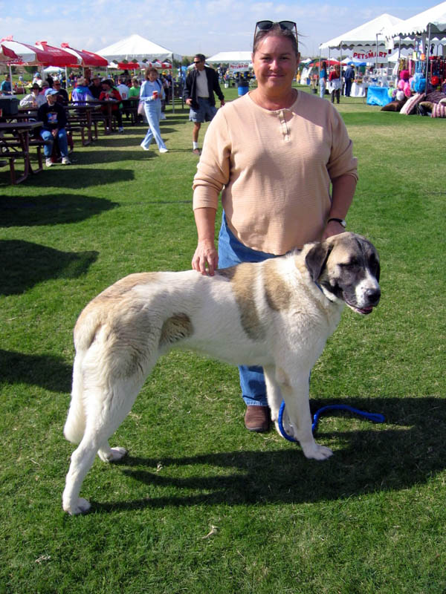
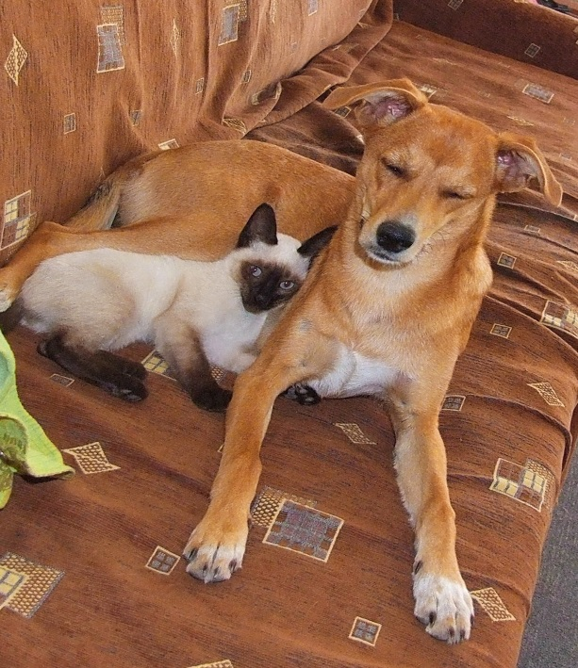
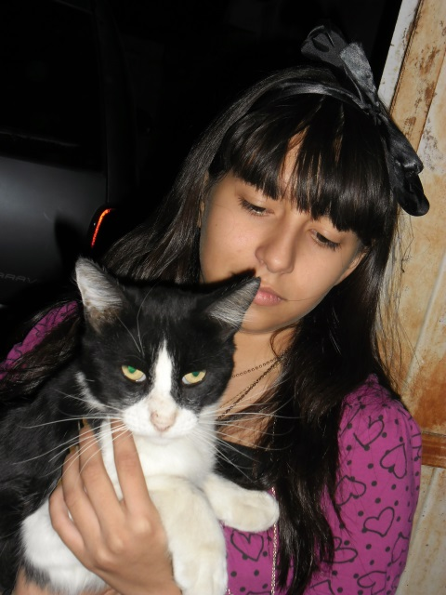
CQ#1: Are you a “cat person” or a “dog person”?
Cats!
Dogs!
Both.
It’s weird to love a pet.

Slide 3
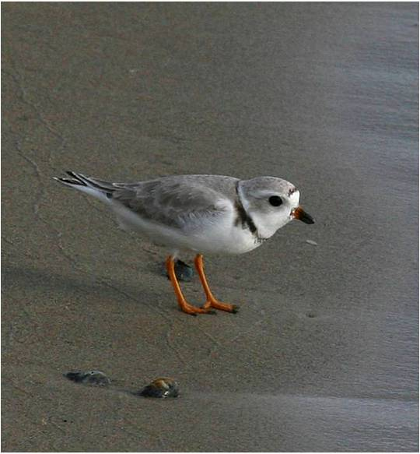
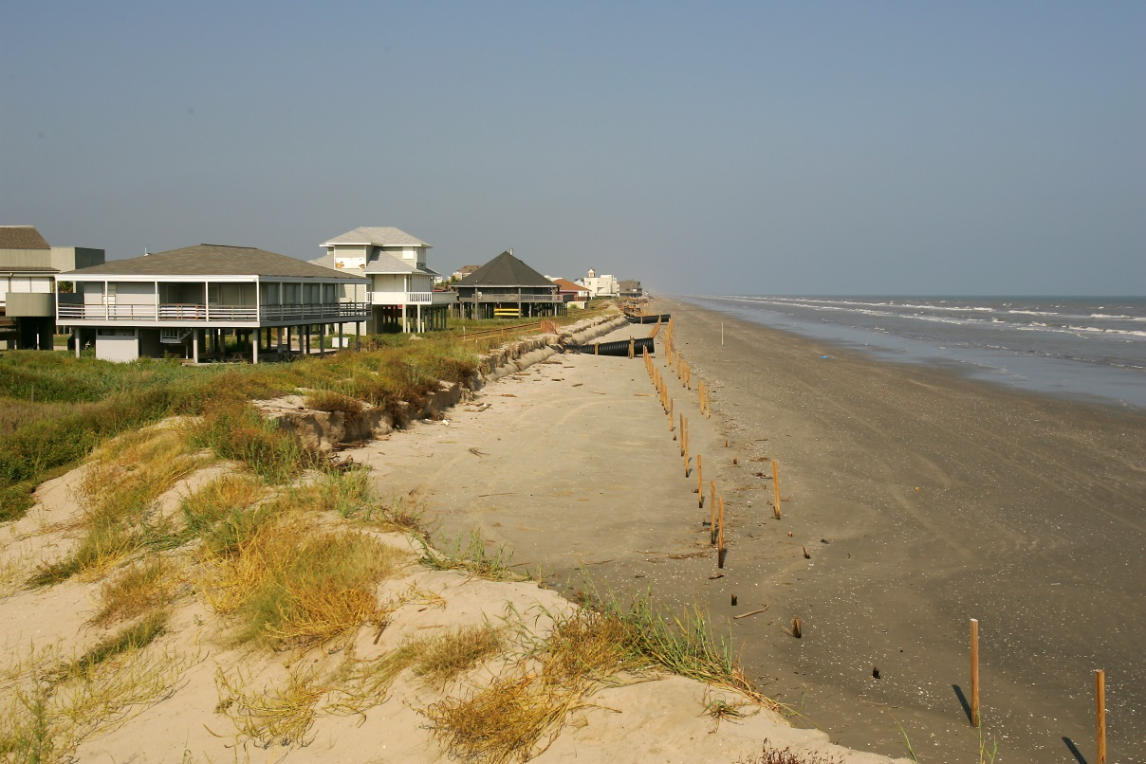
Galveston, Texas
Shoreline is habitat for many birds, including this piping plover.

Slide 4
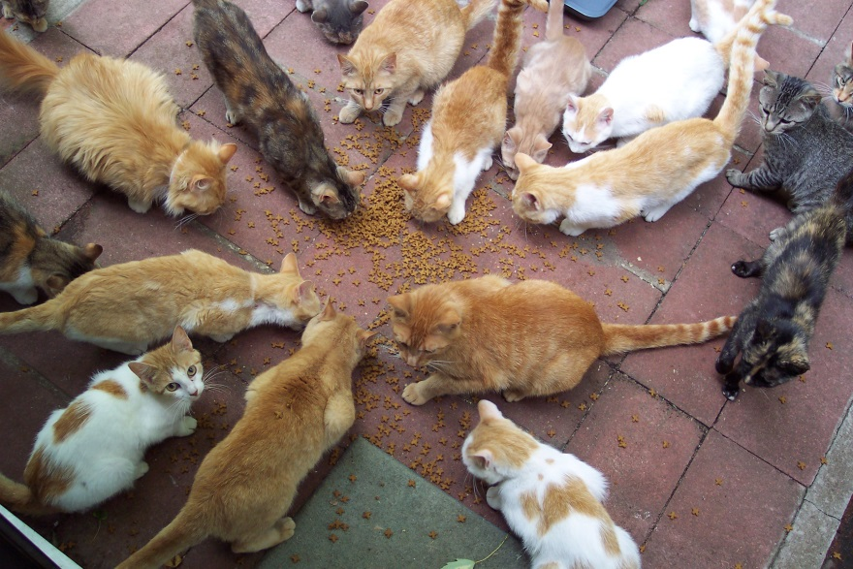
Conflicts
People
Beach
Winter range for the endangered piping plover
And people own cats

Slide 5
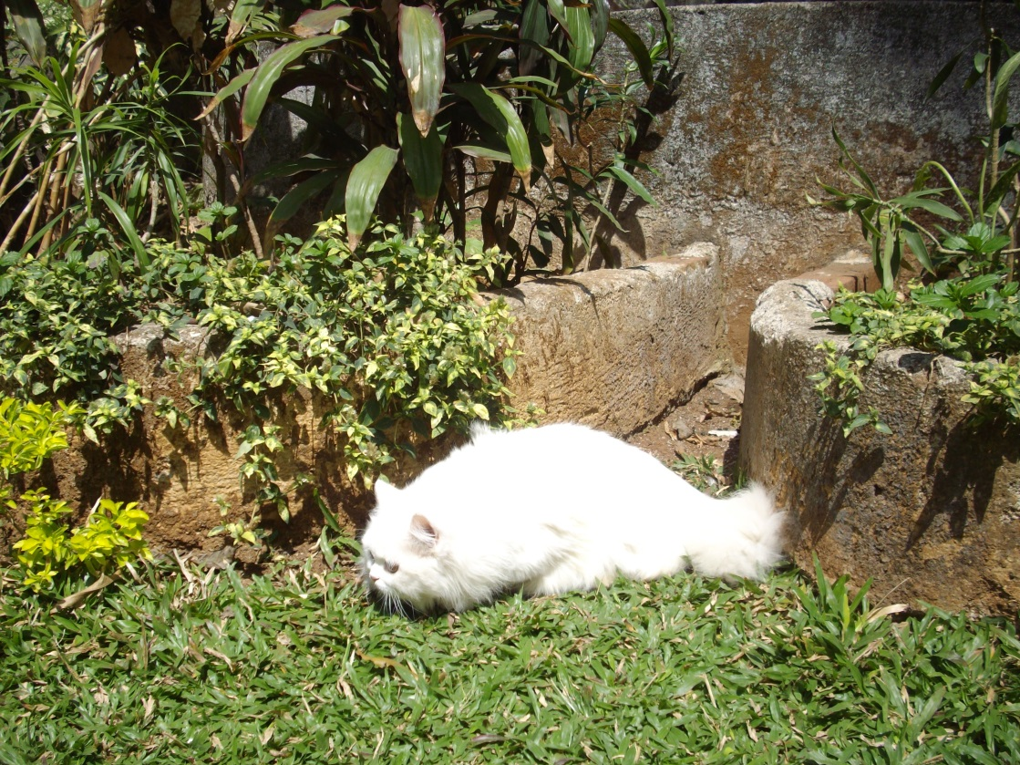
CQ #2: Should cats be allowed outside?
Yes, it’s their nature.
No, they damage the environment.

Slide 6
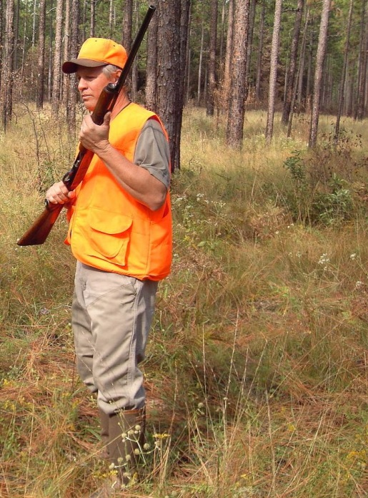
Galveston, November 2005
James Stevenson, an avid birder, protects critical habitat for piping plovers. 500,000 birders visit Galveston every year to watch piping plovers and other bird species.
He observed a cat hunting piping plovers and shot it, a regular practice of his.

Slide 7
CQ #3: What do you think?
Good for him! He’s protecting an endangered native species.
Bad for him! You shouldn’t kill cats.

Slide 8
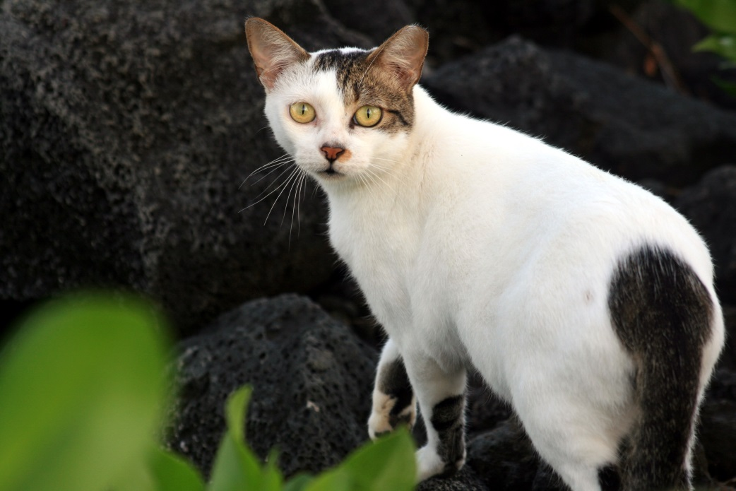
Mama Cat
Lived under a toll bridge.
One of the toll bridge operators, Mr. Newland, regularly gave Mama Cat some food.

Slide 9
CQ #4: What is the status of Mama Cat?
She’s a feral cat and isn’t owned by anyone, in a habitat where cats don’t belong.
She belongs to the toll booth operator Mr. Newland, and should be left alone.

Slide 10
“Catdefender Webblog:”
“Arch-villain James Munn Stevenson [is being tried] for gunning down a pregnant cat known as Mama Cat that he had previously wounded a few days earlier. Actually, this monster has been killing cats for more than a decade and his victims most likely number in the hundreds.”
Notes:
http://catdefender.blogspot.com/2008/01/serial-cat-killer-james-munn-stevensons.html

Slide 11
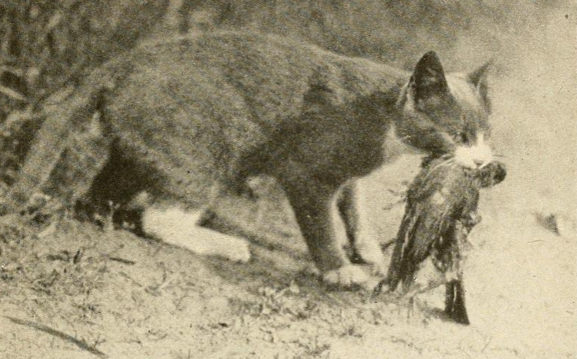
Texas Law: Illegal to Kill Pet Cats
Mr. Stevenson was tried for animal cruelty, under a state law that prohibited killing a cat “belonging to another.”
Should he be convicted?
Yes
No

Slide 12
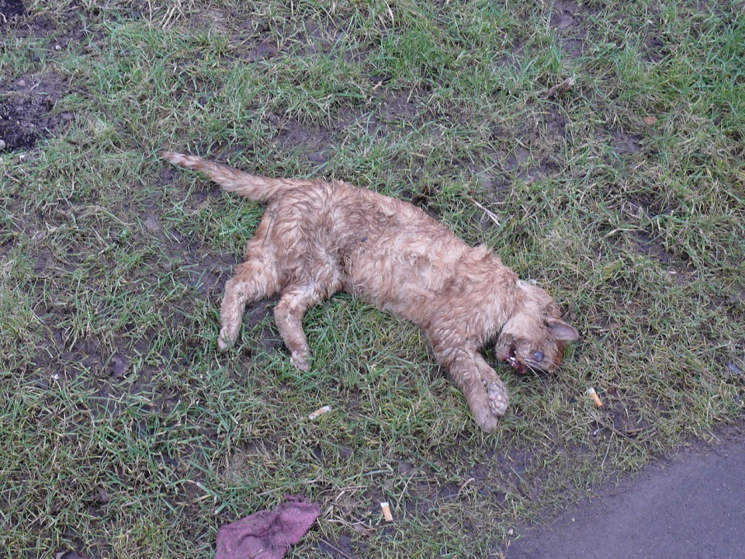
The Outcome
The jury could not agree on a verdict, so he was not convicted.
Texas changed the law to prevent the killing of any cat, whether pet or feral.

Slide 13
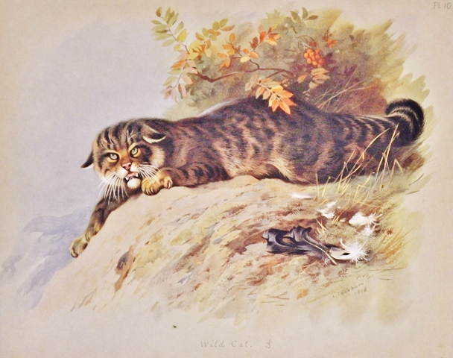
What do cats do?
Cats are native to Egypt and the mideast (e.g. Iran), and were first domesticated more than 4000 years ago.
We estimate there are 84 million pet cats in the United States, and another 30 to 80 million feral cats.

Slide 14
2013 study
Found each “free-range housecat” kills 23 to 46 birds and 129 to 338 tiny creatures per year.
Presumably the number is much higher for feral cats, since they get no pet food.
Huge uncertainty around numbers, but even pet lovers admit cats, including housecats, kill large numbers of wild animals, including an estimated 10% of all songbirds each year.
Notes:
Loss, S.R., T. Will, and P.P. Marra. 2013. The impact of free-ranging domestic cats on wildlife in the United States. Nature Communications.

Slide 15
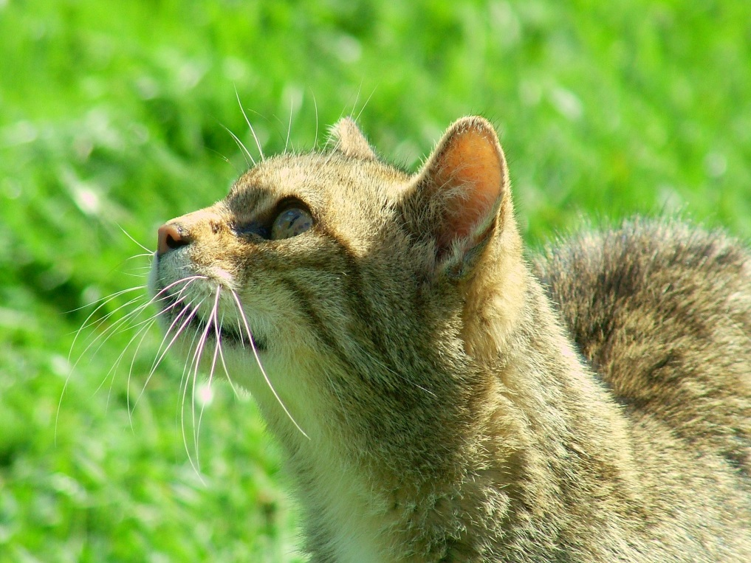
What should we do?
In groups of three or four, decide:
What should we do about letting housecats outside?
What should we do about feral cats?

Slide 16
What should we do?
Housecats are pretty easy. They don’t belong outside. Period. If you are a responsible cat owner, you don’t let your cat outside. Simple as that.
(If you need further incentive, a recent study of cats using video cameras found that more than 20% of them go down into sewers.)

Slide 17
But what about feral cats?
Feral cats should be trapped, neutered, and released.
Feral cats should be trapped and euthanized.
Cats are more important than songbirds. Leave them alone.

Slide 18
Image Credits
Slide 1
Description: A domestic black and white cat eating bird (possiblya Great Tit) on a lawn.
Source: By Flickr user dr_relling, downloaded from Flickr, https://www.flickr.com/photos/7955467@N03/3488673676.
Clearance: Used in accordance with CC BY-SA 2.0 (https://creativecommons.org/licenses/by-sa/2.0/deed.en).
Slide 2–left
Description: Girl with cat.
Source: By LechugaRdz, downloaded from Wikimedia Commons, https://commons.wikimedia.org/wiki/File:CatGirly.JPG.
Clearance: Used in accordance with CC BY-SA 3.0 (https://creativecommons.org/licenses/by-sa/3.0/deed.en).
Slide 2–center
Description: Anatolian Shepherd Dog showing scale compared to a person.
Source: By Elf, downloaded from Wikimedia Commons, https://commons.wikimedia.org/wiki/File:AnatolianShepherdDogAndPerson_wb.jpg.
Clearance: Used in accordance with CC BY-SA 3.0 (https://creativecommons.org/licenses/by-sa/3.0/deed.en).
Slide 2–right
Description: Dog and cat resting together.
Source: By Arantz, downloaded from Wikimedia Commons, https://commons.wikimedia.org/wiki/File:Cat_and_dog.JPG.
Clearance: Used in accordance with CC BY-SA 3.0 (https://creativecommons.org/licenses/by-sa/3.0/deed.en).
Slide 3–left
Description: Piping plover, of which there are only about 6,400 globally.
Source: By D Bales, downloaded from Wikimedia Commons, https://commons.wikimedia.org/wiki/File:Piping_Plover_%285643191797%29.jpg.
Clearance: Used in accordance with CC BY 2.0 (https://creativecommons.org/licenses/by/2.0/deed.en).
Slide 3–right
Description: Galveston, TX, Sept. 26, 2005.
Source: By Bob McMillan, FEMA, downloaded from Wikimedia Commons, https://commons.wikimedia.org/wiki/File:FEMA_-_16103_-_Photograph_by_Bob_McMillan_taken_on_09-26-2005_in_Texas.jpg.
Clearance: This image is a work of a Federal Emergency Management Agency employee, taken or made as part of that person's official duties. As works of the U.S. federal government, all FEMA images are in the public domain in the United States. Additional media usage information may be found at http://www.fema.gov/photo-video-audio-use-guidelines

Slide 19
Image Credits cont.
Slide 4
Description: Group of cats circle around food.
Source: By Scott Granneman, downloaded from Wikimedia Commons, https://commons.wikimedia.org/wiki/File:Group_of_cats_circle_around_catfood.jpg.
Clearance: Used in accordance with CC BY-SA 2.0 (https://creativecommons.org/licenses/by-sa/2.0/deed.en).
Slide 5
Description: Persian cat Matahari, aged 8 months, hunting in the garden in Mumbai.
Source: By Rudolph.A.furtado, downloaded from Wikimedia Commons, https://commons.wikimedia.org/wiki/File:Persian_cat_.Matahari'_hunting_..JPG.
Clearance: Released into the public domain by the author.
Slide 6
Description: Man with shotgun.
Source: By The Florida Fish and Wildlife Conservation Commission, downloaded from Wikimedia Commons, https://commons.wikimedia.org/wiki/File:Quail_Hunting_with_Dogs.jpg.
Clearance: This work is in the public domain in the United States because it is a work prepared by an officer or employee of the United States Government as part of that person’s official duties under the terms of Title 17, Chapter 1, Section 105 of the US Code. See Copyright.
Slide 7
Description: Thumbs up and down illustration.
Source: By Pratheepps, downloaded from Wikimedia Commons, thumbs up at https://commons.wikimedia.org/wiki/File:Symbol_thumbs_up.svg, thumbs down at https://commons.wikimedia.org/wiki/File:Symbol_thumbs_down.svg.
Clearance: Released into the public domain by the author.
Slides 8 and 9
Description: Feral cat.
Source: By Brocken Inaglory, downloaded from Wikimedia Commons, https://commons.wikimedia.org/wiki/File:Feral_cat_1.JPG..
Clearance: Used in accordance with CC BY-SA 3.0 (https://creativecommons.org/licenses/by-sa/3.0/deed.en).

Slide 20
Image Credits cont.
Slide 11
Description: Barn cat with bird.
Source: By Edward Howe Forbush, downloaded from Wikimedia Commons, https://commons.wikimedia.org/wiki/File:Barn_cat_with_bird.png.
Clearance: This work is in the public domain in the United States because it was published (or registered with the U.S. Copyright Office) before January 1, 1923.
Slide 12
Description: Dead cat.
Source: ByAntropomant, downloaded from Wikimedia Commons, https://commons.wikimedia.org/wiki/File:Dead_cat.jpg.
Clearance: Released into the public domain by the author.
Slide 13
Description: Scottish Wildcat illustration from British Mammals by A. Thorburn, 1920.
Source: By A. Thorburn, downloaded from Wikimedia Commons, https://commons.wikimedia.org/wiki/File:Wild_Cat.JPG.
Clearance: This media file is in the public domain in the United States. This applies to U.S. works where the copyright has expired, often because its first publication occurred prior to January 1, 1923.
Slides 15 and 16
Description: British wild cat.
Source: By Reg Mckenna from UK, downloaded from Wikimedia Commons, https://commons.wikimedia.org/wiki/File:British_Wild_Cat.jpg.
Clearance: Used in accordance with CC BY 2.0 (https://creativecommons.org/licenses/by/2.0/deed.en).

