Slide 1
Blood Suckers! A Case Study on Evolution and Speciation
by
Troy R. Nash
Department of Biology
Presbyterian College, Clinton, SC

Slide 2
Learning Objectives
At the end of this case study, you should be able to:
Compare and contrast the different mechanisms of speciation (allopatric, sympatric, parapatric, peripatric).
Explain how the founder effect alters the genetic diversity of populations and species.
Define reproductive isolation (pre-zygotic and post-zygotic) and apply these definitions to specific examples.
Interpret a cladogram showing genetic relationships amongst organisms.
Explain the importance of the iterative nature of scientific inquiry.

Slide 3
Lurking in the shadows…
These are the creatures from which nightmares come! They lie in wait, emerging at dusk to search for prey. Their approach is silent and stealthy, allowing them to attack and feed directly on the blood of their victims!!

Slide 4
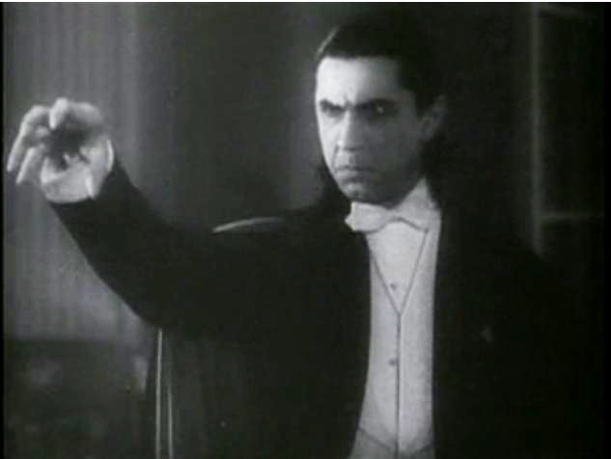
No, not this guy!!!

Slide 5
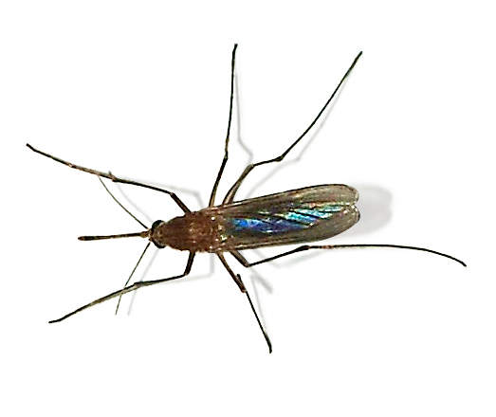
These guys!!!
Meet the common mosquito, Culex pipiens

Slide 6
The common mosquito, C. pipiens
The most common mosquito in the world, found on every continent except Antarctica.
Adult females primarily feed on birds.
After feeding, females lay eggs in stagnant water in open areas (fields, yards, gardens, etc.).
Reproduction and feeding stop when the weather turns cold, as the mosquitoes take refuge and survive off fat reserves (winter diapause).

Slide 7
The underground mosquito, Culex molestus
A relative of C. pipiens.
Lives in underground tunnels and caves.
Adult females primarily feed on humans and rodents.
Females do not need to feed before laying eggs, which occurs in confined spaces.
Feeding and breeding take place year round (no winter diapause).

Slide 8
The underground mosquito, C. molestus
One population of C. molestus, the so-called “London underground mosquito,” has been well studied.
Construction of the London subway tunnel system began in 1854. This population of mosquitoes first came to prominence during WWII however, when many Londoners survived the Germans’ bombs by living in the underground subway tunnels.

Slide 9
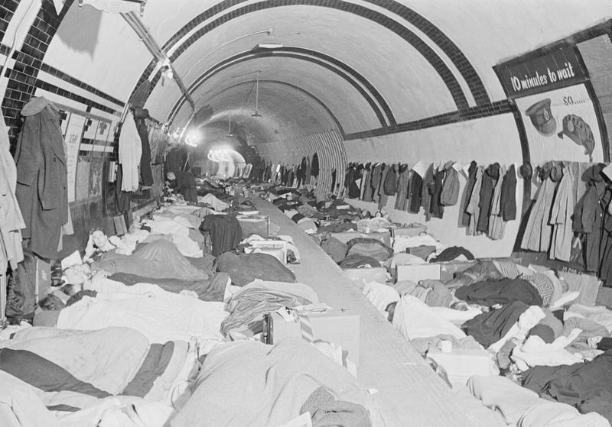
London Underground During the Blitz

Slide 10
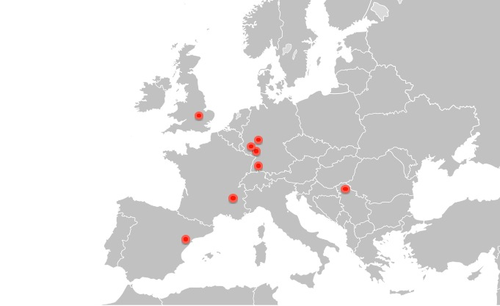
The underground mosquito, C. molestus
There are other populations of C. molestus in parts of western Europe

Slide 11
Clicker Question #1
How do you think the London population of C. molestus first arose?
Some individuals of C. molestus from elsewhere in Europe were accidently carried/migrated to London.
Some individuals of C. pipiens from aboveground London moved into the underground tunnel system, where nature selected for traits beneficial for the underground environment.
Both A and B are possible.
Neither A or B are possible.

Slide 12
Immigration or Selection?
Geneticists Kathryn Byrne and Richard Nichols wanted to answer that very question.
Byrne and Nichols collected C. pipiens from 12 different aboveground sites and C. molestus from 8 different underground sites.
They examined 20 different genes from each type of mosquito and examined the genetic differences of the mosquitoes against their geographic distribution.

Slide 13
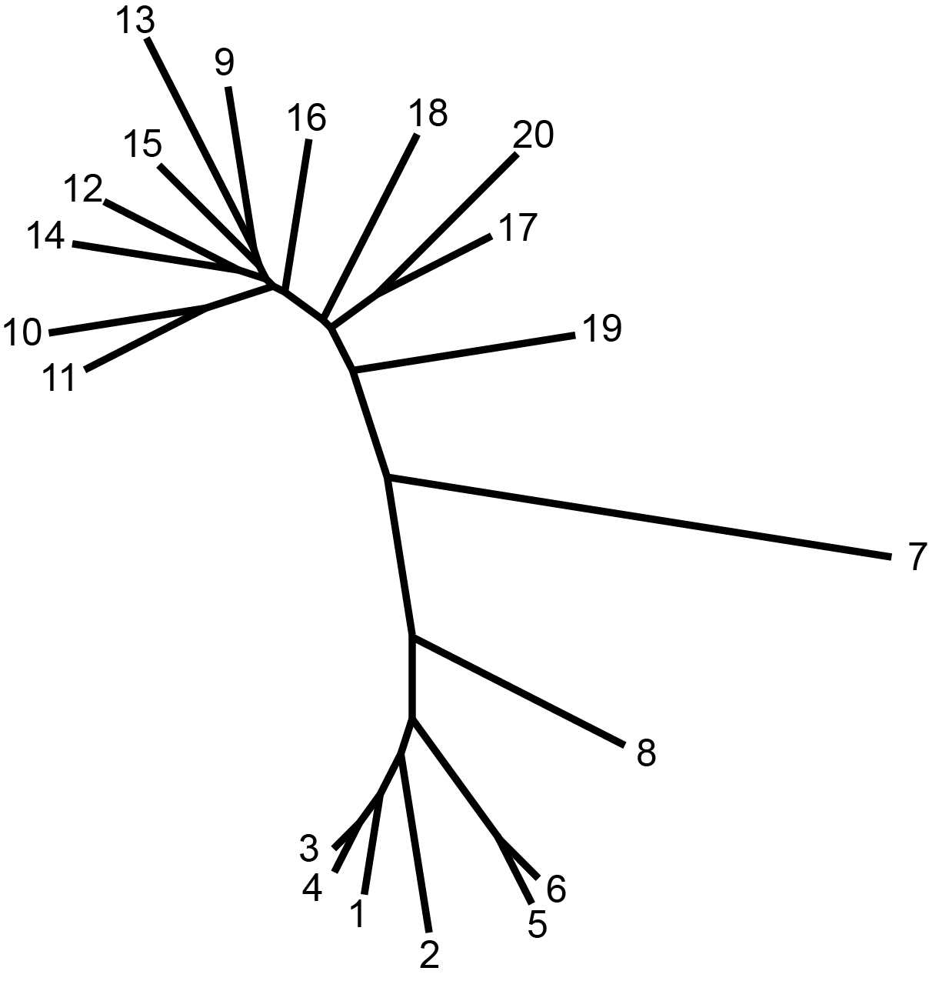
Neighbor Joining Tree of Data
These are all populations of C. pipiens collected from above ground in London
These are all populations of C. molestus collected from the London underground
This sample is from a laboratory-reared
population of C. molestus to serve as a control

Slide 14
Selection it is!!
The London C. molestus populations are more closely related to the nearby London C. pipiens surface population than to other C. molestus populations (the Mogden control sample).
Because of their genetic similarity, it is possible that the London C. molestus populations and the nearby London C. pipiens surface populations share a very recent common ancestor.
This divergence of London C. molestus from London C. pipiens most likely occurred since construction of the London underground first began… only 150 years!

Slide 15
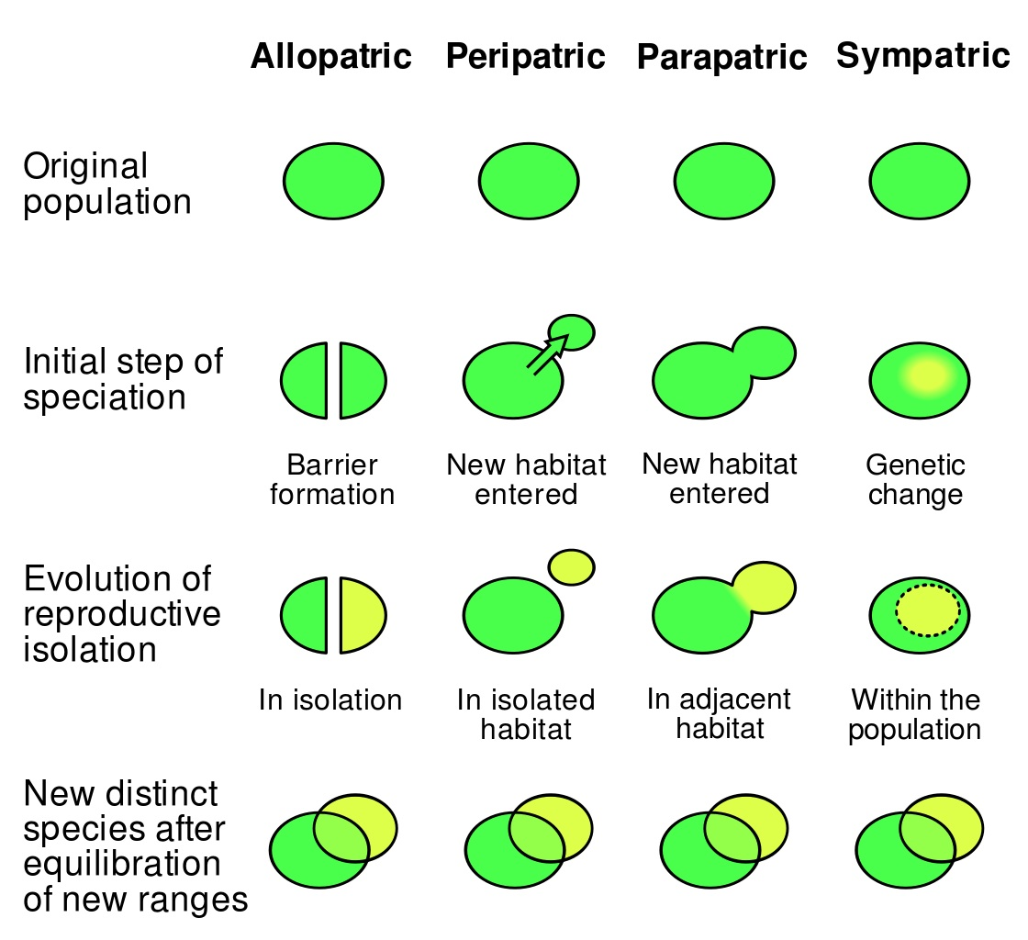
How does one population split from another?

Slide 16
Take 3-4 minutes and compare/contrast these four mechanisms in your group.

Slide 17
Clicker Question #2
Which of these do you think best represents the divergence of C. molestus from C. pipiens, as described by Byrne and Nichols?
Sympatric
Allopatric
Peripatric
Parapatric

Slide 18
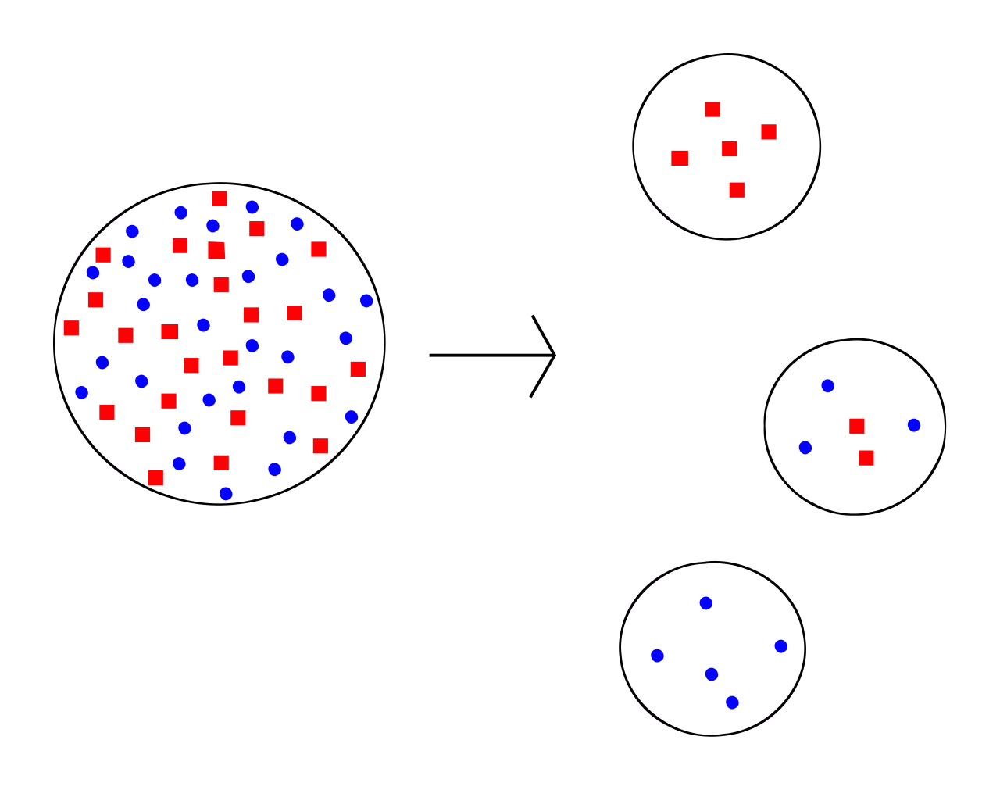
Further Data for Consideration
When a new population is started from a subset of a larger population, the genetic make-up of the new population is often different than the original. This is known as the founder effect.

Slide 19
Take 3-4 minutes and discuss in your groups how the “founder effect” changes the genetic make-up of the new, smaller populations.

Slide 20
Clicker Question #3
If C. molestus was a founder population that derived from the surface C. pipiens population, you would expect _____ genetic diversity in the C. molestus population as compared to C. pipiens?
more
less
the same
Byrne and Nichols found that the genetic diversity among the underground C. molestus population was only about 25% of the surface C. pipiens population! This provides further evidence for the divergence and adaptation theory.

Slide 21
So, what’s next?
Based on the data from Byrnes and Nichols, it appears that the C. molestus populations in the London underground represent a one-time divergence from the nearby surface population of C. pipiens. Does this divergence actually equate to speciation though? That is, are C. molestus and C. pipiens different species, or are they just different populations of the same species living in different locations?
In your groups, take 10-15 minutes to discuss this. Come up with a hypothesis and outline an experimental design to test your hypothesis. Be prepared to explain your hypothesis and experimental design to the class.

Slide 22
Here’s what Byrne and Nichols did…
They paired:
C. molestus females with C. molestus males from the same underground location in London (control).
C. molestus females with C. molestus males from different underground locations in London.
C. molestus females with C. pipiens males from surface populations in London.
Then they watched to see if reproduction occurred. If it did, they tested the ability of the offspring to reproduce as well.

Slide 23
Here’s what Byrne and Nichols saw…
C. molestus females paired with C. molestus males from the same underground location in London produced viable, fertilized egg rafts. These eggs hatched and produced reproductively viable adults.
C. molestus females paired with C. molestus males from different underground locations in London produced viable, fertilized egg rafts. These eggs hatched and produced reproductively viable adults.
C. molestus females with C. pipiens males from surface populations in London did not produce any fertilized egg rafts.

Slide 24
Clicker Question #4
It appears that C. molestus and C. pipiens are different species caused by _____ reproductive isolation.
pre-zygotic
post-zygotic
probiotic
nomadic

Slide 25
Conclusions from Byrne and Nichols
Within the past 150 years (since construction of the London underground began), speciation has occurred in the mosquito population in London.
A small group of individuals from the surface C. pipiens population migrated to the underground subway tunnel system.
With each passing generation, the new underground population became more and more adapted to that environment… remember the differences in C. pipiens and C. molestus discussed earlier?
At some point, the new underground population was different enough from the original surface population that mating was no longer possible.

Slide 26
Cool Story, Huh?
Except, it may not be entirely accurate…
In 2012, Becker et al. did some further research
They collected C. pipiens from 8 different locations and C. molestus from 6 different locations in Europe.
They also collected several other related species of mosquitoes from Europe.
The researchers then examined 11 different genes and used the genetic differences to create a mosquito “family tree” (a cladogram).

Slide 27
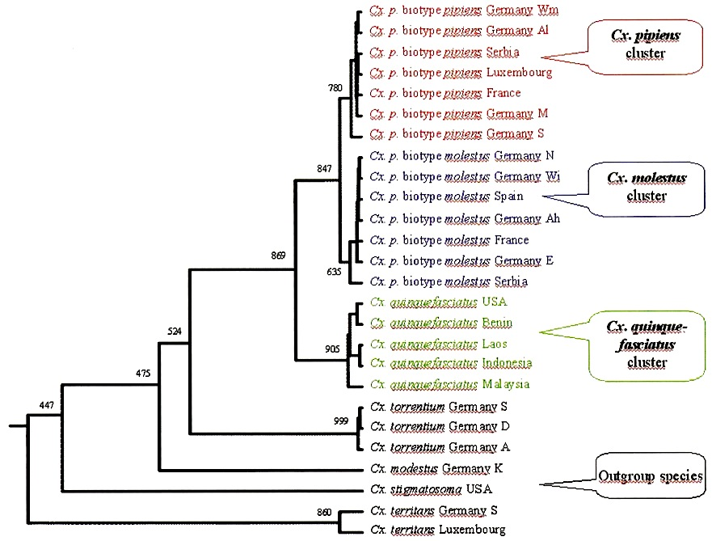
Mosquito Family Tree
Notice that the experimenters examined C. molestus and C. pipiens from several different countries. They also examined a few other species, C. quinquefasciatus, C. torrentium, etc., for additional comparison. They also use an “outgroup” species from the United States.

Slide 28
How does this compare with the findings of Byrne and Nichols?
Take 5 minutes and discuss in your groups. What conclusions can you draw?

Slide 29
What Becker et al. concluded…
It appears that C. molestus and C. pipiens are separate species, which confirms the same conclusion by Byrne and Nichols.
Regardless of geographic location, all of the populations of C. molestus group together and all of the populations of C. pipiens group together.
It is likely that the divergence of C. molestus and C. pipiens in Europe happened one time in one location, rather than happening independently in multiple locations.
The London underground mosquito probably does not represent a local divergence from aboveground C. pipiens.

Slide 30
Individual Two-Minute Essay
Write your own wrap-up from these two studies…
What could Byrne and Nichols have done differently to strengthen their argument?
Why is it important for scientists to continually reexamine ideas and conclusions?
What do you think the next steps should be?

Slide 31
Slide Credits
Slide 1 – Blood drop (licensed image ©arkhom | Fotolia, ID#66322675)
Slide 4 – Bela Legosi as Dracula (Public Domain)
Slide 5 – Culex pipiens by Alves Gaspar (CC BY-SA 3.0)
Slide 9 – London Underground (Public Domain)
Slide 10 – Author, based on map of Europe (Public Domain)
Slide 13 – Author, based on Euclidean distances provided in: Byrne, K. and Nichols, R. A. 1999. Culex pipiens in London Underground tunnels: differentiation between surface and subterranean populations. Heredity 82: 7–15.
Slide 15/16 – Speciation Diagram by Ilmari Karonen (CC BY-SA 3.0)
Slide 18/19 – Founder Effect Diagram (Public Domain)
Slide 27/28 – Culex sp. Dendrogram Figure from Becker, N., Jost, A., and Weitzel, T. 2012. The Culex pipiens complex in Europe. Journal of the American Mosquito Control Association 28 (supplement to No. 4): 53–67.
Slide 33 (alternate Slide 13) – Principal Coordinate Analysis Figure from Byrne, K. and Nichols, R. A. 1999. Culex pipiens in London Underground tunnels: differentiation between surface and subterranean populations. Heredity 82: 7–15.

Slide 32
Acknowledgments
This material is based upon work supported by the National Science Foundation under Grant No. 1323355.
Any opinions, findings, and conclusions or recommendations expressed in this material are those of the author and do not necessarily reflect the views of the National Science Foundation.

Slide 33
Principal Coordinate Analysis of the Data
These are all populations of C. pipiens collected from above ground in London
This sample is from a laboratory-reared
population of C. molestus to serve as a control
These are all populations of C. molestus collected from the London underground
Figure adapted by permission from Macmillan Publishers Ltd: Heredity 82, 7–15, copyright 1999.
Notes:
ALTERNATE SLIDE 13

