Slide 1
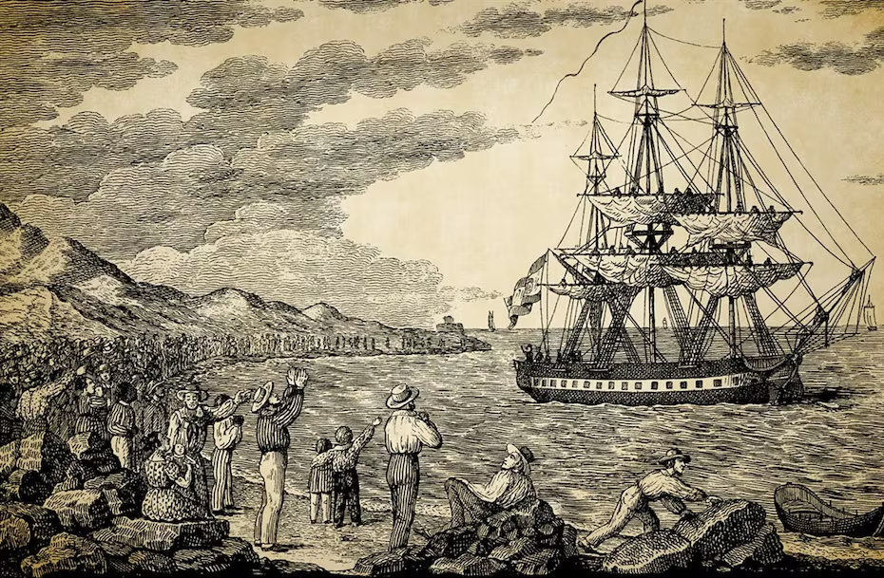
NATIONAL CENTER FOR CASE STUDY TEACHING IN SCIENCE
Challenges in Vaccine Delivery: The Balmis Expedition Viewed Through a 21st-Century Lens
by
Nancy Boury and Harshita Sharma
Plant Pathology, Entomology, and Microbiology
Iowa State University, Ames, IA
Notes:
Image Credit: Etching by Francisco Pérez of the departure of the María Pita from the port of La Coruña, November 30, 1803.

Slide 2
Learning Outcomes Upon completion of this case study, you should be able to:
Describe the development of the first vaccine by Edward Jenner.
Compare and contrast the different types of vaccines in terms of effectiveness, potential risks, and stability.
Differentiate between primary and secondary immune responses.
Use the Belmont Report to evaluate ethically complex situations.

Slide 3
Smallpox is an ancient and deadly disease.
Smallpox is a serious communicable infection caused by the variola virus.
People who have smallpox have a fever and a distinctive, progressive skin rash.
Historically, about 3 people out of every 10 people with the disease died (mortality rate of about 30%).
Many people who survived the disease would have permanent scarring. Some were also left blind.
Smallpox is an ancient disease, possibly seen as early as 1157 BC (in Egyptian Pharoah Ramses V).
Variolation was a process intended to reduce this risk, with people intentionally being exposed to a “mild” case of smallpox to protect themselves against a more serious infection. This was not without risk, as the level of illness was often due to differences in immunity.
Notes:
Centers for Disease Control and Prevention (CDC). 2025. Smallpox: About. CDC. https://www.cdc.gov/smallpox/about/index.html. Accessed 12 June 2025.
Wertheim, J. O. (2017). Viral evolution: mummy virus challenges presumed history of smallpox. Current Biology, 27(3), R119-R120.
Penn Museum. 2025. A Journey into the Human Body. Penn Museum. https://www.penn.museum/sites/expedition/a-journey-into-the-human-body/. Accessed 12 June 2025
NBC News. 2014. Smallpox Vials Discovered in Lab Storage Room, CDC Says. NBC News. https://www.nbcnews.com/health/health-news/smallpox-vials-discovered-lab-storage-room-cdc-says-n150806 . Accessed 12 June 2025

Slide 4
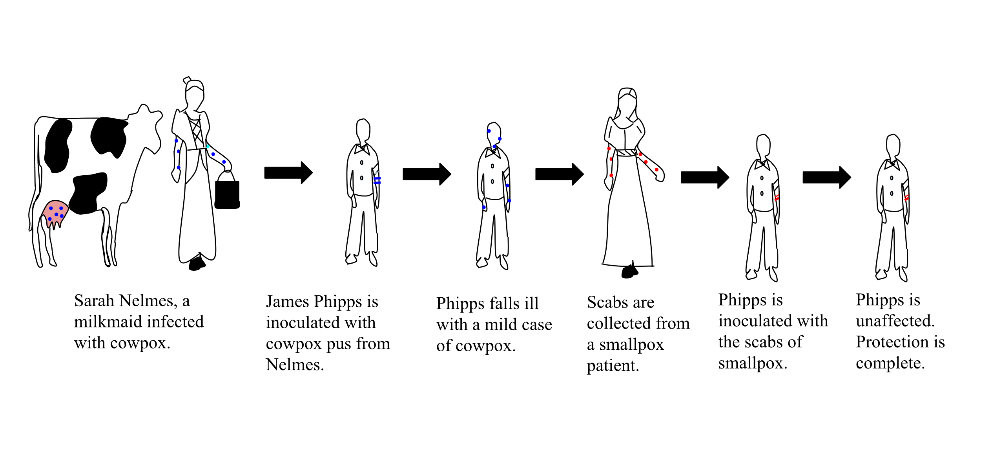
In the 1790s, Dr. Edward Jenner published a report that cowpox could be used to prevent smallpox infection.
He noticed that the milkmaids had clear skin and were not afraid to care for relatives with smallpox.
When he asked Sarah Nehm, a local milk maid, she said she had cowpox so couldn’t get smallpox.
To test this idea, he inoculated James Phipps, the 8-year-old son of his gardener.
After 6 weeks, Jenner inoculated James with smallpox and found James was protected.
Jenner repeated this over 20 times to demonstrate James had long-lasting protection.
Srcyr16, CC BY-SA 4.0 <https://creativecommons.org/licenses/by-sa/4.0>, via Wikimedia Commons
Notes:
(File:Edward Jenner- Smallpox.svg - Wikimedia Commons)
https://commons.wikimedia.org/wiki/File:Edward_Jenner-_Smallpox.svg
FYI James Phipps was inoculated over 20x with Smallpox – never got it.

Slide 5
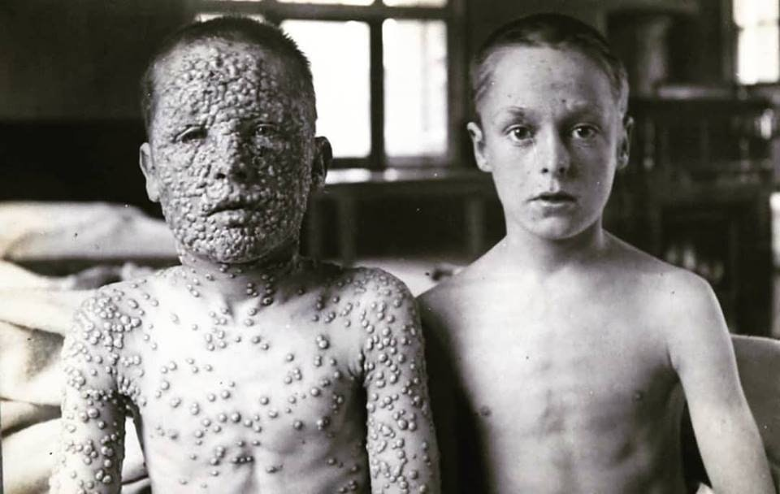
Effectiveness of vaccine: two 13-year-old boys exposed to the same smallpox source.
The boy on the left was unvaccinated
The boy on the right was vaccinated
Notes:
5. New Sydenham Society. 1907. Atlas of Clinical Medicine, Surgery, and Pathology. Internet Archive. https://archive.org/details/atlasofclinicalm00newsyd. Accessed 12 June 2025.
Discussion Questions
Why did Dr. Jenner choose a child as his test subject?
Would James have been a good test subject if he had had smallpox before? Why?
Was James safe throughout this testing?

Slide 6
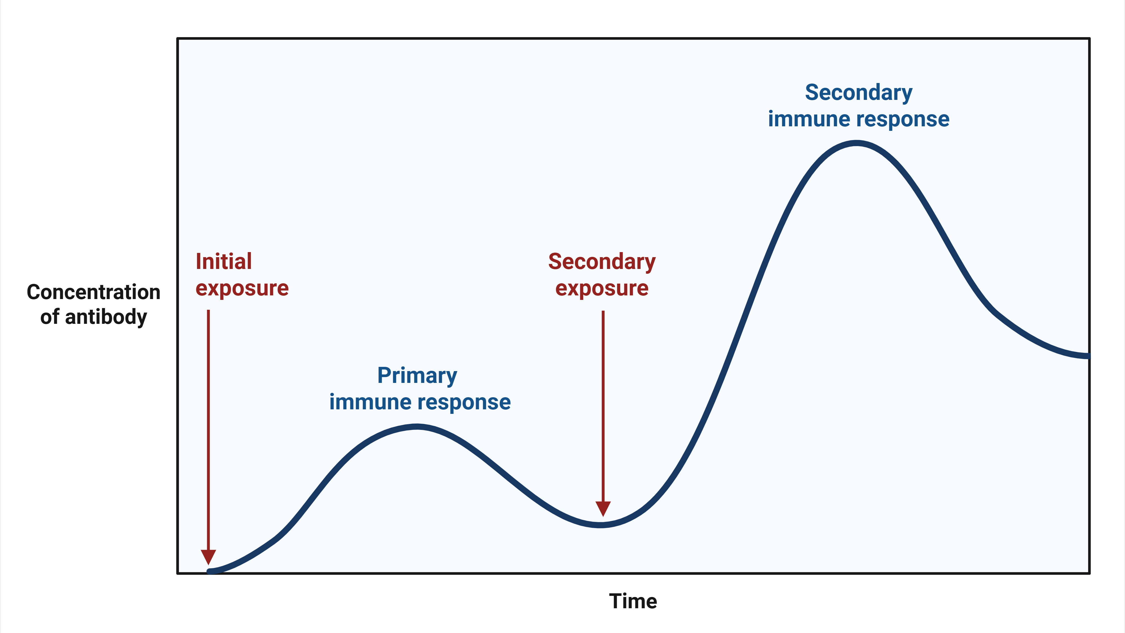
How did James escape getting Smallpox?
Cowpox and smallpox are similar enough that the human immune response, developed in response to cowpox infection, will protect the vaccinated person from smallpox.
There are two general ways to gain immunity:
Active immunity – individuals are challenged with antigens that cause them to develop memory B and T cells leading to a secondary response upon the next exposure.
Passive immunity – individuals are given pre-made antibodies or immune cells. This is very quick, but does not last long, as the antibodies are cleared by the recipient’s immune response.
There are two ways exposure can happen:
Naturally – without direct human intervention.
Artificially – with human intervention.
Notes:
Created in BioRender. Peters, N. (2025) https://BioRender.com/hbb3fsa

Slide 7
There are advantages to each of these.
 | Natural | Artificial
Passive | Transfer of antibody from mother to infant (both via placenta and breast milk) | Gathering serum from recovered patients is given to another patient as therapy (e.g. anti-sera)
Active | Individual exposed to antigens during an illness and recovery | Individual exposed to antigens by vaccination (mRNA, protein, killed, or attenuated)
Passive immunity gives immunity rapidly
Active immunity takes longer to develop, but lasts much longer

Slide 8
There are many different ways to create active immunity.
Classes of Vaccines
Class | Description | Advantages | Disadvantages | Examples –vaccines against:
Live attenuated | Weakened strain of whole pathogen | Cellular and humoral immunity | Difficult to store and transport | Chickenpox, German measles, measles, mumps, tuberculosis, typhoid fever, yellow fever
 |  | Long-lasting immunity | Risk of infection in immunocompromised patients
 |  | Transmission to contacts | Risk of reversion
Inactivated | Whole pathogen killed or inactivated with heat, chemicals, or radiation | Ease of storage and transport | Weaker immunity (humoral only) | Cholera, hepatitis A, influenza, plague, rabies
 |  | No risk of severe active infection | Higher doses and more boosters required
Subunit | Immunogenic antigens | Lower risk of side effects | Limited longevity | Anthrax, hepatitis B, influenza, meningitis, papillomavirus, pneumococcal pneumonia, whooping cough
 |  |  | Multiple doses required
 |  |  | No protection against antigenic variation
Toxoid | Inactivated bacterial toxin | Humoral immunity to neutralize toxin | Does not prevent infection | Botulism, diphtheria, pertussis, tetanus
Conjugate | Capsule polysaccharide conjugated to protein | T-dependent response to capsule | Costly to produce | Meningitis (Hemophilus influenzae, Streptococcus pneumoniae, Neisseria meningitides)
 |  |  | No protection against antigenic variation
 |  | Better response in young children | May interfere with other vaccines
RNA | mRNA for a single protein in a lipid vesicle | Cheaper and quicker to develop | Newer technology, so public mistrust | COVID-19
Notes:
6. Andey, T., Soni, S., & Modi, S. (2024). Conventional vaccination methods: Inactivated and live attenuated vaccines. Advanced Vaccination Technologies for Infectious and Chronic Diseases, 37-50.

Slide 9
Clicker Question Break

Slide 10
CQ1: What is the goal of vaccination?
To treat existing illness by causing a primary response to a dangerous antigen.
To treat chronic illness by stimulating a secondary response to a non-dangerous antigen.
To prevent future illness by causing a primary response to a non-dangerous antigen.

Slide 11
CQ2: You are bitten by a rattlesnake and receive anti-venom in the ER. What type of immunity does the anti-venom confer?
Natural, passive immunity
Artificial, passive Immunity
Natural, active immunity
Artificial, active immunity

Slide 12
CQ3: If you were designing a vaccine for a low-resource area with limited accessibility, which vaccine type would work best?
Sub-unit vaccine
Live, attenuated vaccine
mRNA vaccine
Inactivated vaccine
Notes:
Note – multiple correct responses. Inactivated vaccines are easier to transport but require boosters. Live-attenuated are more effective but require a cold chain.

Slide 13
Europeans brought smallpox to North and South America.
Native Americans were more susceptible than Europeans to several diseases that were endemic to Europe, and smallpox and measles were two of the worst.
The introduction of these new diseases had a devastating effect on the Native American populations.
Tenochtitlan (modern Mexico City) had ~ 20-25 million people in the 1400s; by the 1600s its population had dropped to ~2 million.
While the case fatality rate (CFT) was as high as 30% in Europe, smallpox often had a CFT of over 50% in the Americas.
Notes:
7. Mark, C., & Rigau-Pérez, J. G. (2009). The world's first immunization campaign: the Spanish Smallpox Vaccine Expedition, 1803–1813. Bulletin of the History of Medicine, 63-94.

Slide 14
Shortly after Jenner’s discovery and the spread of vaccine throughout Europe, New Granada (now Columbia) had an epidemic of Smallpox.
If you’re the king of Spain, and the governors of these colonies ask for help, how can you help? (This was not the only Spanish colony affected.)

Slide 15
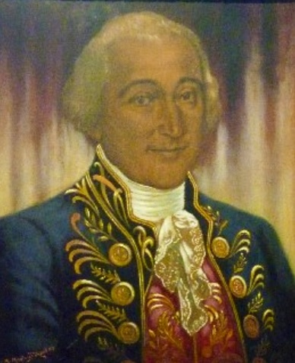
The cowpox virus was a “live” vaccine – effective, but can be “killed” by mishandling.
When King Charles of Spain asked his court physician (Dr. Joseph Flores) to send the vaccine to South America, Dr. Flores ordered samples of lymph (with cowpox virus) sent on two fast ships.
In the early 1800s, it took ~6 weeks to cross the Atlantic Ocean.
When the lymph arrived in South America, it had dried out and was ineffective.
Discussion: Do you think dried lymph would have worked if this was a killed or subunit vaccine?
Discussion: How is the smallpox vaccine like measles (MMR) and COVID-19 mRNA vaccines?
Dr. Joseph Flores
Notes:
File:Jose Felipe Flores.jpg - Wikimedia Commons - public domain (published prior to 1930)

Slide 16
Transport of Vaccines is an important consideration for ALL vaccines.
In modern times, live and mRNA vaccines need a cold chain to keep them active.
Subunit and killed vaccines can be freeze-dried, so are not temperature-sensitive.
Notes:
8. Centers for Disease Control and Prevention (CDC). (2025). Vaccine Storage and Handling Resources. Retrieved from https://www.cdc.gov/vaccines/hcp/storage-handling/resources.html

Slide 17
How could King Charles of Spain bring the smallpox vaccine to South America from Spain?
In other words, how can you transport the cowpox virus for six weeks, with early 1800s technology, and have it usable at the end of the journey?

Slide 18
The Royal Philanthropic Vaccine Expedition (aka Balmis Expedition)
November 30, 1803, Maria Píta set sail from the port of Ciádez to the Americas.
The ship housed 22 orphans (aged 3-10) from a Spanish orphanage.
They had a governess, Balmis, 3 nurses, a surgeon, and 2 assistants to manage the vaccination schedule on board.
At the start of the trip, 2 orphans were inoculated with cowpox.
Every 9-10 days a new set of boys would be inoculated.
February 9, 1804 the Maria Píta arrived in Puerto Rico and traveled throughout the region.
Enslaved girls carried the vaccine from Cuba to Mexico.

Slide 19
Impact of the Balmis Expedition
This was a 10-year campaign (1803-13) – with 62 orphans and enslaved children carrying the vaccine. Balmis traveled to the Philippines, while his deputy surgeon, Salvany, travelled throughout South America.
The original orphaned children from Spain were left in Mexico under the care of the Bishop of Puebla. In Mexico (after vaccinating ~100,000 people), Balmis’s group recruited 25 more orphaned children to help transmit the vaccine to Philippines.
Parents entrusted the expedition to care for their sons for momentary gain and a promise that the children would be returned to them.
Conditions were over-crowded, poor food, and four boys died.
It is estimated that close to 20,000 people were vaccinated in Philippines through the expedition. The crew also faced resistance from many areas (especially those with different political agendas, financial goals and cultural beliefs).
Salvany traveled throughout South America, through the Amazon jungle, Andes Mountains, and the Caribbean. He died in Bolivia in 1810 after immunizing over 200,000 people.
Notes:
9. Franco-Paredes, C., Lammoglia, L., & Santos-Preciado, J. I. (2005). The Spanish royal philanthropic expedition to bring smallpox vaccination to the New World and Asia in the 19th century. Clinical Infectious Diseases, 41(9), 1285-1289.
10. Patowary, K. (2020, December 29). Balmis Expedition: How Orphans Took The Smallpox Vaccine Around The World. Amusing Planet. Retrieved from https://www.amusingplanet.com/2020/12/balmis-expedition-how-orphans-took.html
11. Mark, C., & Rigau-Pérez, J. G. (2009). The world's first immunization campaign: the Spanish Smallpox Vaccine Expedition, 1803-1813. Bull Hist Med, 83(1), 63-94. doi:10.1353/bhm.0.0173.
12. Tarrago, R. E. (2001). The Balmis-Salvany Smallpox Expedition: The First Public Health Vaccination Campaign in South America. Pan American Health Organization. Retrieved from https://www3.paho.org/english/dd/pin/Number11

Slide 20
Clicker Question Break

Slide 21
CQ4: What kind of vaccine was the smallpox vaccine that Jenner developed?
Subunit / inactivated
Killed
Live, attenuated
Whole cell

Slide 22
CQ5: What kind of immunity did the people who survived smallpox after infection vs people who got the vaccine have?
Artificial active immunity, artificial passive immunity
Natural passive immunity, artificial active immunity
Natural active immunity, artificial active immunity
Natural passive immunity, natural artificial immunity

Slide 23
CQ6: What was the most significant challenge King Charles of Spain faced when the Spanish colonies had an outbreak of smallpox in the early 1800s?
The vaccine did not work if the cowpox virus was inactive.
10% of the people getting the vaccine died within two months.
Most people were afraid that they would turn into a cow when they took the vaccine.
Since Queen Elizabeth’s ships destroyed the Spanish armada, Spain lacked ships to transport the vaccine.

Slide 24
Looking at the Balmis Expedition through a modern lens on human subjects' research
Was this expedition ethical?
How do we define “ethical” with human subject’s research?

Slide 25
Nuremberg Code
After World War II, the Allies discovered several people that the Nazis had subjected to brutal conditions and “medical experiments.”
During the Nuremberg trials, the governments participating declared that all people were entitled to basic human rights and laid out basic rules for human experimentation.
Three key tenets of the Nuremberg Code are:
Human subjects must give voluntary consent.
Any experiments involving humans must be based on prior animal experiments.
Experiments should benefit society and cannot include procedures likely to cause death or disability.
Notes:
13. Office of Research Integrity (ORI). (2025). The Protection of Human Subjects: Nuremberg Code Directives on Human Experimentation. Retrieved from https://ori.hhs.gov/content/chapter-3-The-Protection-of-Human-Subjects-nuremberg-code-directives-human-experimentation

Slide 26
There were several unethical “experiments” in the US during the 1950-1970s that lead to the Belmont Report.
Experiments in the Jewish Chronic Disease Hospital included injecting live cancer cells into hospitalized patients without their consent.
A different group of researchers (Willowbrook) used institutionalized, developmentally disabled individuals to study the natural course of hepatitis infection, meaning the scientists directed the test subjects to ingest feces.
The Tuskegee syphilis study lasted over 35 years, depriving hundreds of Black men of medical care for syphilis to study the long-term effects of the disease, even after knowing the cure for syphilis.

Slide 27
Three Core Principles of the Belmont Report
Researchers need to respect the autonomy of potential research participants.
People have the right to make informed decisions and that care must be taken when working with vulnerable populations, such as prisoners, children, mentally challenged, or otherwise incapacitated or coercible individuals.
Researchers need to work from a principle of beneficence.
Do no harm, minimize risks, and maximize benefits to potential test subjects and society as a whole.
The Belmont Report emphasizes justice or fairness to all people.
The group of people bearing the majority of the risk of an experimental study benefit the most from the data gathered.
Potential participants cannot be penalized for not participating in a research study.

Slide 28
Clicker Question Break

Slide 29
CQ7: What led to the development of the Nuremberg Code?
The Tuskegee experiment with African American subjects.
Medical experiments in the Jewish Chronic Disease Hospital.
Human medical experimentation by the Nazis.
Studies using disabled individuals as test subjects to study hepatitis.

Slide 30
CQ8: Modern research that involves human subjects requires that participants provide informed consent. Which aspect of the Belmont Report does informed consent address?
Respect for the autonomy of the participants
Monetary compensation
Beneficence
Justice

Slide 31
Which principles of the Belmont Report apply to:
Jenner and James Phipps
Orphans from Spain
Enslaved Children

Slide 32
Take Home Message
Smallpox was a devastating disease with a long history. It is also the first infectious disease with a vaccine.
Vaccines vary in type (subunit, killed, live-attenuated, mRNA), durability (live and mRNA vaccines are more fragile), and usefulness (live vaccines are typically more effective for longer than heat killed or subunit vaccines).
Some vaccines require extraordinary effort and resources to transport to at-risk populations. This was true in the 19th century, and still true in the 21st century.
Researchers have strict rules to follow when experimenting on human subjects. The Nuremberg Code and Belmont Report describe the spirit of these rules: autonomy (informed consent must be freely given and revocable), beneficence (do no harm, animal studies first, research of value to society), justice (risk = benefit).

Slide 33
References
Centers for Disease Control and Prevention (CDC). 2025. Smallpox: About. CDC. https://www.cdc.gov/smallpox/about/index.html. Accessed 12 June 2025.
Wertheim, J. O. (2017). Viral evolution: mummy virus challenges presumed history of smallpox. Current Biology, 27(3), R119-R120.
Penn Museum. 2025. A Journey into the Human Body. Penn Museum. https://www.penn.museum/sites/expedition/a-journey-into-the-human-body/. Accessed 12 June 2025
NBC News. 2014. Smallpox Vials Discovered in Lab Storage Room, CDC Says. NBC News. https://www.nbcnews.com/health/health-news/smallpox-vials-discovered-lab-storage-room-cdc-says-n150806 . Accessed 12 June 2025
New Sydenham Society. 1907. Atlas of Clinical Medicine, Surgery, and Pathology. Internet Archive. https://archive.org/details/atlasofclinicalm00newsyd Accessed 12 June 2025
Andey, T., Soni, S., & Modi, S. (2024). Conventional vaccination methods: Inactivated and live attenuated vaccines. Advanced Vaccination Technologies for Infectious and Chronic Diseases, 37-50.
Mark, C., & Rigau-Pérez, J. G. (2009). The world's first immunization campaign: the Spanish Smallpox Vaccine Expedition, 1803–1813. Bulletin of the History of Medicine, 63-94.
Centers for Disease Control and Prevention (CDC). (2025). Vaccine Storage and Handling Resources. Retrieved from https://www.cdc.gov/vaccines/hcp/storage-handling/resources.html
Franco-Paredes, C., Lammoglia, L., & Santos-Preciado, J. I. (2005). The Spanish royal philanthropic expedition to bring smallpox vaccination to the New World and Asia in the 19th century. Clinical Infectious Diseases, 41(9), 1285-1289.
Patowary, K. (2020, December 29). Balmis Expedition: How Orphans Took The Smallpox Vaccine Around The World. Amusing Planet. Retrieved from https://www.amusingplanet.com/2020/12/balmis-expedition-how-orphans-took.html
Mark, C., & Rigau-Pérez, J. G. (2009). The world's first immunization campaign: the Spanish Smallpox Vaccine Expedition, 1803-1813. Bull Hist Med, 83(1), 63-94. doi:10.1353/bhm.0.0173.
Tarrago, R. E. (2001). The Balmis-Salvany Smallpox Expedition: The First Public Health Vaccination Campaign in South America. Pan American Health Organization. Retrieved from https://www3.paho.org/english/dd/pin/Number11
Office of Research Integrity (ORI). (2025). The Protection of Human Subjects: Nuremberg Code Directives on Human Experimentation. Retrieved from https://ori.hhs.gov/content/chapter-3-The-Protection-of-Human-Subjects-nuremberg-code-directives-human-experimentation

