Slide 1
History of the Atom From Atomism to the Nuclear Model
Jack F. Eichler Department of Chemistry University of California, Riverside

Slide 2
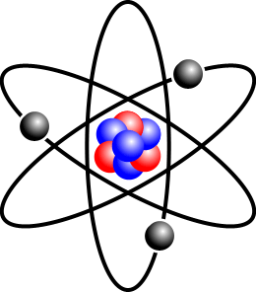
1. Where did the idea of atoms originate?
What is the evidence that allows us to conclude that atoms exist?
How have our models of the atom evolved over time?
Let’s take a tour through a history of scientific discovery and find answers to these questions…

Slide 3
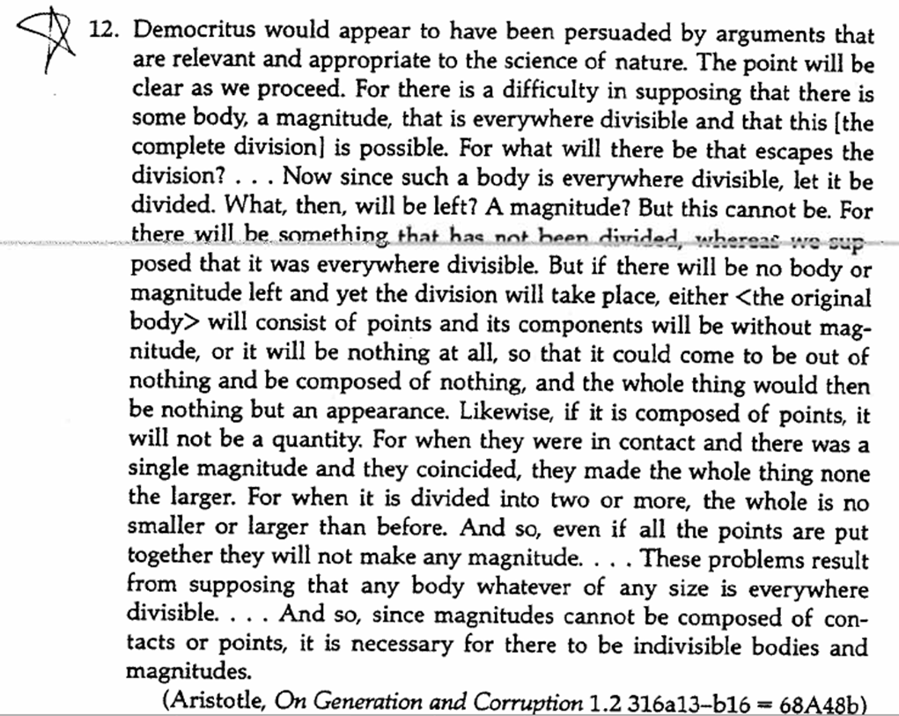
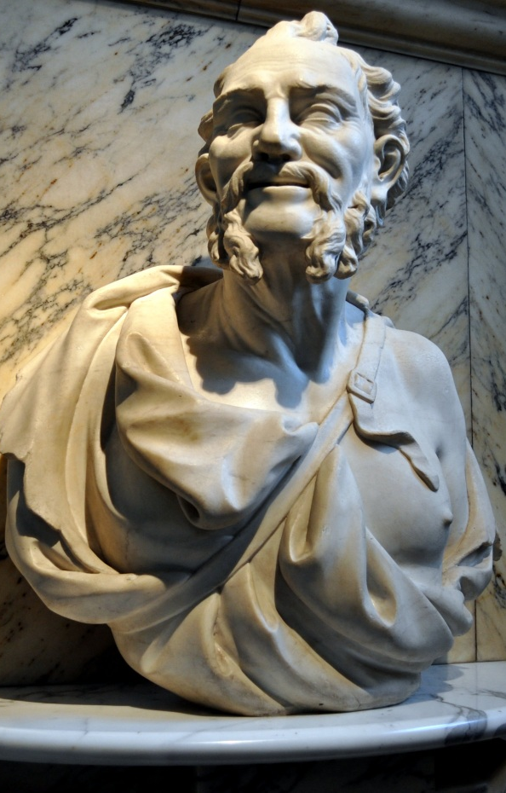
Democritus – Atomism
(5th Century BCE)
Readings in Ancient Philosophy: From Thales to Aristotle, edited by S Marc Cohen (2000).

Slide 4
CQ#1: What “evidence” did Democritus use to conclude that atoms exist?
Since matter is not empty space, it must be made of uncuttable particles (atoms).
If you divide up matter into smaller pieces for infinity, you end up with essentially nothing; since matter cannot be made up of nothing, it must have a small fundamental unit of matter that is uncuttable (atoms).
The Greeks observed that chemical reactions could take place; reactions cannot take place unless matter is made up of uncuttable particles (atoms).
Democritus did not use any evidence; he simply created the idea of atoms using his imagination.
All of these are correct.

Slide 5
Democritus—Atomism

Slide 6
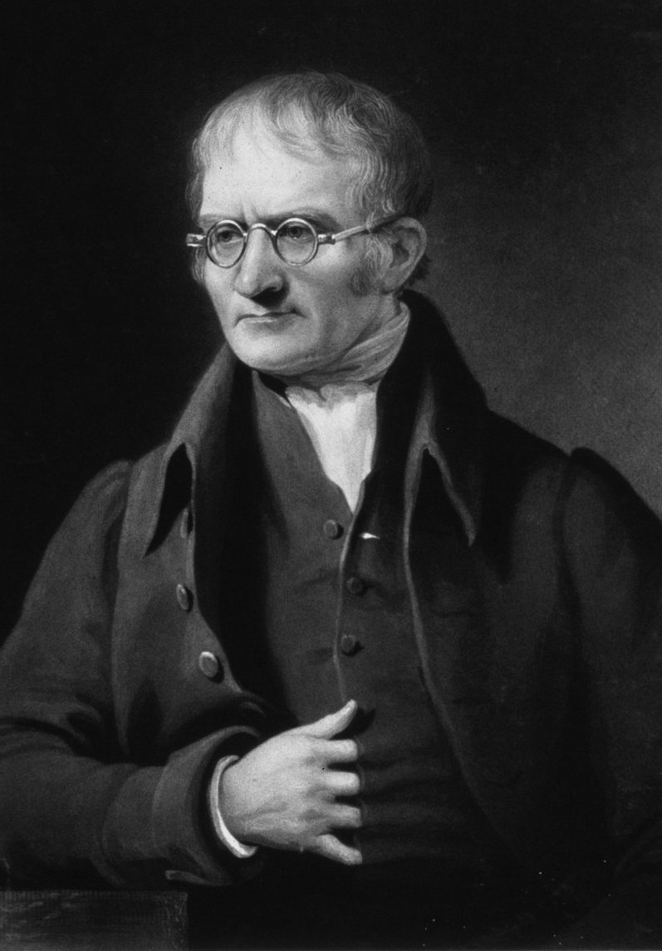
Dalton’s Atomic Theory (1805)
Matter is composed of indivisible particles called atoms.
Atoms of the same element have the same chemical properties.
Compounds are made of combinations of atoms of different elements, and are formed in reactions where rearrangements or separations of atoms occur (atoms are not created or destroyed in chemical reactions).

Slide 7
Dalton’s Atomic Theory – Mass of Oxygen and Chromium in Two Samples of Chromium Oxide
Sample # Appearance Mass of Cr (g) Mass of O(g)
1 orange crystals 1.3509 0.9319
red powder 0.6441 0.1481
2 red powder 1.3509 0.3106
Sample #2 – if we have 1.3509 g of Cr, how many grams of O?
1.3509 g Cr/x g O = 0.6441 g Cr/0.1481 g O
x = 0.3106 g O
If sample #2 is CrO, what is the formula of sample #1?
0.9319/0.3106 = 3.0003
sample #1 must be CrO₃
Notes:
The content of this slide (and on slide 9) was adapted from “A Letter from Dalton” by Susan E. Groh, Problem-Based Learning Clearinghouse at University of Delaware, http://www.udel.edu/pblc, item#54122785113.

Slide 8
CQ#2: What evidence did Dalton use to conclude that atoms exist?
Since chromium oxide had two different types of compounds, it must be made up of chromium and oxygen atoms.
Since the mass of chromium was the same in each sample, that indicates chromium must be made up of identical atoms.
Since the two chromium oxide samples had different masses of oxygen, and the oxygen masses differed in whole number ratios, that suggests the compounds had different numbers of oxygen “units” (atoms); if the atoms could be “cut” up into different sizes, these whole number ratios would not exist.
The different colors of the compounds indicated that each sample must be made up of different ratios of oxygen and chromium atoms.
All of these are correct.

Slide 9
Dalton’s Atomic Theory – Mass of Oxygen and Chromium in Two Samples of Chromium Oxide
Sample # Appearance Mass of Cr (g) Mass of O(g)
1 orange crystals 1.3509 0.9319
red powder 0.6441 0.1481
2 red powder 1.3509 0.3106
Sample #2 – if we have 1.3509 g of Cr, how many grams of O?
1.3509 g Cr/x g O = 0.6441 g Cr/0.1481 g O
x = 0.3106 g O
If sample #2 is CrO, what is the formula of sample #1?
0.9319/0.3106 = 3.0003
sample #1 must be CrO₃

Slide 10
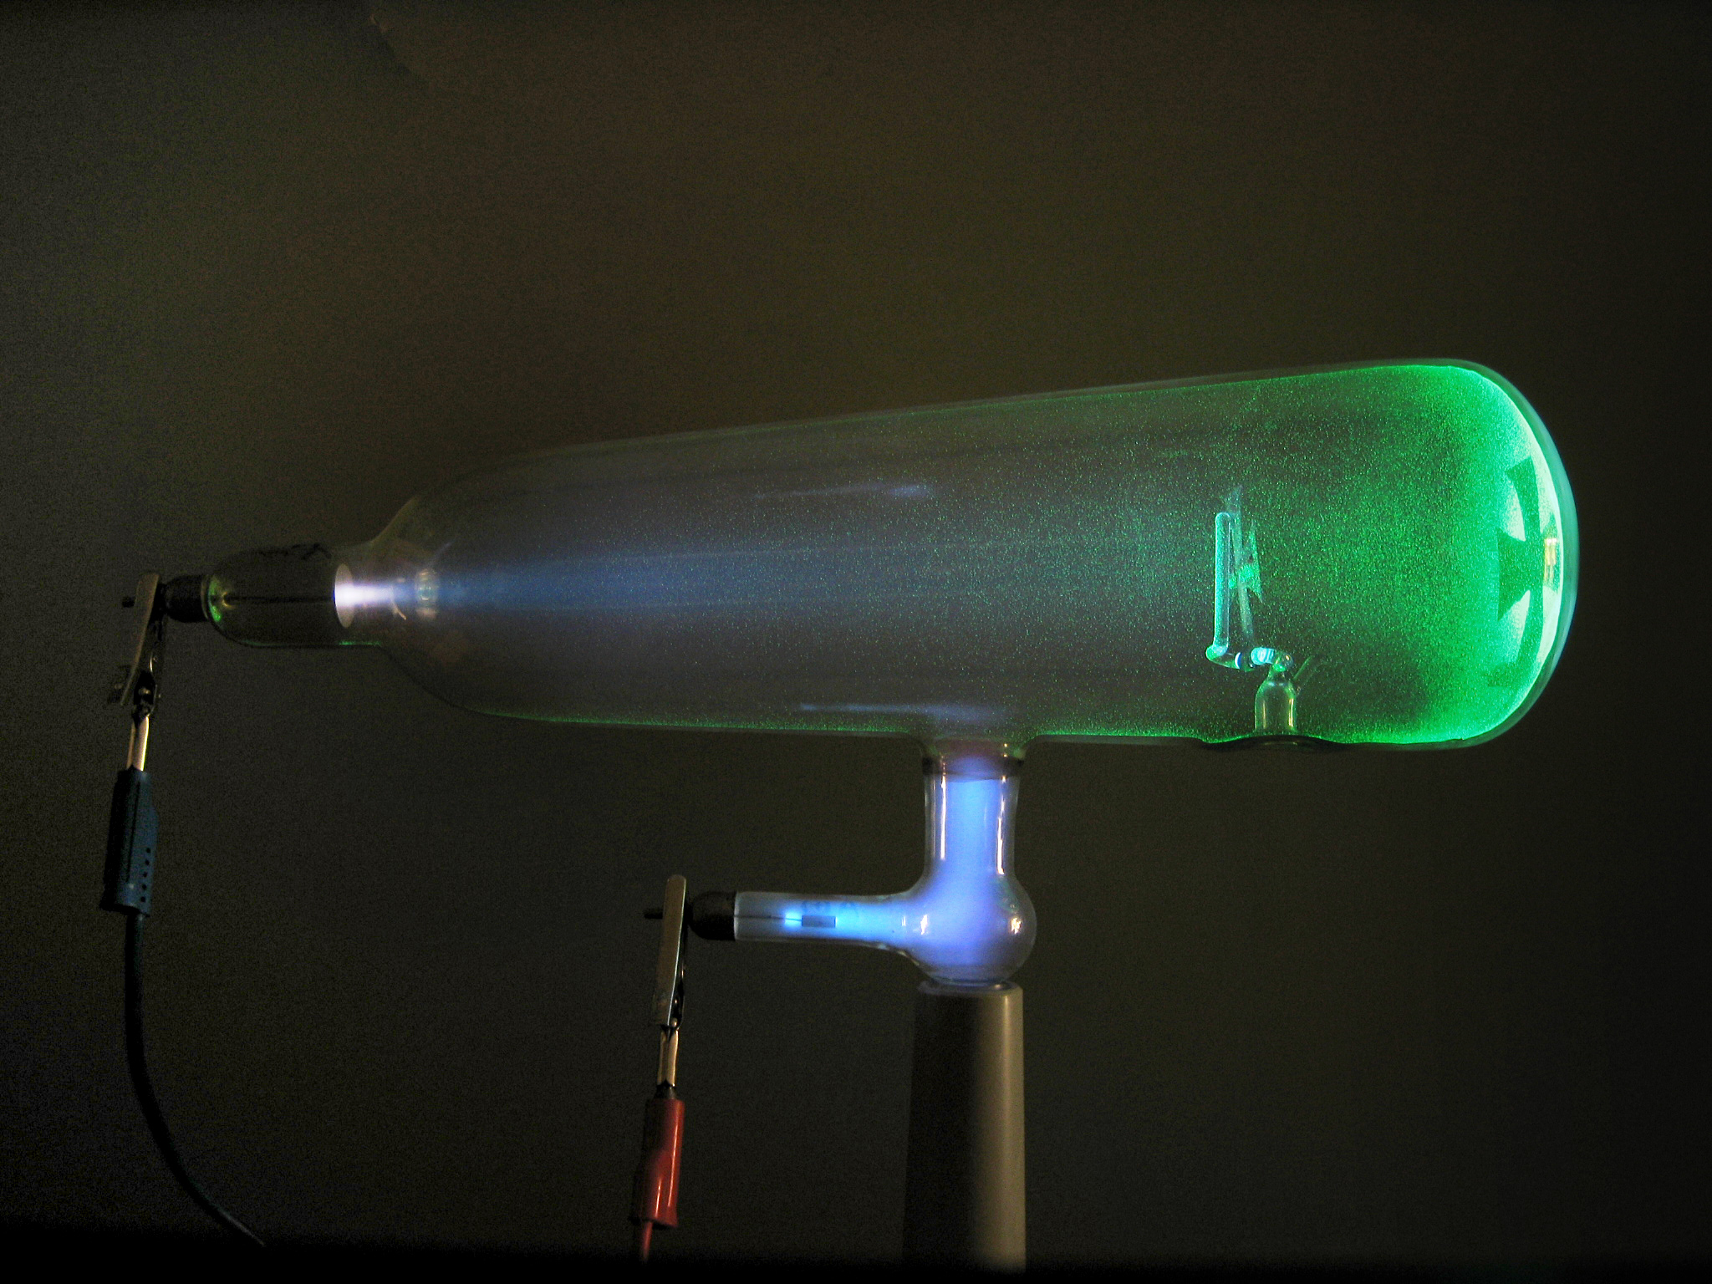
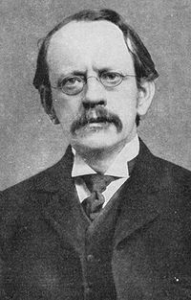
Thomson Cathode Ray Tube (1897)

Slide 11
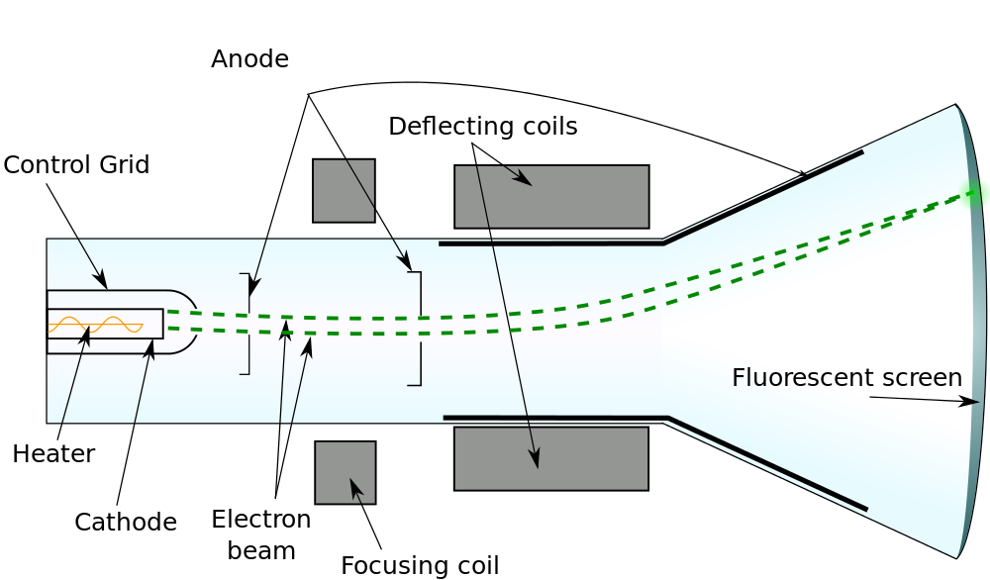
Thomson Cathode Ray Tube (1897)

Slide 12
CQ#3: Which model of the atom is confirmed by the data/observations from the cathode ray tube experiment? A. B. C. D.
+
-
-
-
-
-
-
-
-
-
-
-
-
-
-
-
+
+
+
+
+
-
-
+
+
-
-

Slide 13
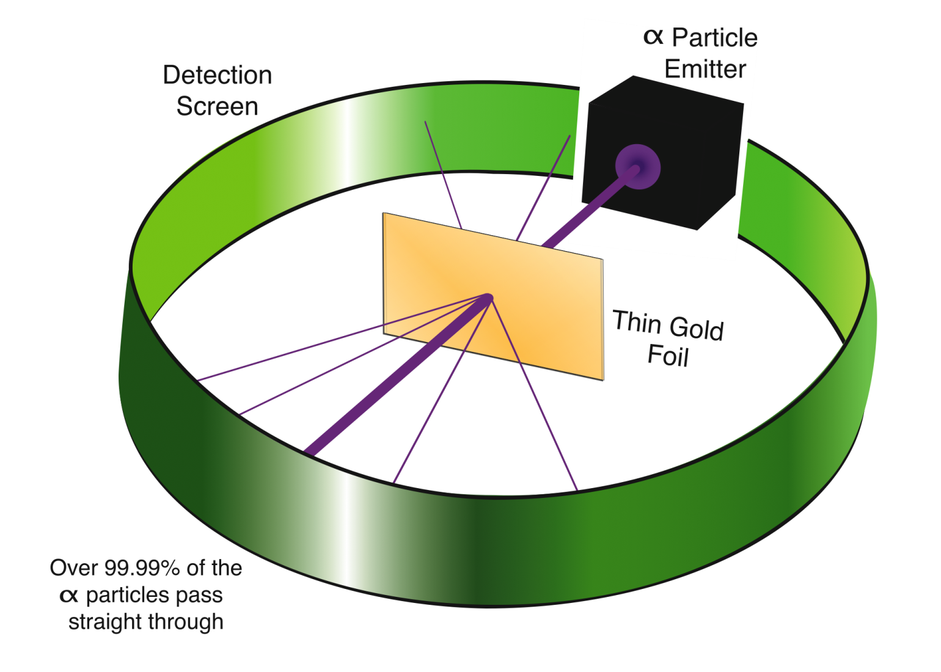
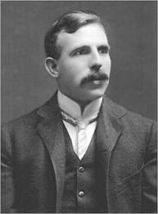
Rutherford Gold Foil Experiment (1911)

Slide 14
CQ#4: Which model of the atom is confirmed by the data/observations from the gold foil experiment? A. B. C. D.
+
-
-
-
-
-
-
-
-
-
-
-
-
-
-
-
+
+
+
+
-
-
+
+
+
-
-

Slide 15
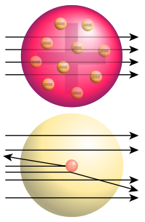
Rutherford Gold Foil Experiment (1911)
vs.

Slide 16
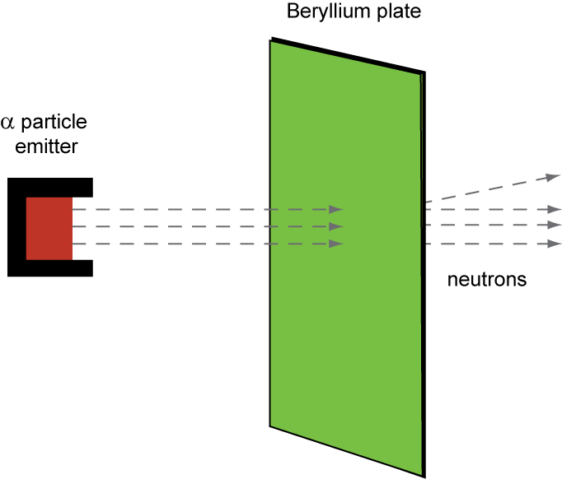
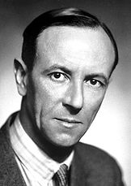
Chadwick Beryllium Experiment (1932)
Nuclear Model of the Atom: nucleus possesses protons and neutrons; “electron cloud” surrounds the nucleus.

Slide 17
Nuclear Model of the Atom
Electron (-)
Proton (+)
Neutron

Slide 18
We know about the basic structure of atoms…how were atoms of the elements different from one another? How were they organized?

Slide 19
Relative Atomic Mass
Example: H₂O
In the late 1700’s and 1800’s, scientists such as Dalton were able to determine experimentally that when water formed, it took two “parts” of hydrogen by volume and one “part” of oxygen by volume. This suggested water was made of two hydrogen atoms and one oxygen atom. How does this relate to relative atomic mass?

Slide 20
CQ#5: Which of the following best explains how relative atomic mass could be determined from the type of data available to Dalton?
By determining the mass of oxygen contained in a sample of water, its atomic mass could be determined.
By comparing the masses of hydrogen and oxygen contained in a sample of water, the atomic masses could be determined.
By comparing the mass of hydrogen in the two “parts” of hydrogen and the mass of oxygen in the one “part” of oxygen in water, the relative atomic masses could then be determined.
A and B are correct.
B and C are correct.

Slide 21
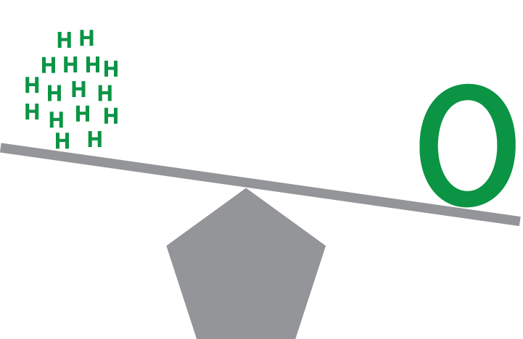
Relative Atomic Mass
Example: H₂O
If one part of oxygen weighs 8 times as much as two parts of hydrogen in a sample of water, then one oxygen atom weighs 8 times as much as 2 hydrogen atoms…this is relative atomic mass.

Slide 22
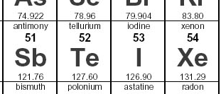
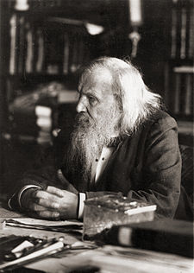
Mendeleev and the Periodic Table (1869)
Mendeleev used atomic mass and periodic trends to order the elements; his table predicted the existence of elements not yet discovered at the time (Ga, Sc, Ge…).
Periodic trends trumped atomic mass in some cases.

Slide 23
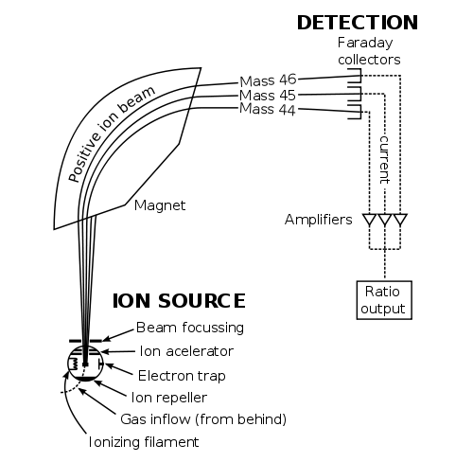
Mass Spectrometry: Identifying Masses of Atoms (J.J. Thompson – 1910)

Slide 24
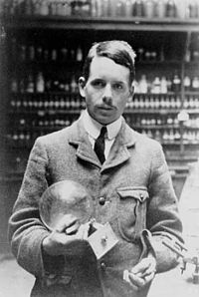
Moseley’s Determination of Atomic Number (1913)
Number of protons in nucleus corresponded to shift in energy of spectral lines (shift in wavelength)
X-rays
Excited e-’s
Light emitted
prism
Spectral lines
Sample of matter

Slide 25
CQ#6: How is it possible that the atomic number increases in order, yet the atomic masses do not?
There is no relationship between the atomic number and mass of the atom.
The masses of the protons for Te, I, and Xe have slightly different masses.
Since the numbers of neutrons do not neccessarily increase from one atom to the next, it is possible for the atomic number to increase while the total mass does not increase.
A and B are both correct.
B and C are both correct.

Slide 26
Atomic Mass vs. Mass Number

Slide 27
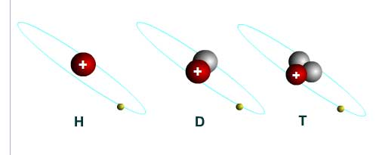
Neutrons, Atomic Number, Mass Number, and Average Atomic Mass
1
2
3
H
H
H
1
1
1

Slide 28
CQ#7: The average atomic mass (amu) of hydrogen is listed as 1.001amu on the periodic table. If the three isotopes of hydrogen have a mass of 1 amu, 2 amu, and 3 amu, respectively, how is this average atomic mass possible?
Hydrogen-1, hydrogen-2 (deuterium), and hydrogen-3 (tritium) must have different numbers of neutrons, which then shifts the mass closer to 1.001 amu.
The natural abundance of hydrogen-1 must be higher than the natural abundance of the other two isotopes of hydrogen.
The average atomic mass is a weighted average of the three isotopes, and since there is more hydrogen-1 in nature than either of the other two isotopes, the average is thus less than the simple average of the three isotope masses.
A and B are both correct.
B and C are both correct.

Slide 29
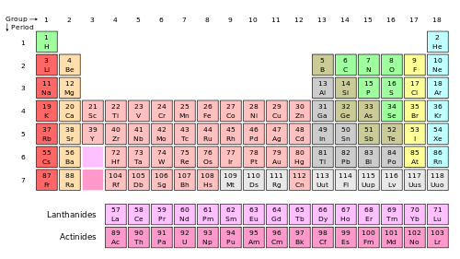
The Nuclear Model of the Atom
Atomic Mass and Atomic Number
+
-
-
+
+
-
hydrogen-1
Atomic mass = 1 amu
Atomic number =1
helium-4
Atomic mass = 4 amu
Atomic number = 2

Slide 30
The next step…how do we get from the nuclear model of the atom to the current model of the atom?
Quantum Theory!

Slide 31
Image Credits
Unless otherwise noted below, images in this presentation were created by the author or by the National Center for Case Study Teaching in Science.
Slide 1
Description: Stylized illustration of an atom.
Source: © valdis torms - Fotolia.com, ID#37659203.
Clearance: Licensed image.
Slides 2 and 17
Description: Atom schema.
Source: Halfdan, Wikimedia Commons, http://commons.wikimedia.org/wiki/File:Stylised_Lithium_Atom.png.
Clearance: Creative Commons Attribution-Share Alike 3.0 Unported license.
Slide 4
Description: Carved Italian marble bust depicting Democritus at the Victoria and Albert Museum Knightsbridge London England.
Source: Photo by Afshin Darian, Flickr, http://www.flickr.com/photos/micronova/5480353202/.
Clearance: Creative Commons Attribution 2.0 Generic license.
Slide 6
Description: British physicist and chemist John Dalton (1766-1844), painted by J. Lonsdale, engraved by C. Turner.
Source: Image available from the United States Library of Congress's Prints and Photographs division under the digital ID cph.3b12511, http://www.loc.gov/pictures/item/2004671522/.
Clearance: U.S. public domain because of expired copyright.
Slide 10
Description: Photo of Crookes tube.
Source: D-Kuru/Wikimedia Commons, http://commons.wikimedia.org/wiki/File:Crookes_tube-in_use-lateral_view-standing_cross_prPNr%C2%B011.jpg
Clearance: Creative Commons Attribution-Share Alike 3.0 Austria license.
Slides 10 and 23
Description: Photo of J.J. Thomson.
Source: GWS - The Great War: The Standard History of the All Europe Conflict (volume four) edited by H. W. Wilson and J. A. Hammerton (Amalgamated Press, London 1915), http://www.firstworldwar.com/photos/graphics/gws_thomson_01.jpg
Clearance: U.S. public domain because of expired copyright.
Slide 11
Description: Diagram of cathode ray tube.
Source: Theresa Knott, Wikimedia Commons, http://commons.wikimedia.org/wiki/File:Cathode_ray_Tube.PNG.
Clearance: Creative Commons Attribution-Share Alike 3.0 Unported license.
Slide 13
Description: Photo of Ernest Rutherford, circa 1910.
Source: Wikimedia Commons, http://commons.wikimedia.org/wiki/File:Ernest_Rutherford.jpg.
Clearance: U.S. public domain because of expired copyright.

Slide 32
Image Credits
Slide 13:
Description: Diagram of gold foil experiment.
Source: John Hutchinson, Structure of an Atom, http://cnx.org/content/m44315/1.1/.
Clearance: Creative Commons Attribution 3.0 Unported license (CC BY 3.0).
Slide 15
Description: Diagram of the nuclear deflection of alpha particles.
Source: Wikimedia Commons, http://commons.wikimedia.org/wiki/File:Rutherford_gold_foil_experiment_results.svg.
Clearance: This work has been released into the public domain by its author, Fastfission.
Slide 16
Description: Photo of James Chadwick.
Source: http://nobelprize.org/nobel_prizes/physics/laureates/1935/chadwick-bio.html
Clearance: U.S. public domain because of expired copyright.
Slide 22
Description: Photo of Dmitri Mendeleev.
Source: Wikimedia Commons, http://commons.wikimedia.org/wiki/File:DIMendeleevCab.jpg.
Clearance: U.S. public domain because of expired copyright.
Slide 23
Description: Schema of typical mass spectrometer.
Source: Devon Fyson, http://pubs.usgs.gov/of/2001/ofr01-257/images/figure1.gif, part of http://pubs.usgs.gov/of/2001/ofr01-257/index.html
Clearance: U.S. public domain because it contains materials that originally came from the United States Geological Survey, an agency of the United States Department of Interior.
Slide 24
Description: Photo of Henry Moseley.
Source: Wikimedia Commons, http://commons.wikimedia.org/wiki/File:Henry_Moseley.jpg.
Clearance: In the U.S. public domain because of expired copyright.
Slide 27
Description: Illustration of deuterium and tritium
Source: European Fusion Development Agreement (EFDA), http://www.efda.org/downloads/hydrogen-deuterium-tritium/.
Clearance: Used in accordance with EFDA’s terms of use, http://www.efda.org/disclaimer-copyright/.
Slide 29
Description: Periodic table.
Source: Wikimedia Commons, http://commons.wikimedia.org/wiki/File:Periodic_table.svg.
Clearance: Released to the public domain by author.

