Slide 1
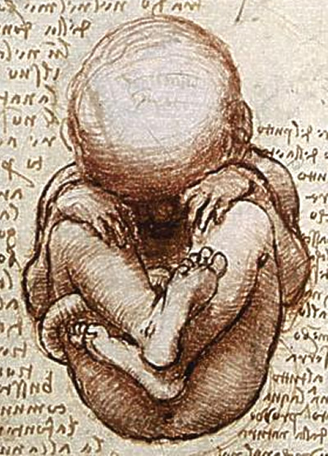
Anencephaly in Yakima: Many Questions, Few Answers
NATIONAL CENTER FOR CASE STUDY TEACHING IN SCIENCE
by
Justin F. Shaffer and Sha Sun
Department of Developmental & Cell Biology
University of California, Irvine
Notes:
Image credit: Detail from a drawing by Leonardo da Vinci, https://commons.wikimedia.org/wiki/File:Views_of_a_Foetus_in_the_Womb_detail.jpg

Slide 2
Learning Objectives
Describe the general classes of teratogens.
Explain what neural tube defects are and how they can affect human development.
Explain how neural tube defects may be prevented.
Evaluate the anencephaly outbreak in Yakima, WA and determine what should be done next.

Slide 3
Olivia Jackman was born in September 2013 in Yakima, WA to her 30-year old mother Andrea Jackman.
She was born with spina bifida (a type of neural tube defect) and had surgery to correct it a few days after being born.
The surgery was successful and she is developing normally.
Notes:
Source: Aleccia, J. 2014. “Bizarre” cluster of severe birth defects haunts health experts. NBC News. Feb 17 2014, 4:55 AM ET. Accessed at:
http://www.nbcnews.com/health/kids-health/bizarre-cluster-severe-birth-defects-haunts-health-experts-n24986
Image credit: D Sharon Pruitt, CC BY 2.0, https://commons.wikimedia.org/wiki/File:Sweet_Baby_Kisses_Family_Love.jpg.
Note: The persons portrayed are not Olivia and Andrea Jackman.

Slide 4
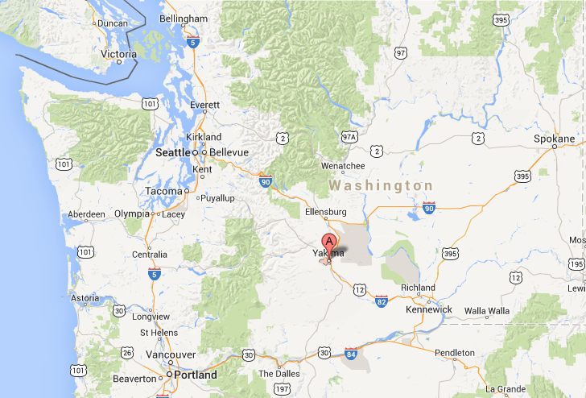
Google Maps

Slide 5
“Bizarre” Cluster of Severe Birth Defects Haunts Health Experts
February 17, 2014
“This is bizarre. This is a very, very small area.”
http://www.nbcnews.com/health/kids-health/bizarre-cluster-severe-birth-defects-haunts-health-experts-n24986
http://www.cdc.gov/mmwr/preview/mmwrhtml/mm6235a5.htm
Notes:
First link: Aleccia, J. 2014. “Bizarre” cluster of severe birth defects haunts health experts. NBC News. Feb 17 2014, 4:55 AM ET.
Second link: Centers for Disease Control and Prevention. 2013. Notes from the field: investigation of a cluster of neural tube defects—Central Washington, 2010–2013. Morbidity and Mortality Weekly Report 62(35):728–728.

Slide 6
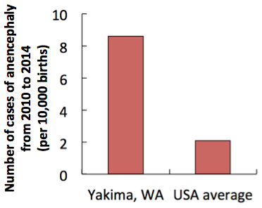
CQ#1: What can you conclude from these data?
There were higher rates of anencephaly in Yakima than in the USA from 2010-2014.
There were higher rates of all birth defects in Yakima than in the USA from 2010-2014.
There were higher rates of anencephaly in females in Yakima than in the USA from 2010-2014.
There were higher rates of anencephaly in Yakima than in the USA in 1980 and from 2010-2014.
What do you think is going on?

Slide 7
CQ#2: What do you think is causing this outbreak?
Drugs
Viruses or bacteria
Environmental pollutants
Radiation
Extremes of diet

Slide 8
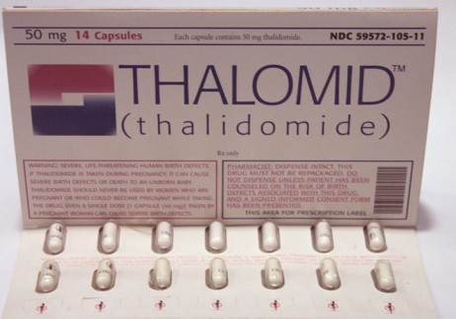
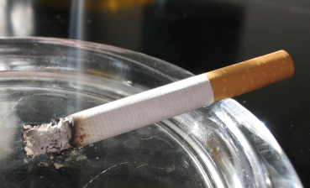
General classes of teratogens
Drugs, alcohol, and tobacco
Viruses and bacteria
Environmental pollutants
Radiation
Extremes of diet
Notes:
Image credits:
Left: © 2005 by Tomasz Sienicki, CC BY-SA 3.0, https://en.wikipedia.org/wiki/Smoking#/media/File:Papierosa_1_ubt_0069.jpeg
Right: Stephencdickson, CC BY-SA 4.0, https://commons.wikimedia.org/wiki/File:Pack_of_Thalidomide_tablets_c.1960.JPG

Slide 9
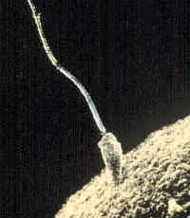
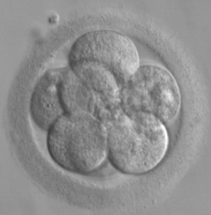
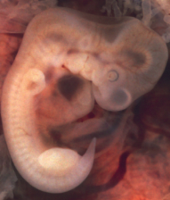
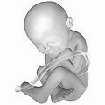
CQ#3: When is a developing baby most susceptible to teratogens?
Cleavage and implantation (weeks 0 to 2)
Embryonic period
(weeks 3 to 8)
Fetal period
(weeks 9 to birth)
Fertilization
Before pregnancy
Cleavage and implantation
Embryonic period
Fetal period
What can go wrong?
Notes:
Image credits:
(1) Sperm fertilizing egg: Public domain, https://commons.wikimedia.org/wiki/File:Sperm-egg.jpg
(2) Cell embryo: Public domain, https://commons.wikimedia.org/wiki/File:Embryo,_8_cells.jpg
(3) Human embryo: OpenStax College, CC BY 3.0,
https://commons.wikimedia.org/wiki/File:819_Embryo_at_Seven_Weeks.jpg
(4) Human fetus: Melchior Meijer, CC BY-SA 2.5,
https://commons.wikimedia.org/wiki/File:40_weeks_pregnant.png

Slide 10
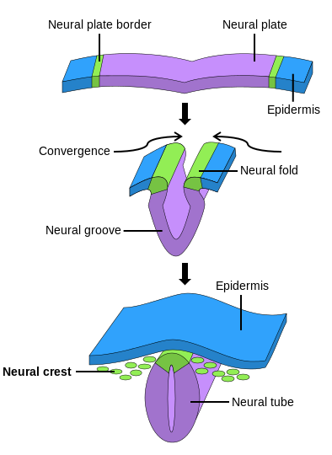
Neural tube defects
Neurulation is the process in the developing embryo that forms the neural tube which leads to the brain and spinal cord.
Neural tube defects arise when the neural tube does not close properly.
Affects 300,000 births worldwide every year and can be minor to fatal.
CQ#4: What organs develop from the neural tube?
Heart and blood vessels
Lungs and trachea
Brain and spinal cord
Stomach and intestines
Notes:
Image credit: NikNaks, public domain, https://commons.wikimedia.org/wiki/File:Neural_crest.svg

Slide 11
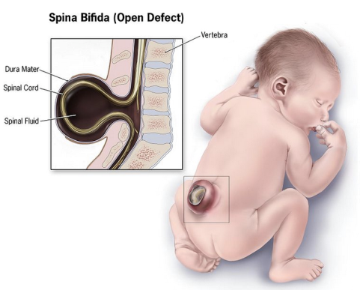
Spina bifida
Neural tube fails to close during development and thus the spinal cord may protrude from the back.
Can be minor or result in paralysis.
Surgery can correct some forms; can also be done prenatally.
Source: http://www.ninds.nih.gov/disorders/spina_bifida/detail_spina_bifida.htm
Notes:
Image credit: Centers for Disease Control and Prevention, https://commons.wikimedia.org/wiki/File:Spina-bifida.jpg

Slide 12
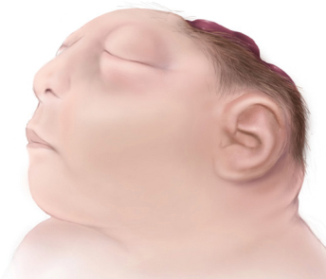
Anencephaly
Fetus develops without parts of the brain or skull.
The upper part of the neural tube does not close all of the way.
Almost all babies born with anencephaly die within hours after birth.
Source: http://www.cdc.gov/ncbddd/birthdefects/anencephaly.html
Notes:
Image credit: Centers for Disease Control and Prevention, https://commons.wikimedia.org/wiki/File:Anencephaly-web.jpg.

Slide 13
If you lived in Yakima, WA and were trying to have a baby, what would you do?
If you worked for the WA State Health Department and were investigating this outbreak, what would you do?

Slide 14
CQ#5: If you lived in Yakima, WA and were trying to have a baby, what would you do?
Keep trying because the risk is so small, what are the odds it will happen to me?
Keep trying but move to a different city first.
Stop trying for now, but maybe try again in a few years if they figure out what is causing this.
Stop trying because I don’t want to risk anything bad happening to my baby.

Slide 15
CQ#6: If you worked for the WA State Health Department, what would you do first?
Interview the mothers.
Look at the mothers’ medical records.
Find out where the mothers lived.
Find out where the mothers worked.
Find out if the mothers had other children with neural tube defects.

Slide 16
What information would you try to get from the mothers?
The WA State Health Department looked over medical records to find out…
Where the mothers worked and lived.
Their use of tobacco and alcohol.
What medications they took.
What diseases they had.
Where they got their water (public or private well).
What their race and ethnicity were.

Slide 17
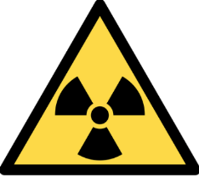
What are some risk factors for neural tube defects?
Maternal diabetes
Maternal obesity
Radiation
Fungal toxins
Arsenic
Cigarette smoking
Deficiency in folic acid
The definitive cause is unknown

Slide 18
Folic acid
Type of B vitamin (B₉)
Important for cell division, DNA and RNA synthesis, and for preventing mutations to DNA.
Important component of prenatal vitamins.
Naturally found in dark green leafy vegetables, fruits, nuts, beans, etc.
CQ#7: What foods have folic acid added to them?
Peanut butter
Milk and yogurt
Orange juice
Bread and cereal
Notes:
Image credit: Ragesoss, CC BY-SA 3.0, https://commons.wikimedia.org/wiki/File:Prenatal_vitamin_tablets.jpg

Slide 19
Folic acid and neural tube defects
70% of cases can be prevented by proper intake of folic acid.
In 1996, US FDA required addition of folic acid to enriched breads, cereals, flours, corn meals, pastas, rice, and other grain products.
Since then, CDC found that the rate of neural tube defects dropped 25%.
Assuming the Yakima mothers had sufficient intakes of folic acid, what could be the cause of the anencephaly outbreak?
Notes:
Image credit: United States Department of Agriculture, https://commons.wikimedia.org/wiki/File:GrainProducts.jpg

Slide 20
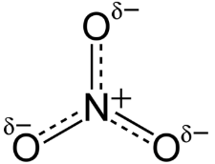
A possible lead…
Ingestion of nitrates from pesticides.
Private wells have 17.5 mg / L nitrate, 5.0 mg/ L in public water, and 0.33 mg / L in bottled water.
5 mg / L or more daily doubled risk of spina bifida (but not anencephaly) in mothers living in Iowa and Texas.
Another study however found an increased risk of anencephaly from nitrates in drinking water in mothers in California.
Andrea Jackman (Olivia’s mom) drank from a private well for years before becoming pregnant

Slide 21
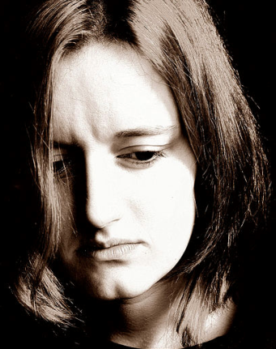
The sad reality
Jocelyn Robles is a young woman that lives in Yakima, WA.
She was pregnant and due to give birth on October 31, 2014 to her first child.
From an ultrasound screening, she knew that her fetus had anencephaly.
Local news video:
http://komonews.com/news/local/medical-mystery-in-central-wash-baffles-experts-11-21-2015
Notes:
Image credit: Jiri Hodan, public domain, https://commons.wikimedia.org/wiki/File:Sad_Woman.jpg.
Note: This is not an image of Jocelyn Robles.

Slide 22
Investigation update from the WA State Health Department
As of February 11, 2016
From 2010 to 2016, there were 67 cases of all neural tube defects and 42 cases of anencephaly in the Yakima region.
64 mothers of infants with neural tube defects have been identified, and 17 of them (27%) have been interviewed.
Many interviewed mothers experienced risk factors for neural tube defects, including prior neural tube defect pregnancy, obesity, diabetes, and use of anti-seizure medication.
Community outreach has occurred to educate people about the risk factors for neural tube defects and the importance of folic acid intake.
For future updates, check this website:
http://www.doh.wa.gov/YouandYourFamily/IllnessandDisease/BirthDefects/AnencephalyInvestigation

