Slide 1
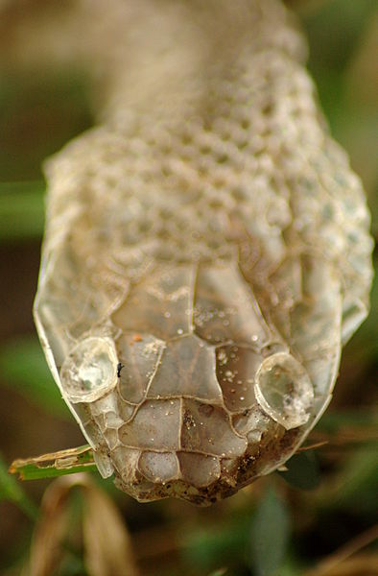
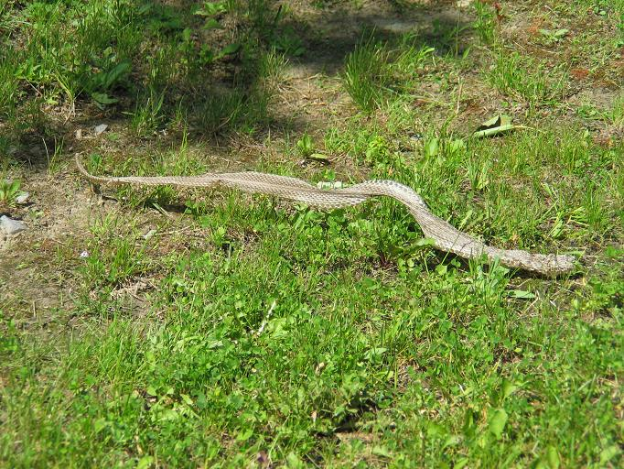
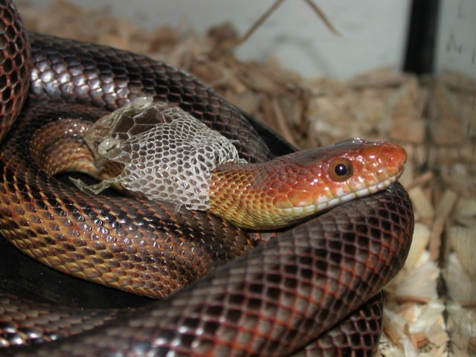
Snake shedding its skin
Image credit (left to right): Mike Ferris, Jonathan Crowe, mylittlefinger

