Slide 1
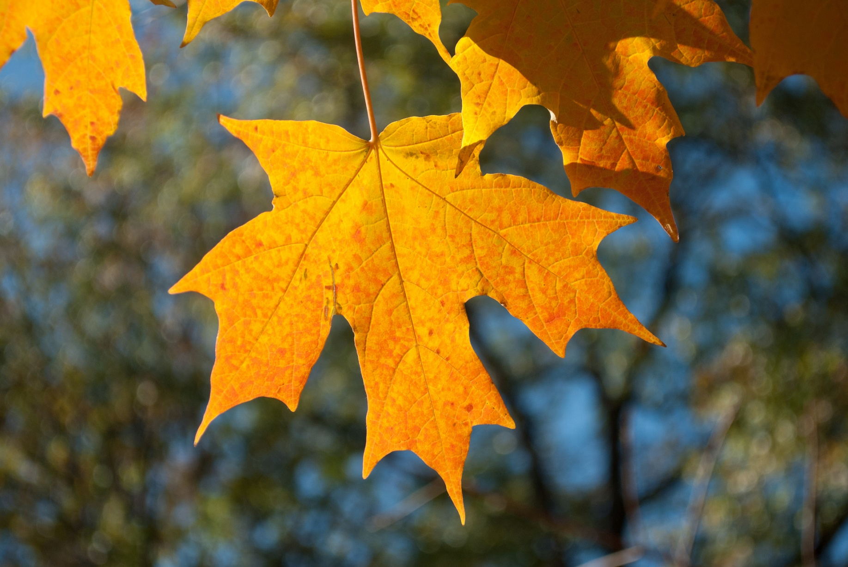
Plant Body Structure: Leaves
Leaf of a maple tree in the fall.
Photo by Jean Flanagan
Copyright © 2013 BSCS and AAAS

Slide 2
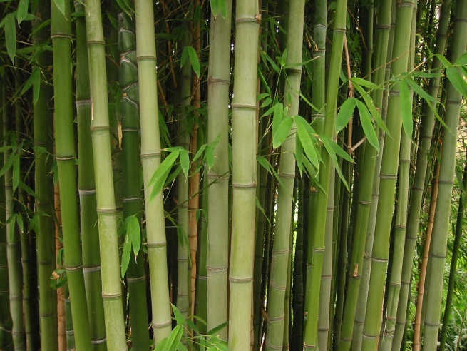
Plant Body Structure: Stems
Bamboo stems.
Photo by Mike Lowe
Copyright © 2013 BSCS and AAAS

Slide 3
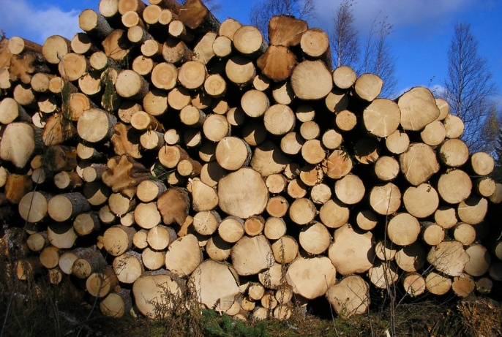
Plant Body Structure: Wood
Stack of chopped wood from tree trunks.
Photo by miguel c m
Copyright © 2013 BSCS and AAAS

Slide 4
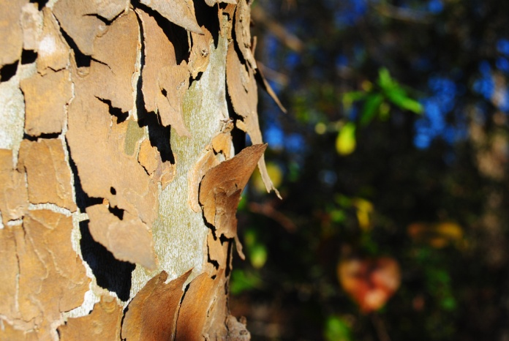
Plant Body Structure: Bark
Peeling bark of an American Sycamore tree.
Photo by Jean Flanagan
Copyright © 2013 BSCS and AAAS

Slide 5
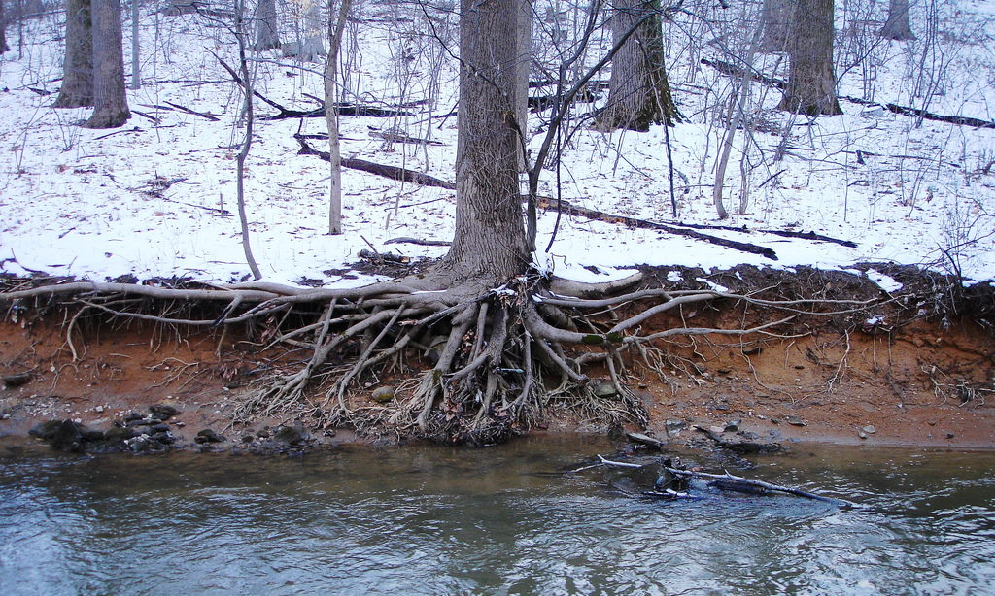
Plant Body Structure: Roots
Tree roots exposed by erosion.
Roots absorb water and minerals from the ground.
Photo by Cyndy Sims Parr (cyanocorax)
Copyright © 2013 BSCS and AAAS

Slide 6
Plant Body Structure: Flowers
Flowers of a White Viburnum shrub.
Photo by Jean Flanagan
Copyright © 2013 BSCS and AAAS

Slide 7
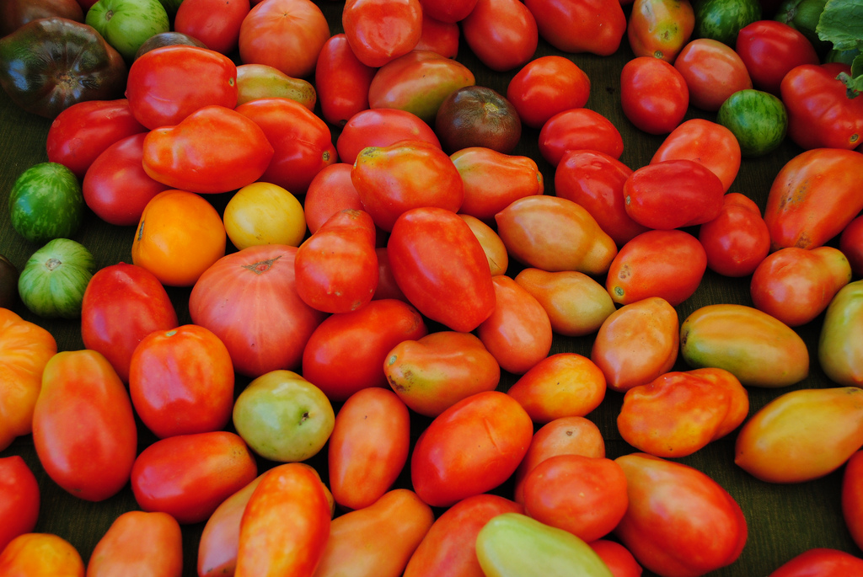
Plant Body Structure: Fruit
Tomatoes at a farmers’ market.
Photo by Jean Flanagan
Copyright © 2013 BSCS and AAAS

Slide 8
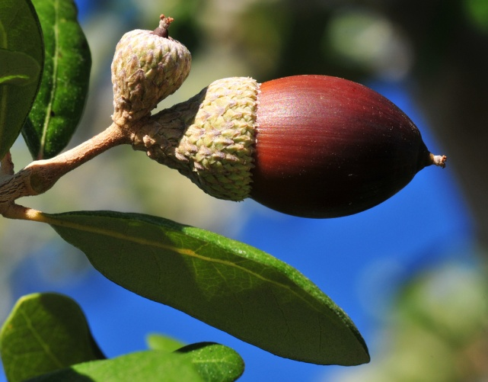
Plant Body Structure: Seeds
Acorn on an oak tree.
Photo by Paul Garland
Copyright © 2013 BSCS and AAAS

