Slide 1
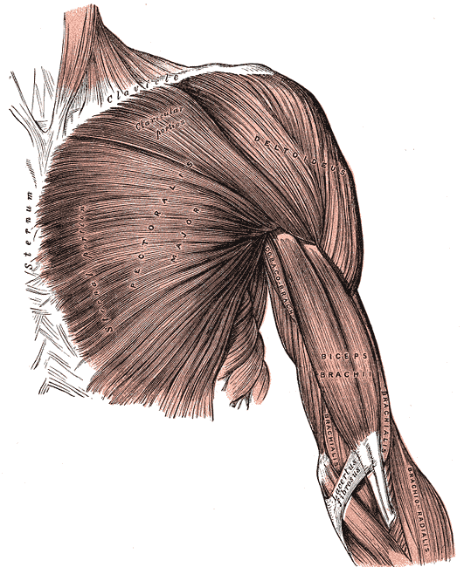
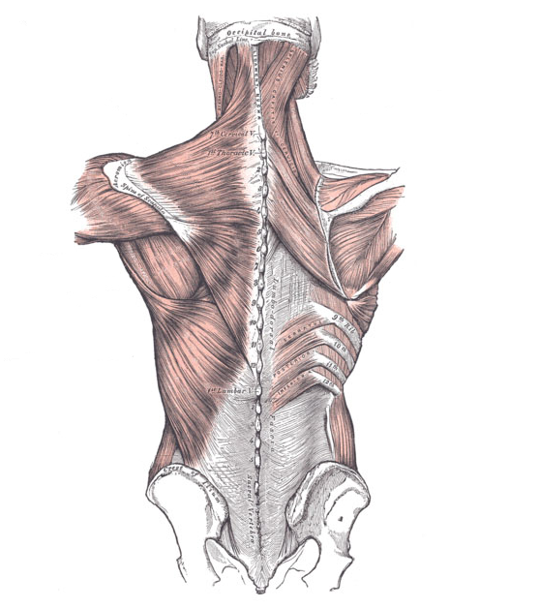
Interior Human Anatomy
Images from Gray's Anatomy of the Human Body
Copyright © 2013 BSCS and AAAS

Slide 2
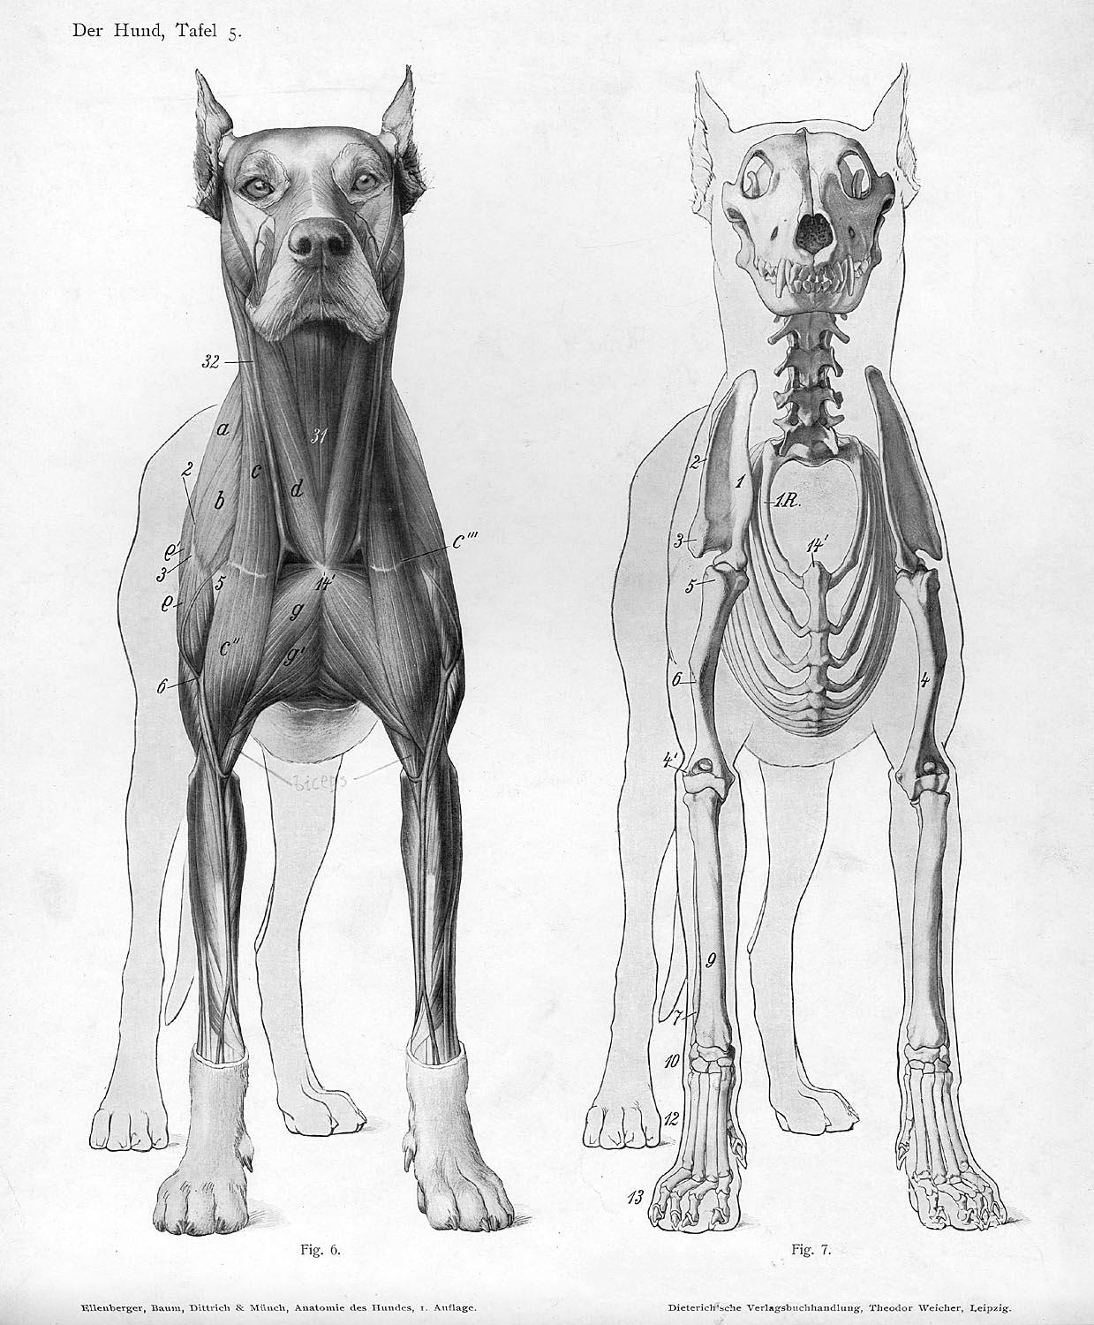
Interior Dog Anatomy
Image from Ellenberger, W., & Baum, H. (1901). Handbuch der Anatomie der Tiere für Künstler. University of Wisconsin Digital Collections.
Copyright © 2013 BSCS and AAAS

Slide 3
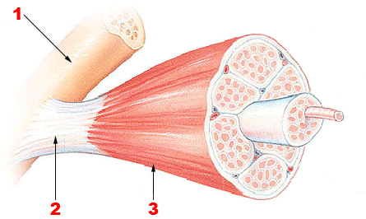
Muscles, Tendons, and Bones
1: Bone
2: Tendon
3: Muscle
Image from National Institutes of Health
Copyright © 2013 BSCS and AAAS

