Slide 1
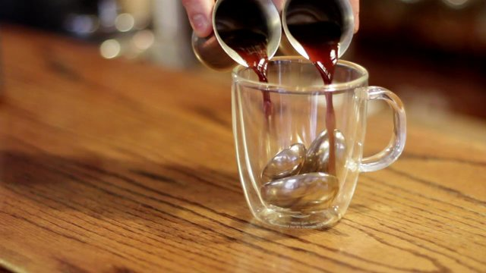
Phase Change Presentation
By: Jacques Klapisch, Adela Miller, and Grace Skylstad

Slide 2
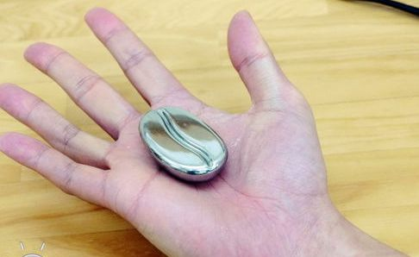
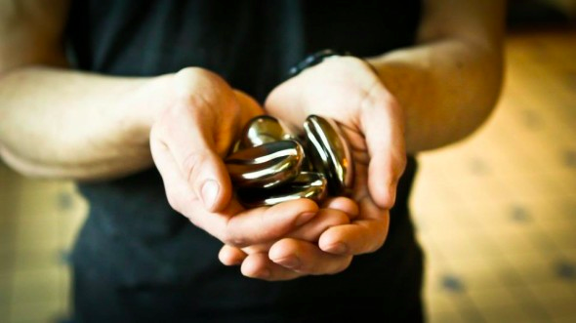
Our Experiment
Our group was curious how changing the amount of coffee joulies used would affect the temperature of the liquid over time. We were interested to find out if using more coffee joulies was more effective than using just one. We predicted that the more coffee joulies used, the more constant the temperature would be.

Slide 3
Coffee Joulie Experiment
The experiment tested the relative effectiveness of the coffee joulies. We put one coffee Joulie in one cup, four in another, and a control with no coffee Joulies with them. This tested how several coffee Joulies would work in comparison to it without.
1st Cup
2nd Cup
3rd Cup
1st cup- zero coffee joulies 2nd cup- one coffee joulies 3rd cup- four coffee joulies

Slide 4
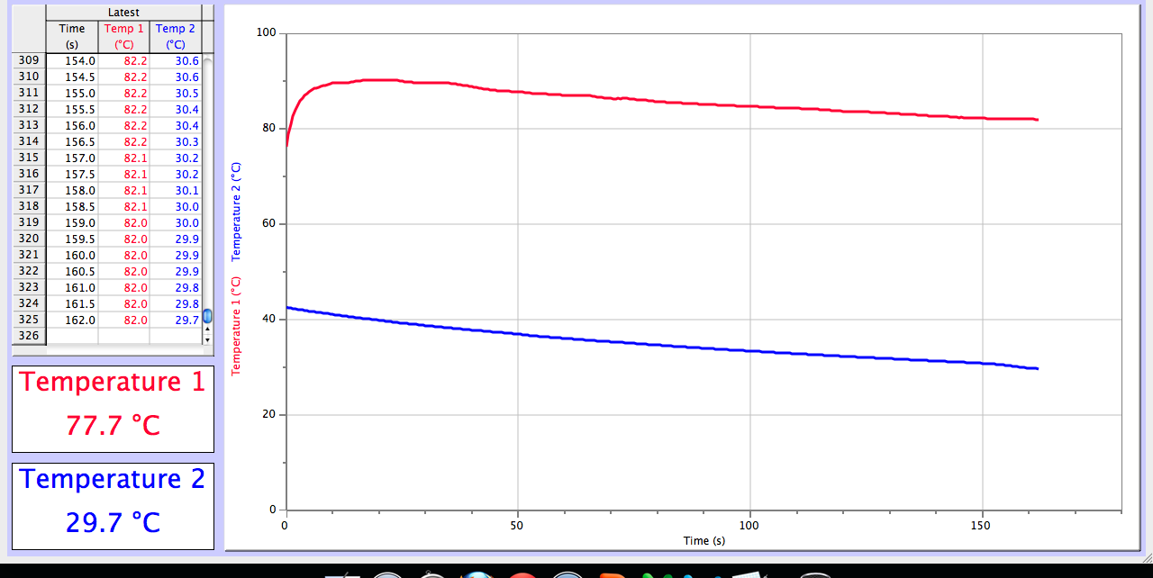
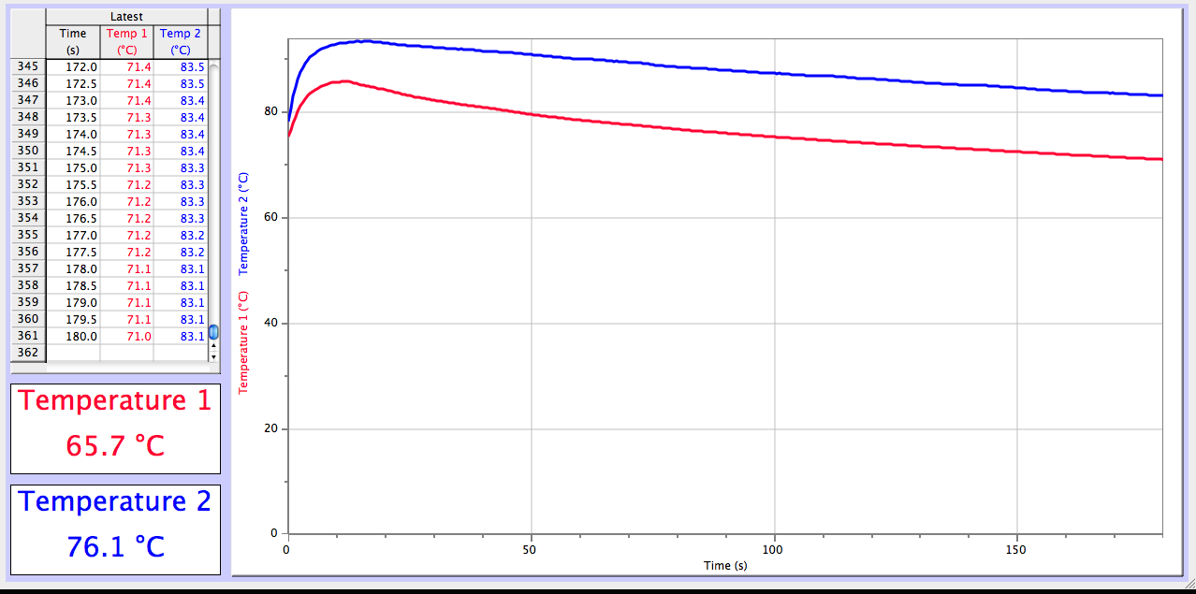
Experiment Data
Red line= 3rd cup
Blue line= 1st cup
Blue line = 2nd cup

Slide 5
Boiling
-Vaporization is the phase transition from a liquid to a gas.
Vaporization occurs during the boiling or vaporization of a liquid, which turns into a gas, or vapor.

Slide 6
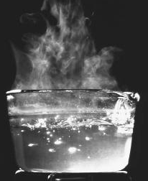
Boiling
1st-Some heat source (such as a stove) adds kinetic energy to the water particles
Steam (gaseous form of H₂0)
2nd-The added total kinetic energy/Thermal energy causes the average kinetic/temperature energy (this makes sense because now there is more energy per particle)
When the water reaches its boiling point, it marks the beginning of the process of evaporation.

Slide 7
What Happens When The Temperature of the Water Increases?
As you probably know, when the temperature of a liquid increases, there is the a phase change becomes possible
So… When does water (liquid H₂0) become steam (gaseous H₂0)?
Good Question. The boiling point of water is when water can start to become steam. The boiling point of water is defined by specific temperature.
-100ºC = Boiling point
-212ºF = Boiling point

Slide 8
If the boiling point is 100ºC, is it possible for water to exist in liquid form at 100ºC?
YES!!! IT IS POSSIBLE FOR LIQUID WATER TO EXIST AT 100^{O}C (212^{O}F); HOWEVER NOTE THAT AT THIS TEMPERATURE THE WATER WILL BE BOILING, AND SOME WILL BE EVAPORATING.

Slide 9
Evaporation
-Unlike when water boils and quickly becomes steam evaporation is a much slower process in which the surface of the liquid is slowly vaporized
-Occurs when water is exposed to air

Slide 10
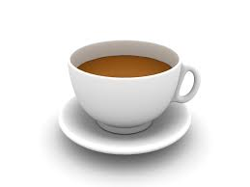
Tea Time
Contrasting Boiling & Evaporation
Boiling
Evaporation
-Occurs quickly
-Boiling affects the entire mass of the liquid (example: making pasta)
-Occurs slowly
-Evaporation only occurs on the surface of the liquid (example: puddles on a sunny day)

Slide 11
Conclusions
-Boiling is a quick form of vaporisation that requires an increase in temperature (to the boiling point)
-Evaporation is a slower form of vaporisation requires water’s exposure to air

