Slide 1
ICE CREAM DESIGN CHALLENGE

Slide 2
Knowledge Probe

Slide 3
What did you learn in the Endothermic v. Exothermic Investigation?

Slide 4
BASIC INSTRUCTIONS
Add ½ cup milk, ½ tsp vanilla and 1 tbls sugar to a quart-sized bag. Zip shut and mix.
Add 4 cups of ice and 4 tbls of salt to a gallon-sized bag.
Take temperature of ice cream mixture and place ice cream mixture into gallon-sized bag and zip. Start timer.
After five minutes check the temperature of the ice cream mixture.

Slide 5
WHY SALT AND ICE?
Video: https://www.youtube.com/watch?v=x-_omONdCIo
Notes:
Show only the first half.

Slide 6
WHAT ENDOTHERMIC PROCESS WILL FREEZE YOUR ICE CREAM?
When salt is added to ice, a salt water solution is created. Salt water has different properties than water. One of which is that the freezing point is lower. As a result some of the ice melts.
Melting is an endothermic process.
Endothermic processes take in heat from their surroundings.
Where will the ice take heat from to allow it to go through the endothermic process of melting???

Slide 7
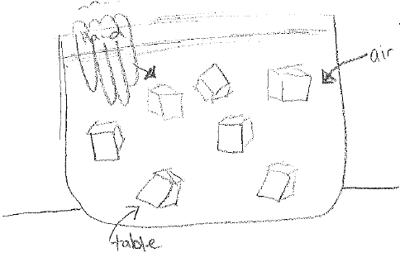
What are the possible surrounding that the ice can take heat from in order for this endothermic process to occur?
The heat (energy) can come from many places, causing a decrease in temperature of those places (hand, air table, etc.).

Slide 8
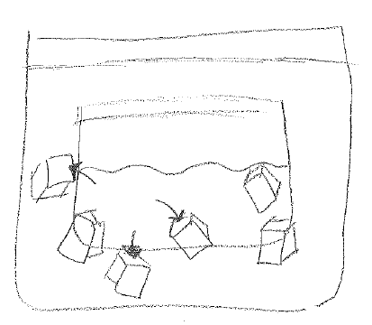
What is the goal? Where do we want the heat to transfer from?
If the heat (energy) comes from the milk, then the milk will decrease in temperature. This is our goal!

Slide 9
Testing

Slide 10
DIRECTIONS
1. Add ½ cup of water to a quart-sized bag. Zip shut.
2. Put 4 cups of ice in the gallon sized bag.
3. Take temperature of water.
4. When instructed, add salt to a gallon-sized bag.
5. You now have one minute to place water bag into device.
6. Start timer for five minutes.
After five minutes check the temperature of the water.

Slide 11
CLEAN UP
Put ice in the sink.
Throw away plastic bags.
Clear off table. I will come spray and wipe tables when they are cleared off.

Slide 12
Class Data
Learn about your classmate’s designs:
Share your results.
Discuss what worked well and what didn’t.
Record their temperature change and interesting things about their design.

Slide 14
Final Test - ICE CREAM!

Slide 15
DIRECTIONS
1. Add ½ cup milk, ½ tsp vanilla and 1 tbls sugar to a quart-sized bag. Zip shut and mix.
2. Add 4 cups of ice to the gallon sized bag.
3. Take temperature of ice cream mixture.
4. When instructed, add the salt to your ice. You now have one minute to place ice cream mixture into device.
5. Start timer for five minutes.
After five minutes check the temperature of the ice cream mixture.
You may continue to process your ice cream after this point. However, you must record the temperature after five minutes as your final temperature.

Slide 16
CLEAN UP
Put ice in the sink.
Throw away plastic bags.
If any parts can be saved, remove any trash from them.
Throw away all trash.
Clear off table. I will come spray and wipe tables when they are cleared off.

