Slide 1
Can You Solve a Puzzle?

Slide 2
Lesson Objective:
Students will uncover the relationship between changes in an ocean environment and a population of seabirds.

Slide 3
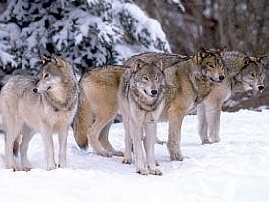
How Can We Take Care of Our Environment?

Slide 4
What are Sustainability Practices?
Choices that meet the needs of the present without compromising the ability of future generations to meet their own needs

Slide 5
The Key to Sustainable Choices and Development is a good understanding of the relationships of all sectors of our world and how they are connected.

Slide 6
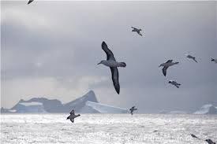
The Sea Bird Mystery
?

Slide 7
Common Murre

Slide 8
Tufted Puffin

Slide 9
Cassin’s Auklet

Slide 10
Pigeon Guillemot

Slide 11
Marbled Murrelet

Slide 12
Ocean Food Web

Slide 13
Food Web of Cassin’s Auklet

Slide 14
Number of Breeding Adults of this Bird

Slide 15
Number of Breeding Adults of this Bird

Slide 16
Ocean Climate Data from 1950 - 2014

Slide 17
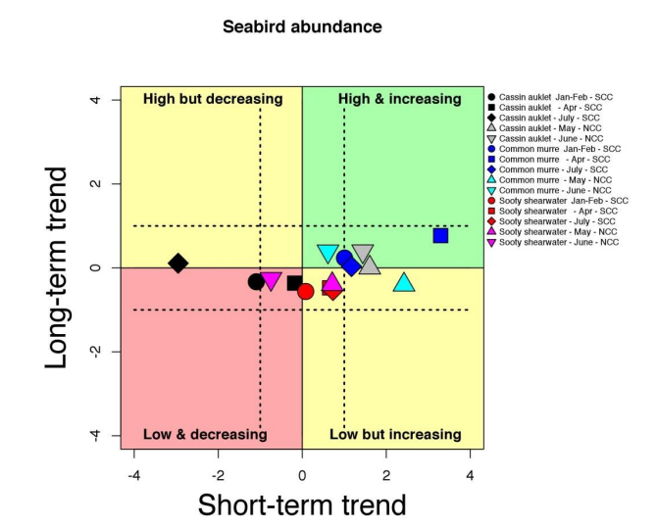

Slide 18
The Polar Jet Stream is Warped by the HOT BLOB in the Pacific Ocean
Notes:
Show video of Jet Stream

Slide 19
The California Current is Cold Water
Notes:
Show video of Upwelling

Slide 20
The Pacific Warm Water Blob interferes with Upwelling

Slide 21
What does the Hot Blob look like?

Slide 22
Warmer water temperatures can result in coral bleaching. When water is too warm, corals will expel the algae (zooxanthellae) living in their tissues causing the coral to turn completely white

Slide 23
Why?
The reason for the phenomenon is unclear. Some experts consider that the wedge of warm water portends a cyclical change with the surface waters of the mid-latitude Pacific Ocean flipping from a cold phase to a warm phase in a cycle known as the Pacific decadal oscillation (PDO
Sea surface temperature anomalies are a physical indicator which adversely affect the zooplankton (mainly copepods) in the Northeast Pacific and specifically in the Coastal Upwelling Domain. Warm waters are much less nutrient-rich than the cold upwelling waters which were the norm till recently off the Pacific Coast.^{[13]} This results in reduced phytoplankton productivity with knock on effects on the zooplankton which feed on it and the higher levels of the food chain

