Slide 1
Grand Canyon Cross Section Tutorial

Slide 2
Background: Geology
Geologists are interested in the structure of solid Earth and the rocks of which it is composed.
Geologists also care about the shape of rocks both on the surface and below the surface of the Earth.
Geologists use representations called geologic maps to illustrate what rock layers are exposed at the surface of the Earth.
Notes:
Intro

Slide 3
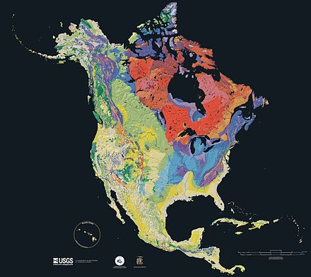
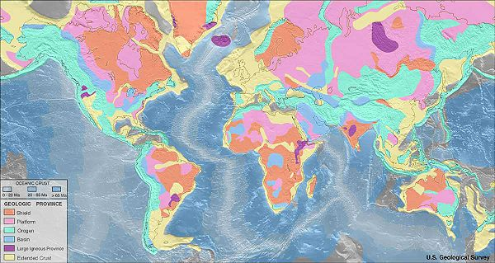
Background: The Geologic Map
A geologic map is a special-purpose map made to show geological features. Different types of rock are shown by different color to indicate where they are exposed at the surface.
Notes:
Intro

Slide 4
Part 1: Make A Cross-Section
A cross-section is a drawing that shows what the inside of something looks like after a cut has been made across it.
Imagine slicing into a loaf of bread so that you can see the inside.
The inside is the cross-section!
A geologic map would be like
looking at the top of the loaf of bread.
Cross-section
Notes:
Intro

Slide 5
Part 2: Core Sample Comparison
Geologists take core samples to see how rocks are layered below the surface.
Core samples are obtained by using long drills with steel tubes.
The material that is removed from the steel tubes is removed and analyzed.

Slide 6
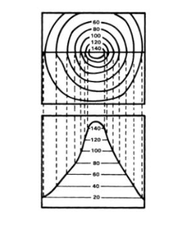
Part 3: Elevation
This map is also a topographic map. Topographic maps are used to show elevation, or height.
Contour lines indicate the elevation at a certain point on the map.
The contour interval for the map to the right is 10 meters. So, the difference in elevation between two lines that are next to each other is 10 meters.
The contour interval for your map is 20 meters.
View from the top
View from the side

Slide 7
Part 4: Strike and Dip
To better understand the orientation of rock layers that compose the geologic map geologists measure strike and dip.
Strike indicates the direction the layers of rock are trending (N,S,E,W).
Dip is the angle the
rock layer is inclined.
http://geology.wikia.com/wiki/Strike_and_dip
Notes:
intro

Slide 8
Part 5: Gold!
Using what you’ve learned about geologic (and topographic!) maps suggest 5 more drill hole locations! Include:
Their latitude and longitude.
How deep you would like to drill.
Argue why these are the best locations and depths for the sample sites you selected.

Slide 9
Disclaimer
There is no gold in the Grand Canyon!

