Slide 1
Solarize Your School

Slide 2
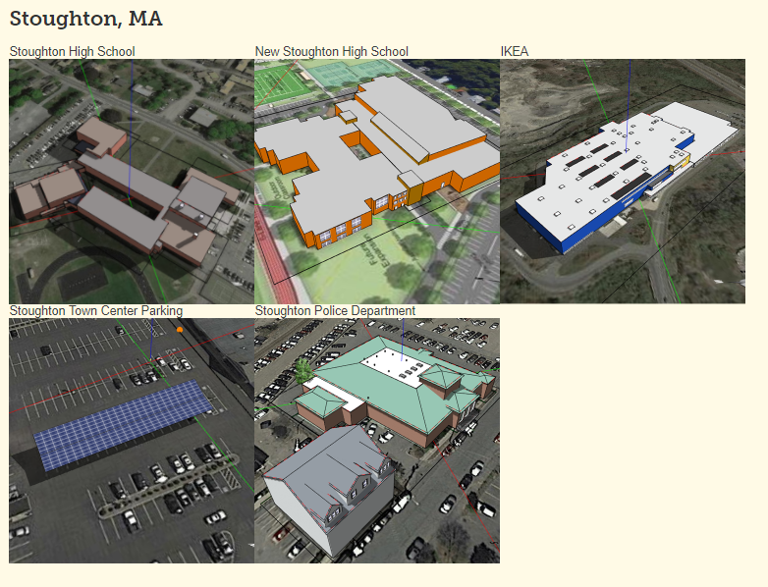
Step 1: Choose a Site and Import its Model energy.concord.org/energy3d/sites.html

Slide 3
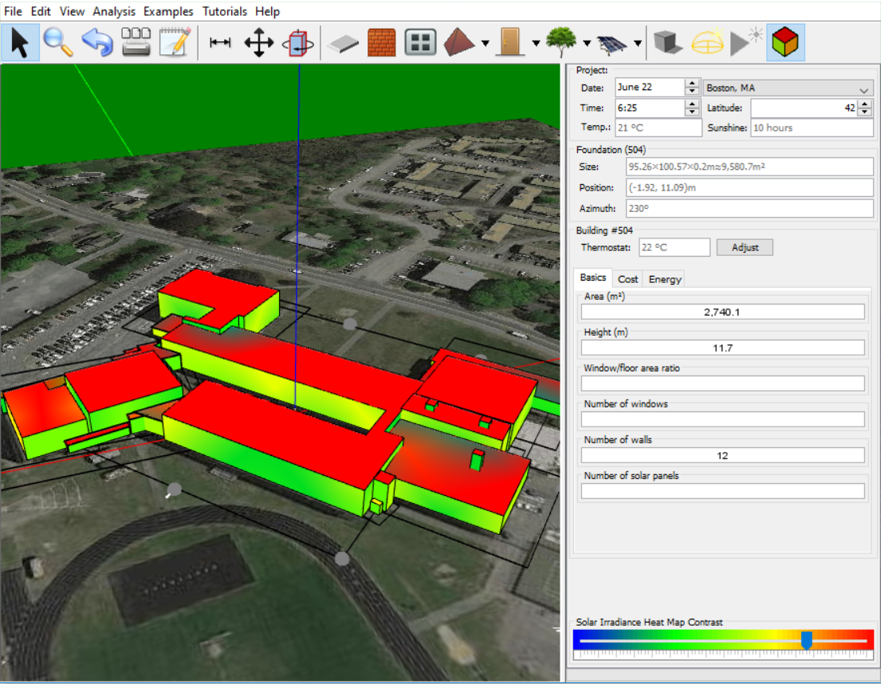
Step 2: Analyze Solar Insolation Available for Your Site
Directions
Set date to June 22
Click on “Calculate energy of the day”
Adjust contrast as needed
Make a copy of the image and paste it into your Design Journal
Repeat for March 22 and December 22

Slide 4
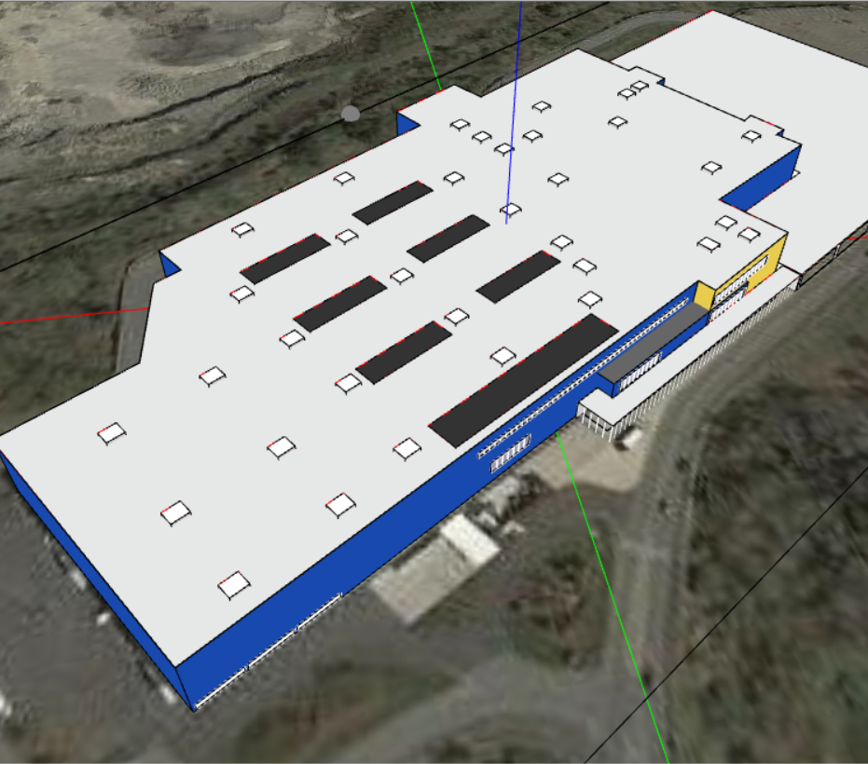
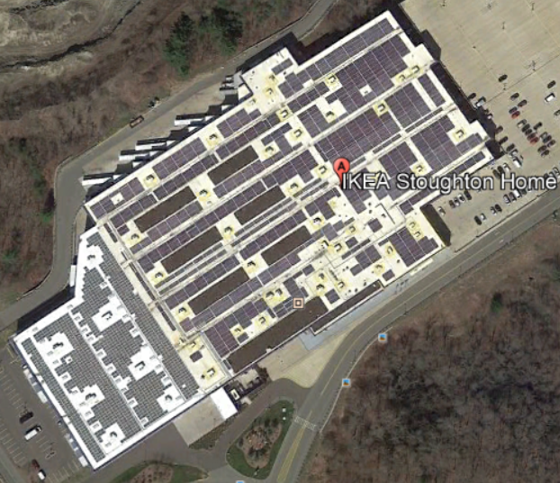
Step 3: Note Obstructions

Slide 5
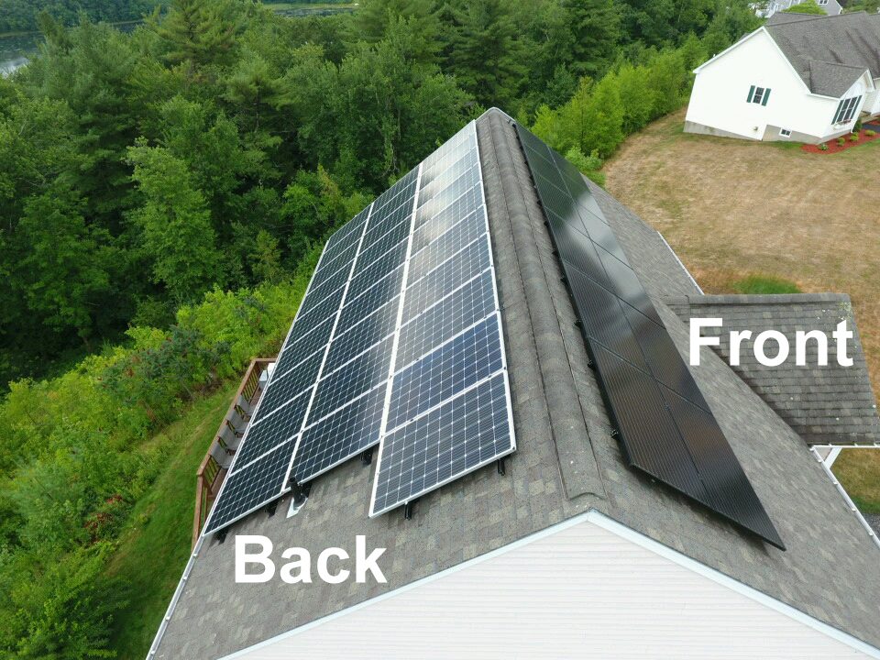
Step 4: Keep Curb Appeal in Mind

Slide 6
Step 5: Avoid the Edge of the Roof
International Fire Code Compliance
“There shall be a minimum of 6-foot-wide (1.8m) clear perimeter around the edges of the roof.”
Hint → Use a single solar (1.5m in length) panel along the edge of the building to help mark boundaries. Delete afterwards.

Slide 7
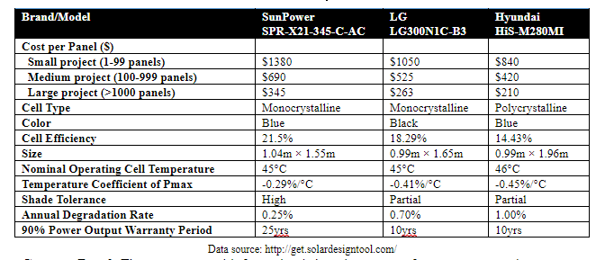
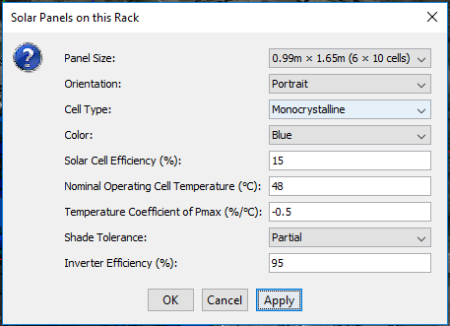
Step 6: Select a Brand of Solar Panels
Directions
Place solar rack on the roof of the building.
Right-click the rack → Solar Panels
Enter the information for solar panel selected

Slide 8
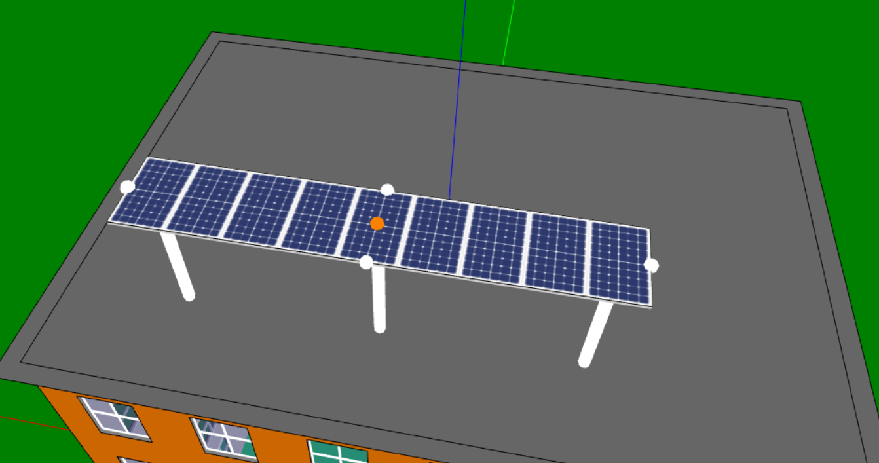
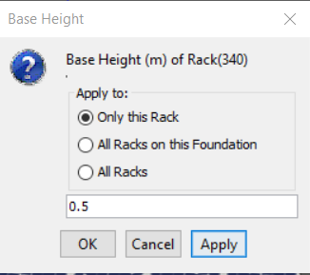
7a: Set the Rack Size and Base Height
Directions
Expand the rack by using the white dots on the selected rack.
Right-click on rack → Base Height (<1m)

Slide 9
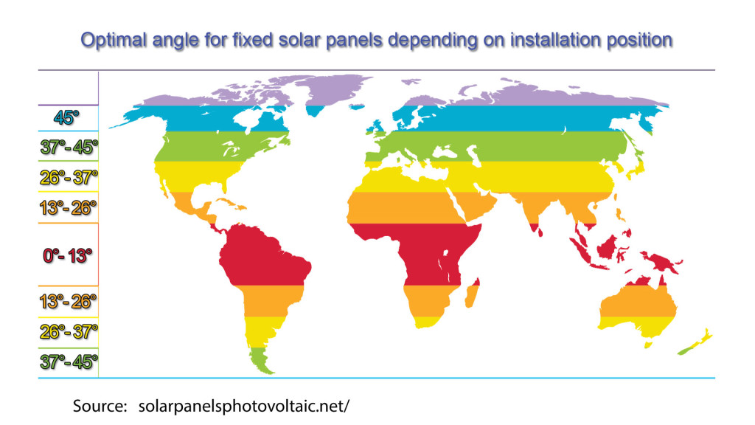
7b: Pick a rack system and tilt angle
Ballasted Racking System
Tilt angle ≤ 15 degrees
15% of the total cost of panels
Attached Racking System
Tilt angle ≤ 45 degrees
20% of the total cost of panels
Directions
Right Click on solar rack → Tilt Angle
(Hint → you may have to adjust base height)

Slide 10
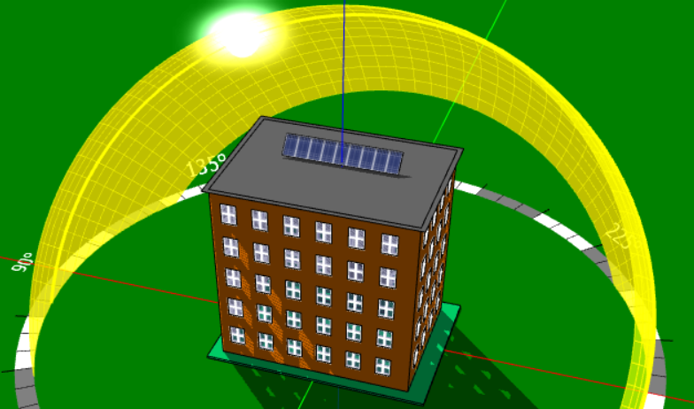
7c: Set Azimuth Angle
Directions
Turn on Helidon
Click on the Rack and then click the rotate tool to move the titled face of the panel toward the sun’s path.

Slide 11
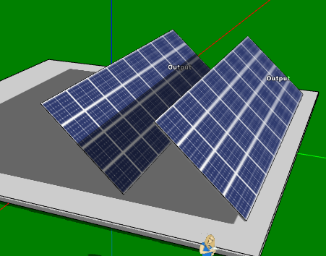
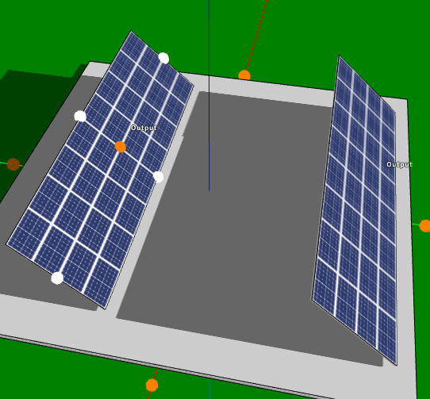
Step 7d: Determine the ideal inter-row distance
Directions
Select and copy (Ctrl+C) your rack and paste (Ctrl+V) three more rows on the roof parallel to the first rack.
Main Menu → Analysis → Annual Yield Analysis of Solar Panels (F4)

Slide 12
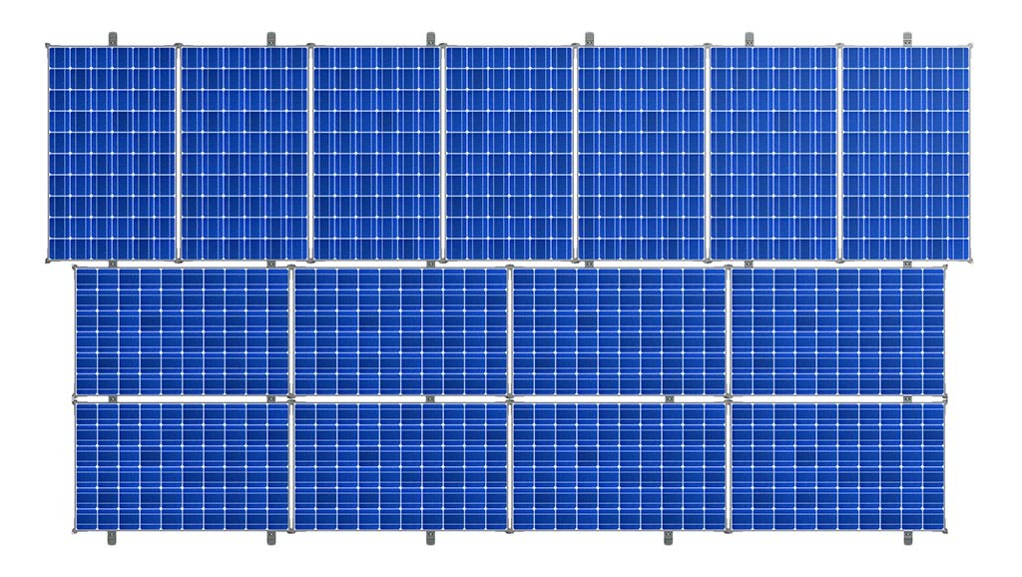
Step 7e: Optimize the Orientation of Solar Panels
Directions
Place a rack of solar panels on the roof.
Run ‘Analysis’ → ‘Annual yield of solar panels’ (F4).
Click ‘Close’ → Click ‘Yes’ to save results of run
Right click on the rack → select ‘Solar Panels’ → Change orientation.
Run ‘Analysis’ → ‘Annual yield of solar panels’ (F4).
Make a Copy of the graph and paste it in the Design Journal

Slide 13
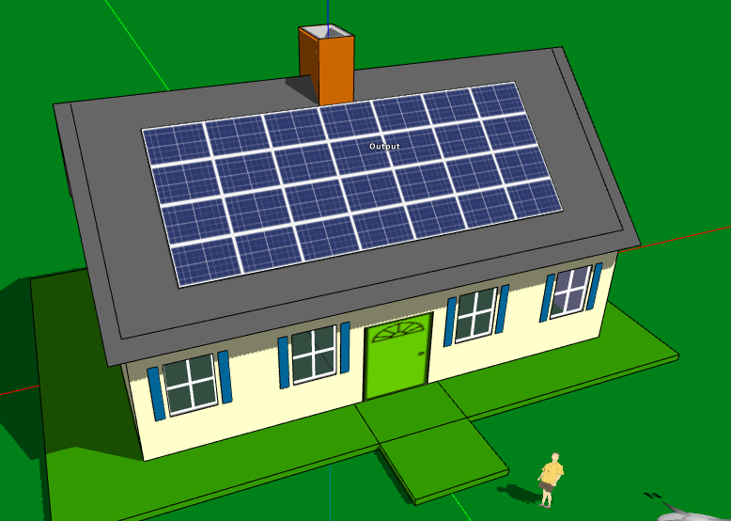
Step 8: Produce a solar array design prototype

Slide 14
Test and Analyze Your Solution

Slide 15
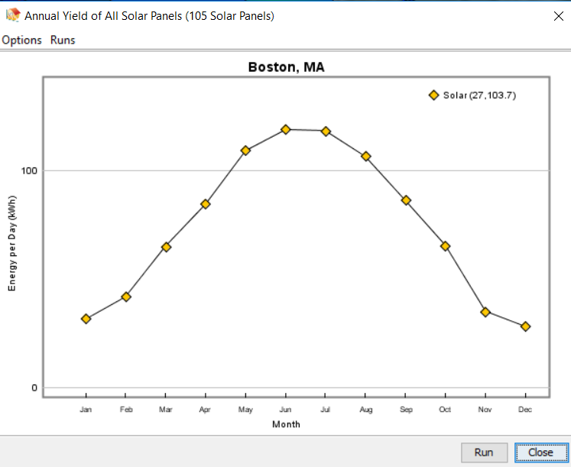
Step 1: What is your Energy Yield of your Prototype?
Directions
Click outside the foundations of your model.
Run an Annual Yield Analysis of Solar Panels (F4).
Record this total number in your Design Journal - Iteration 1 Prototype.
Record the number of solar panels in Design Journal
When you close the graph, click “YES” to save the results.

Slide 16
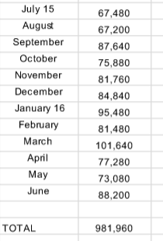
Step 2: Determine the Solar Offset of Your Design
Stoughton High School Electricity Usage (kWh) July 2015 - June 2016
How to calculate solar offset:
Predicted Annual Electricity Produced (step 1)
Annual Energy Consumption (see chart)
Record this total number in your Design Journal - Iteration 1 Prototype.

Slide 17
Step 3: Calculate the Total Project Cost
How to calculate total project cost:
# of panels (already recorded) x the cost of each panel (refer to chart)
Which racking system did you use?
Ballasted Racking System = add 15% of the total cost of panels
Attached Racking System = add 20% of the total cost of panels
Record the TOTAL cost into your Design Journal.
How to Calculate Annual Energy per dollar spent:
Annual energy yield
Project Cost
Record this data into your Design Journal.

Slide 18
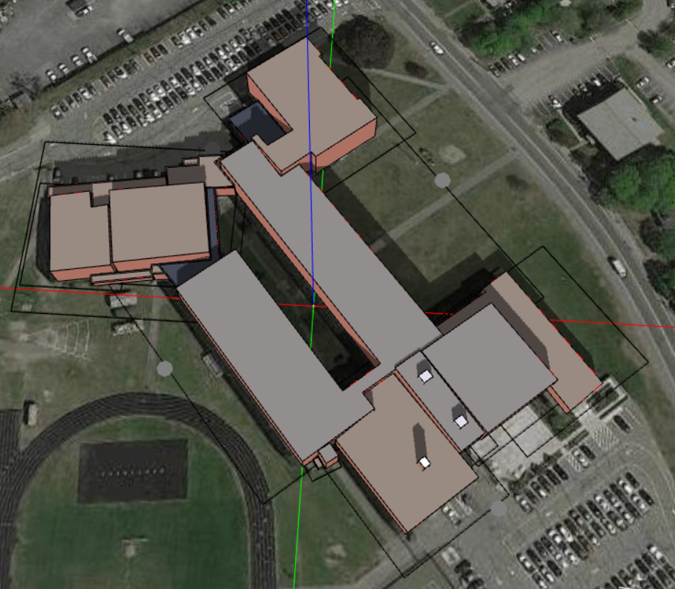
Stoughton High School Design Requirements...
Criteria
Solar Offset: 20% (196,392 kWh)
Constraints
Budget: $300,000
Existing Structures
Fire code compliance
Variables
panel orientation
tilt angle
azimuth angle
solar panel brand
# solar panels
Inter-row spacing
rack size

