Slide 1
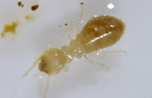
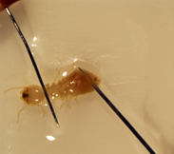
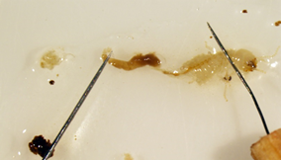
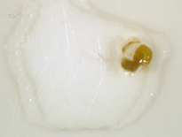
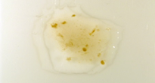
DISSECTION GUIDE
Use forceps to catch a termite around the head, being careful not to squeeze the abdomen, and place the termite in 0.85% saline on the slide.
Place the slide on the stage of the stereoscope.
While observing through the stereoscope, remove the gut. Place dissecting needles on either side of the termite abdomen (left), press down gently and pull apart (center).
Gently pull the gut apart into small pieces, much like scrambling an egg.
Finally, place a glass coverslip over your sample.
Repeat these steps using new microscope slides
with 1.7% saline and distilled water .
termite gut + 0.85% saline
termite gut + 1.7% saline
termite gut + distilled water

