Slide 1
Notes:
https://www.youtube.com/watch?v=_6xlNyWPpB8 Great video to watch about how plastic bottles are made and what happens to them

Slide 2
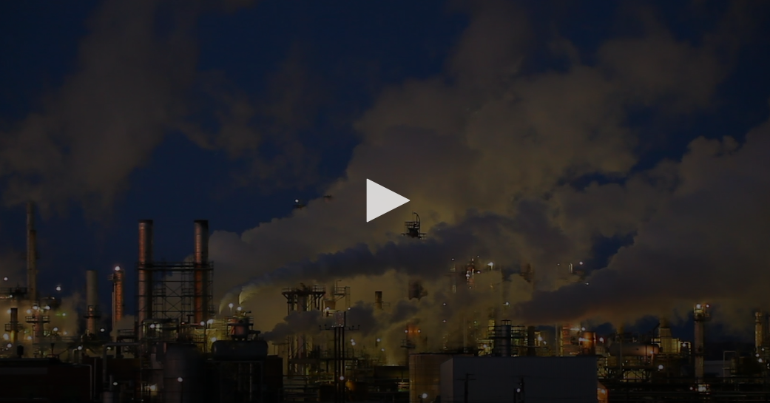
Engage!
Air
What is the impact of trash on the earth’s surface?
Notes:
Teachers, you will be prompted to create a copy when you click in the circle above. Be sure to set the share settings on everybody can edit (File, Share, Advanced) Then, with the Doc open, go to Addons - Get more Addons and search for Word Cloud Generator. To enable, click on free. When students click to share their first thought, it will open a shared document that they can type into. As they enter their words, it will develop into a word cloud.

Slide 3
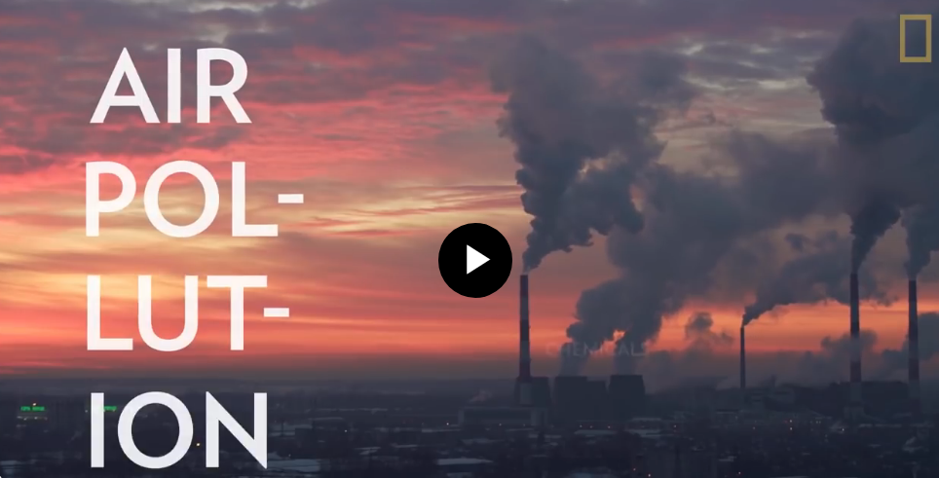
Explore
Watch the video to learn about

Slide 4
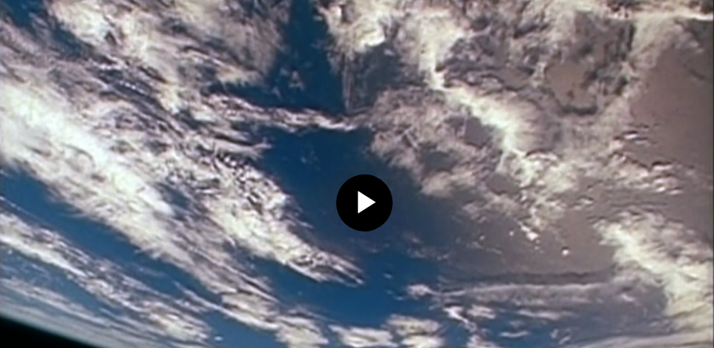
Engage!
Land
What is the impact of trash on the earth’s surface?
Notes:
Teachers, you will be prompted to create a copy when you click in the circle above. Be sure to set the share settings on everybody can edit (File, Share, Advanced) Then, with the Doc open, go to Addons - Get more Addons and search for Word Cloud Generator. To enable, click on free. When students click to share their first thought, it will open a shared document that they can type into. As they enter their words, it will develop into a word cloud.

Slide 5
Explore
Watch the video to learn
On average, how much garbage does each person make per day?
What makes us a wasteful society?
What can we do to limit the amount of waste coming into a landfill?

Slide 6
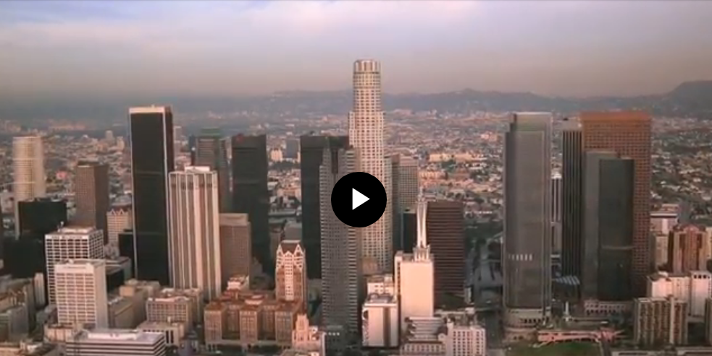
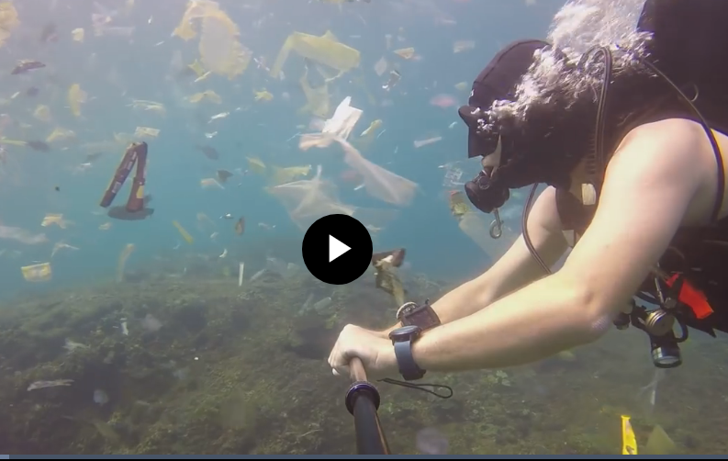
Water
Engage!
Why the concern about plastic? Watch the video, then click on the icon above to share your first thought.
What is the impact of trash on the earth’s surface?
Notes:
Teachers, you will be prompted to create a copy when you click in the circle above. Be sure to set the share settings on everybody can edit (File, Share, Advanced) Then, with the Doc open, go to Addons - Get more Addons and search for Word Cloud Generator. To enable, click on free. When students click to share their first thought, it will open a shared document that they can type into. As they enter their words, it will develop into a word cloud.

Slide 7
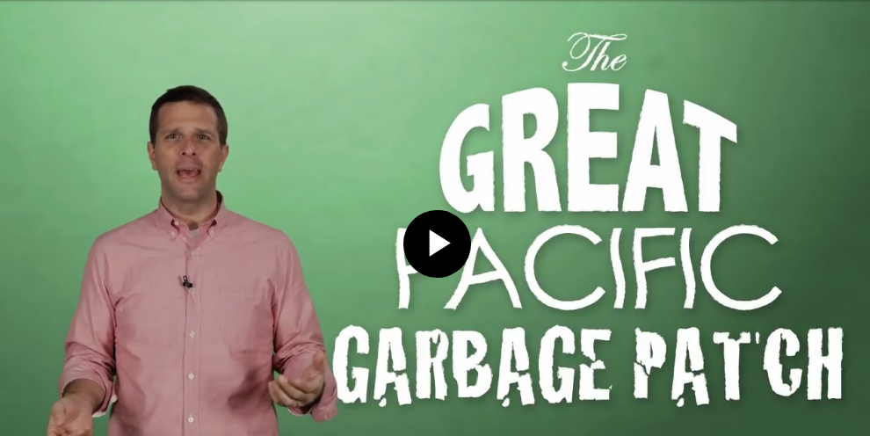
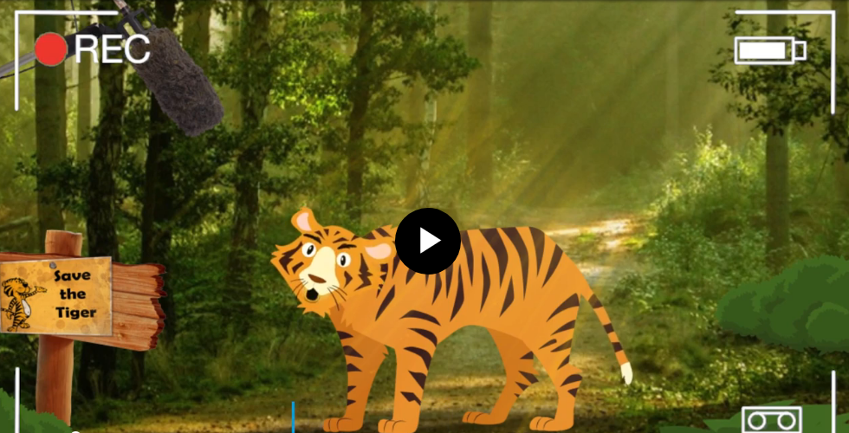
Explore
Watch the video to learn about The Great Pacific Garbage Patch.

