Slide 1
Maglev from Global to Local

Slide 2
Problem: Some islands around the world have frequent floods due to rising tides. Some homes are built on stilts, but those can only protect a house if the floodwaters don’t rise higher than the structure.

Slide 3
Lira Luis is an American architect from a frequently flooded island in the Philippines. She wanted to design a home that would always remain above the water level.
Notes:
Photo source: http://inhabitat.com/could-maglev-hovering-homes-be-the-answer-to-rising-sea-levels/

Slide 4
Turn and Talk
How could we use what we know about magnets to solve this problem?

Slide 5
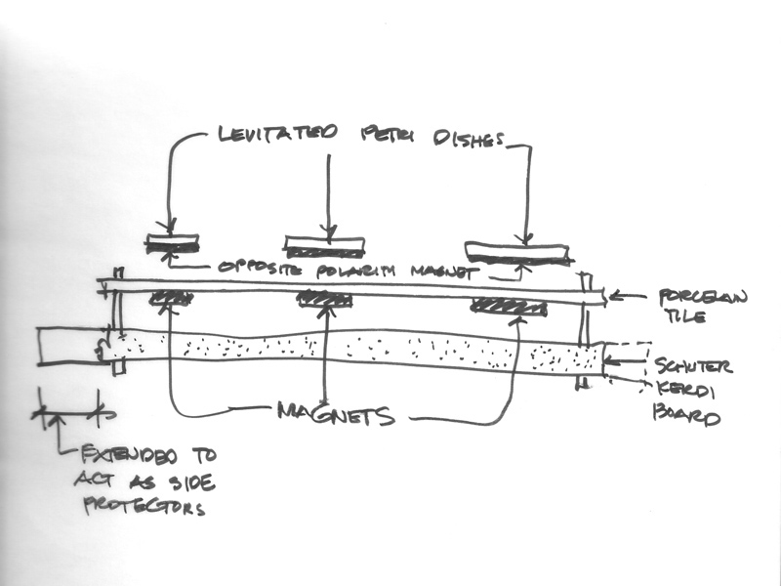
Lira Luis developed a concept for a maglev house that could help people stay in their hometowns in the Philippines.
Notes:
Photo source: http://inhabitat.com/could-maglev-hovering-homes-be-the-answer-to-rising-sea-levels/

Slide 6
She has built a tiny model of a levitating home and successfully made it levitate 1.5 inches off the ground.
Eventually, she wants to build a whole floating village!
Notes:
Photo source: http://inhabitat.com/could-maglev-hovering-homes-be-the-answer-to-rising-sea-levels/

Slide 7
Problem: Sometimes we have to wait a long time for elevators that only go up and down.

Slide 8
Turn and Talk
How could we use what we know about magnets to solve this problem?

Slide 9
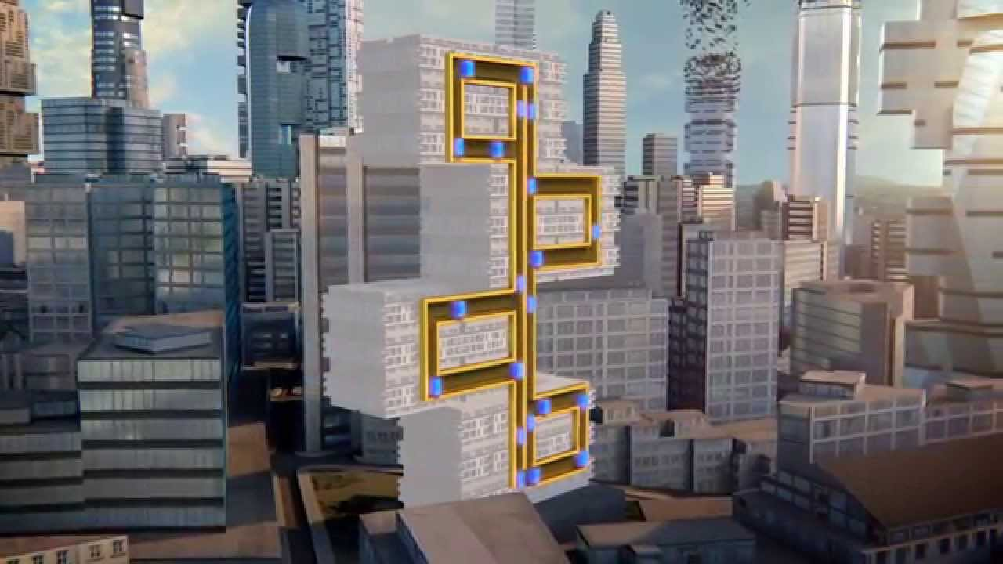
Engineers in Germany plan to use maglev to make elevators that move up and down, and side to side. With maglev, architects could create new buildings that have different heights, forms, and functions.
Notes:
Photo source: http://www.wsj.com/articles/thyssenkrupp-reimagines-the-elevator-as-a-hyperloop-for-buildings-1468875762

Slide 10
Problem: Train engines run on diesel electricity (fossil fuels) to pull train cars.

Slide 11
Turn and Talk
How could we use what we know about magnets to solve this problem?

Slide 12
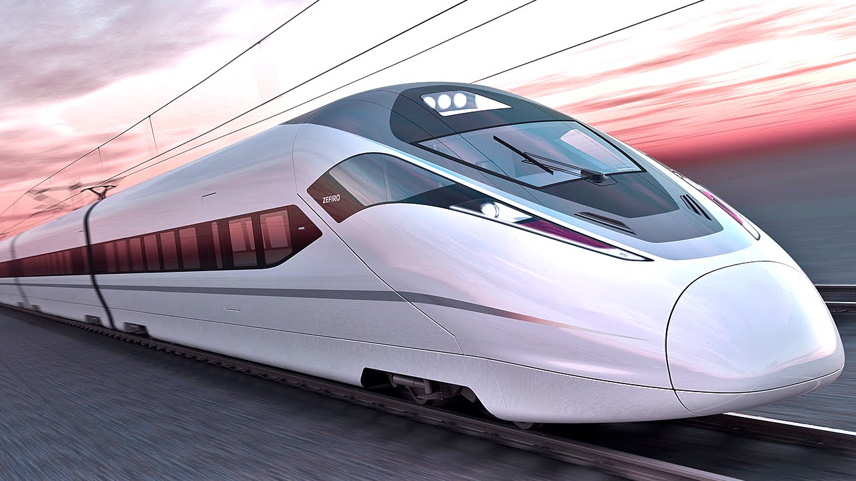
Maglev trains reduce the workload by floating above the ground. The magnetic field created by electrified coils in the guide way walls and track propel the train.

Slide 13
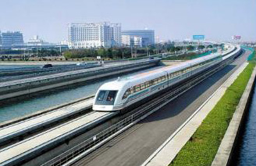
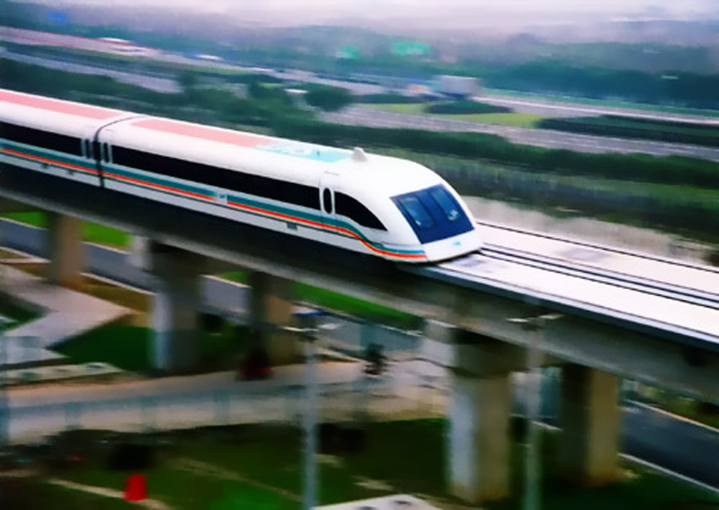
Today, there are maglev trains in Korea, Japan, and China.
Currently, the Shanghai Maglev Train is the fastest commercial train in operation and has a top speed of 270 mph.

Slide 14
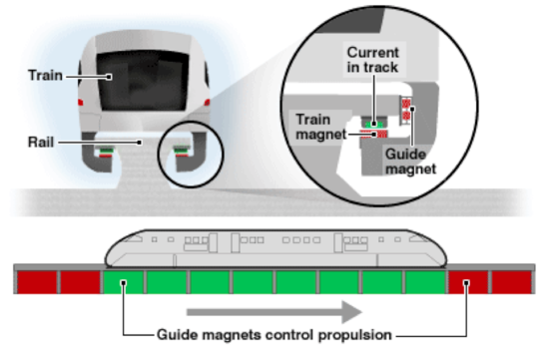
Maglev trains move without touching the ground. This reduces friction and allows high speeds.

Slide 15
Let’s see a maglev train in action!

Slide 16
What problems have we observed in our city?
Air pollution from buses, cars, and taxis
Traffic
Long waits for elevators at home

Slide 17
Turn and Talk
How could we use what we know about magnets to solve these problems?

