Slide 1
Sound and Waves
How does sound reach our ears?

Slide 2
How do your ears hear?

Slide 3
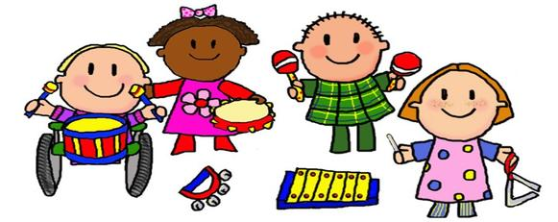
Observing Instruments

Slide 4
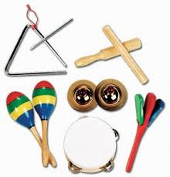
How Is Sound Produced?
What did you observe?

Slide 5
Vibration is Sound and Sound is a Wave!
The Magic School Bus!

Slide 6
Song about Sound Waves
♪ ♪ ♪
How can you hear it –
how can you hear it –
It comes in waves,
it comes in waves.
A noise is a sound and a sound is a wave,
it comes in waves, it comes in waves!
Written, composed and performed by Zoila Morell

Slide 7
Song about Sound Waves
♪ ♪ ♪
¿Cómo se escucha?–
¿Cómo se escucha?–
Viene por ondas,
viene por ondas.
La bulla es un sonido y un sonida es una onda.
Viene por ondas, viene por ondas.
Written, composed and performed by Zoila Morell

Slide 8
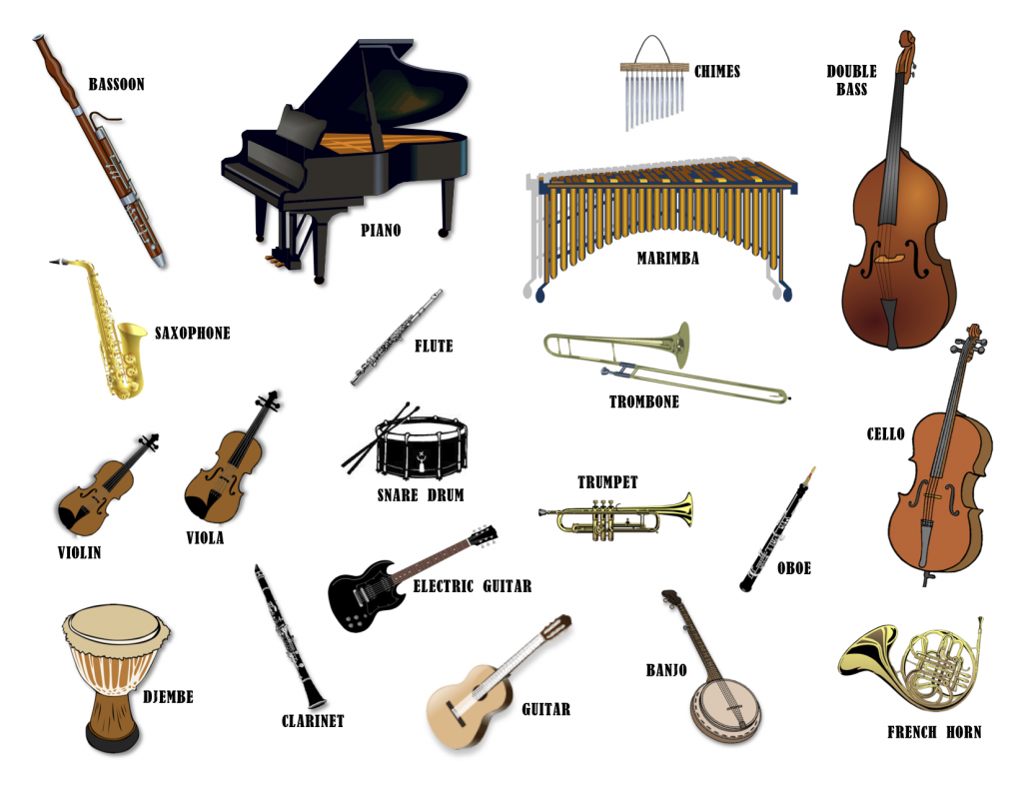
Thinking About Instruments
What does an instrument have to be able to do to make sound?

